Slide 1
Using Jamboard to create a Stakeholder Engagement Strategy

Slide 2
Locate the Stakeholder Analysis Tool Under “Identify a Leadership Team…”

Slide 3
Once you’ve navigated to the JamBoard, click the three dots at the top

Slide 4
Click on “Make a Copy” to use this Jamboard for your Ecosystem

Slide 5
You can now Use the Tools Bar to Create Stickies, Write Notes, and Draw

Slide 6
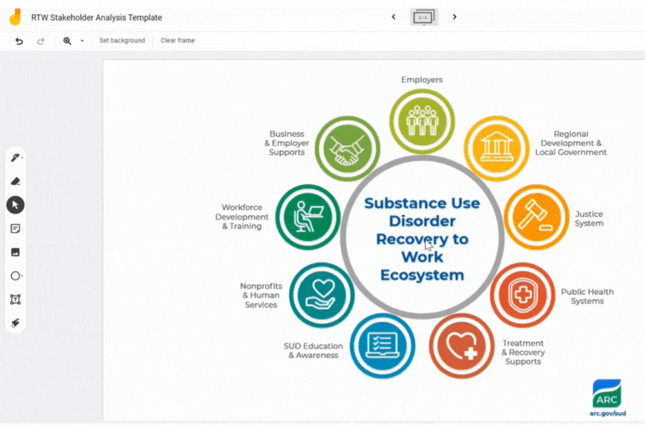
You can Create new Sticky Notes and Categorize them by Function
click here for examples of the types of organizations in each category

Slide 7
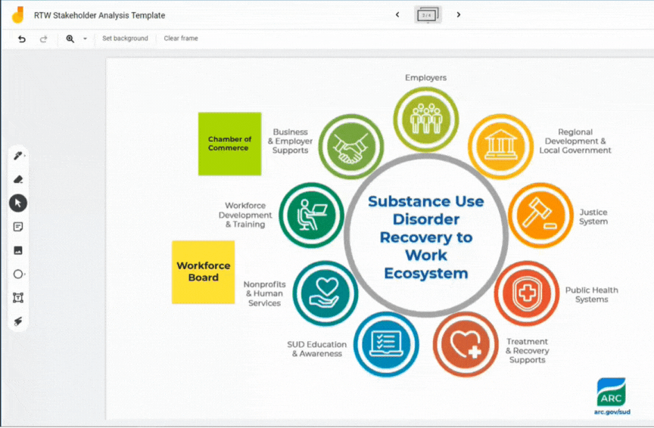
On the Next Page, you can Copy and paste the Stickies and Place them in the Matrix
You can copy the Sticky by using the
“CTL + C” command on your keyboard. Then, paste your sticky to the next page with the “CTL +V” command

Slide 8
Click Here to Access the Jamboard!
https://jamboard.google.com/d/1rdf9zhAYVJpwtPsxgqaNy40eHFifoPFHTnha2TviQfU/edit?usp=sharing

