Slide 1
Using Miro to create a Stakeholder Engagement Strategy

Slide 2
Locate the Stakeholder Analysis Tool Under “Identify a Leadership Team…”

Slide 3
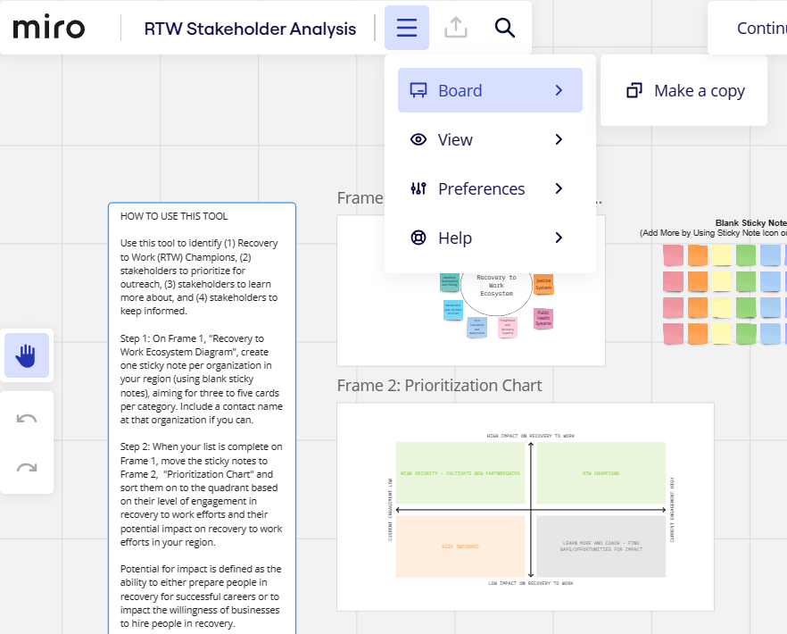
Once you’ve navigated to the Miro Board, click the Main Menu To Make a Copy

Slide 4
Read the Sidebar, “HOW TO USE THIS TOOL” TO GET STARTED

Slide 5
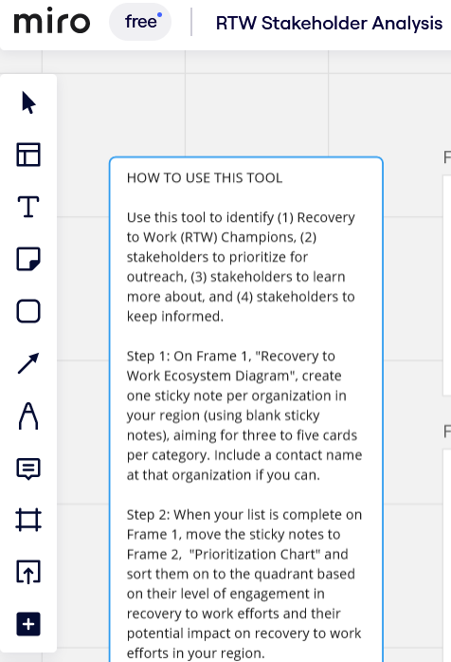
You can Also Use the Tools Bar to Create More Stickies, Write Notes, and Draw

Slide 6
You can Create new Sticky Notes and Categorize them by Function
click here for examples of the types of organizations in each category

Slide 7
Click Here to Access the Miro Board!
RTW Stakeholder Analysis, Visual Workspace for Innovation (miro.com)

