Slide 1
Mapping Recovery-to-Work Ecosystem Roles and Relationships
Designing a flowchart for your region

Slide 2
Agenda
Goal of Mapping Roles and Relationships
Create a coordinated team of recovery to work champions ready to work together to support the employment of people in recovery by (1) connecting people in recovery to the services they need and (2) identifying and preparing businesses to hire.
Identify gaps in services, partners to include, and opportunities to strengthen or formalize relationships.
Regional Examples
Hub and Spoke
Sequential Intercept Model
Flowchart
Designing a Flowchart or Map for Your Region

Slide 3
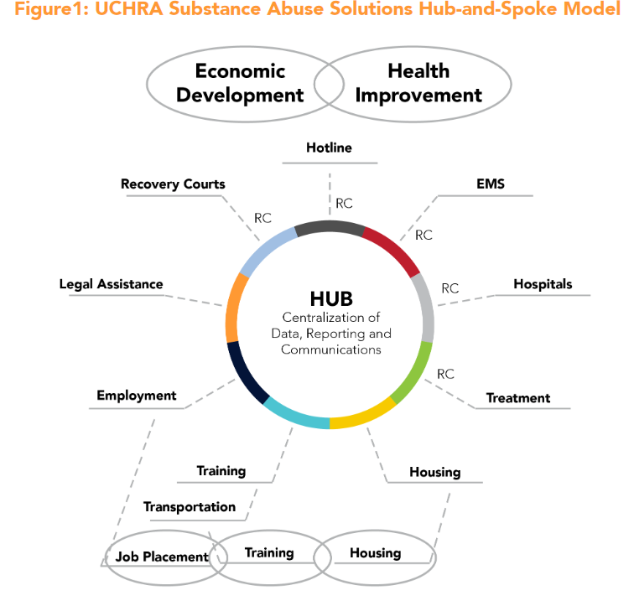

Slide 4
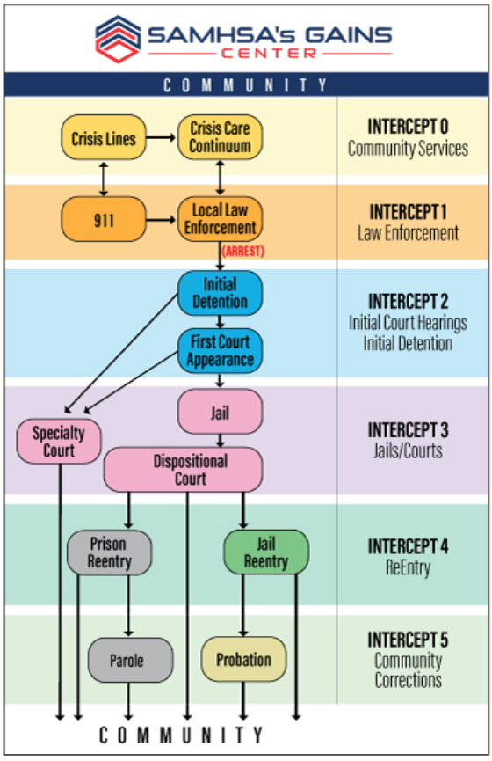

Slide 5
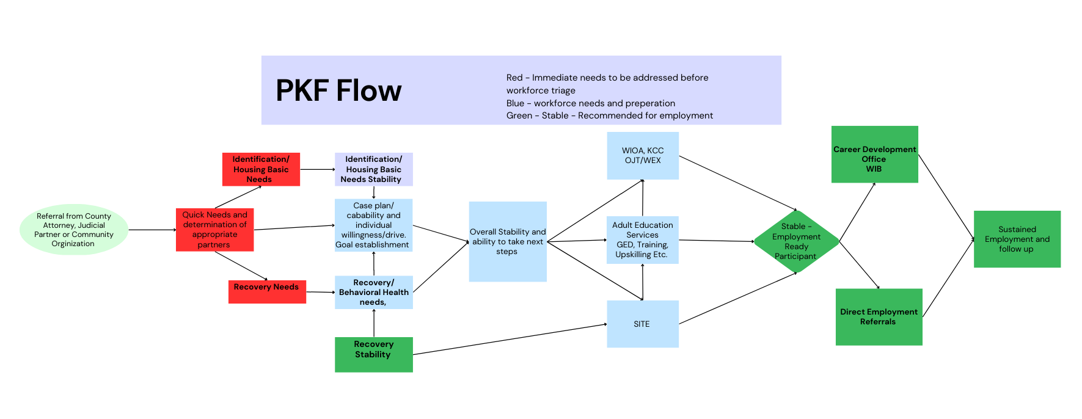

Slide 6
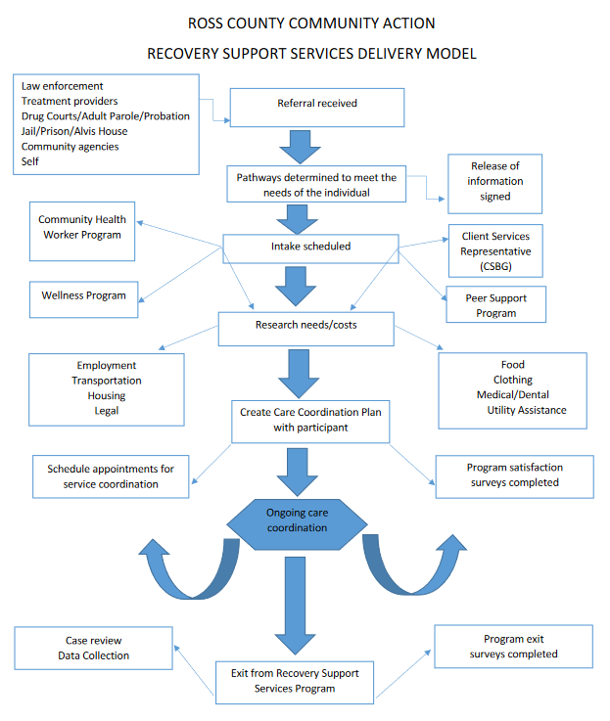

Slide 7
How Can a RTW Ecosystem Support Businesses?
In addition to the flowchart to support workers, regions can benefit from map of the support system that works with businesses in the region to simultaneously identify recovery-friendly jobs and support businesses through the hiring process.
It is unlikely that there is a captive audience of businesses waiting to hire people receiving training and support coordinated by community partners. A recovery-to-work ecosystem requires a complementary team of champions to identify and prepare businesses for hiring and supporting people in recovery. This group can help to recruit businesses and assure them that potential hires will be well-supported and low-risk.

Slide 8
Designing a RTW Ecosystem Flowchart or Map for Your Region
Map the “individual in recovery side” of the flowchart. Refer to previous examples for formatting ideas.
Intake:
How are individuals in recovery identified?
What are all the sources of referrals?
Assessment:
Who does an intake assessment to determine immediate needs?
Is there a standard intake assessment to identify and triage needs?
Is there a standard skills assessment?
Navigation:
Who helps an individual navigate between steps and connect to the service providers that can support specific needs (workforce training, transportation, housing, childcare, etc)?
Formalization:
Are there formal relationships (MOUs, data sharing agreements) in place?
Where are new partnerships needed?

Slide 9
Designing a RTW Ecosystem Flowchart or Map for Your Region
Map the “business side” of the flowchart.
Intake:
How are recovery friendly businesses identified?
Which business-facing organizations will regularly recruit businesses to hire people in recovery through providing materials, hosting events, and conducting targeted outreach?
Navigation:
Which organizations will help businesses develop the internal policies and procedures they need in place to be “recovery friendly”?
Formalization:
What ongoing support is in place for businesses?
What other formal partnerships are needed?

