Slide 1
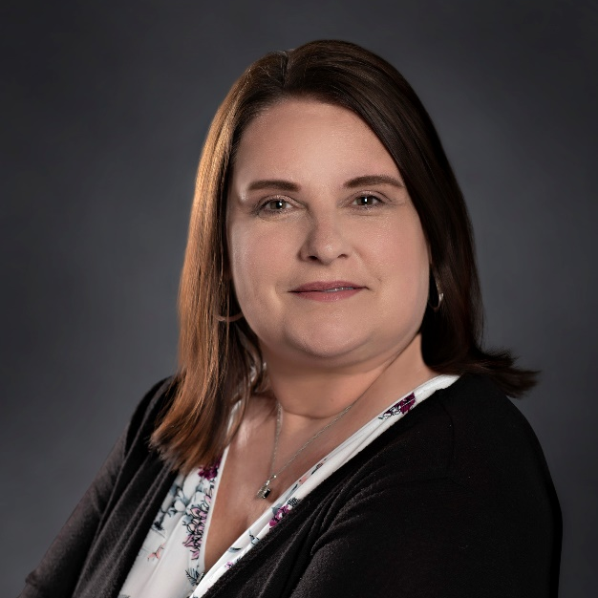
Julia Hinzman Mobility Manager,
Washington & Noble Counties jhinzman@buckeyehills.org
740-376-7621

Slide 2
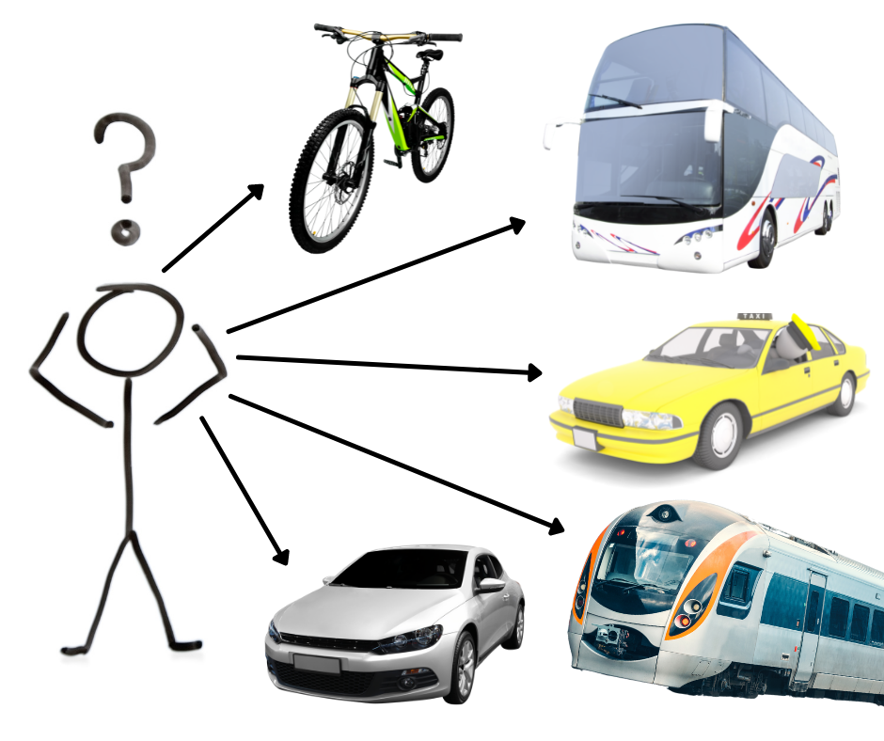
Notes:
So we want to take the time to explain what a MM is and what we do in our communities.

Slide 3
WHAT IS MOBILITY MANAGEMENT?
The Ohio Mobility Management Program increases access to mobility for Ohioans by increasing understanding and awareness of community transportation needs, coordination of transportation options, and building sustainable and healthy communities by integrating transportation into planning and programs for many of the 88 counties of Ohio.
Mobility Management has existed in Ohio since 2008
Notes:
While this is our main scope, each community is different and may have other needs and goals that the Mobility Manager works to identify. Making recommendations and referrals to appropriate agencies within the counties.

Slide 4
ODOT PROGRAM GOALS
Increase understanding and awareness of community transportation needs
Increase awareness of current community transportation options and programs
Ensure that transportation considerations are included in local and regional planning activities
Increase local capacity for transportation services
Assist individuals with accessing all community transportation options
Notes:
Our program goals align with the goals provided from ODOT.
Increase understanding and awareness of community transportation needs. (Surveys in community)
Increase awareness of current community transportation options and programs. (Community visits and advertisement)
Ensure that transportation considerations are included in local and regional planning activities. (Coordination Transportation plans are developed)
Increase local capacity for transportation services (Filling the gaps where there is no transportation)
Assist individuals with accessing all community transportation options. (800-331-2644 Ext. 6)

Slide 5
WORKFORCE DEVELOPMENT
New Focus for Mobility Managers
The Workforce Mobility Partnership Program was first established in Section 755.20 of House Bill 23.
Goal to support projects in the rural and urban areas of Ohio that easily and efficiently transport resident workforce members to economically significant employment centers or to places of employment outside of their resident community.
Notes:
What does this mean? This means that the Ohio Department of Transportation (ODOT) saw a growing need in transportation options in Ohio among Seniors, Individuals with Disabilities and low-income individuals. Individuals were needing transportation to medical appointments, grocery stores, school and even work but was finding gaps in the transportation needs.

Slide 6
Importance of Transportation in Recovery
Improving Finances
Stability
Quality of Life

Slide 7
CHALLENGES
Transportation Funding
The beginning start
Matching funds in community

Slide 8
HOURS OF OPERATION
Current transit services 8am -4pm
Evening Jobs
Early Morning shifts

Slide 9
CITY OF MARIETTA 6-MONTH PROGRAM
City of Marietta has partnered with Cab Service to provide after hours services in the city limits.
Working well
Providing transportation 4pm -3am Monday thru Saturday 8am-2pm on Sunday
Low rate $3.00
Provides needed services
City of Marietta ONLY

Slide 10
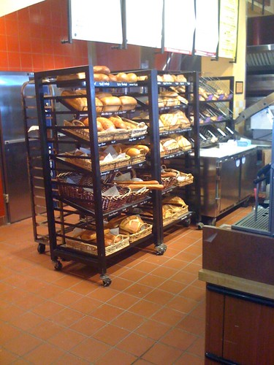
Success Story

Slide 11
FILLING GAPS IN TRANSPORTATION
Coordinated Transportation Plan
Required by ODOT
Locally developed
Talk to your Mobility Manager!
Notes:
The Mobility Manager helps to fill these gaps and needs in transportation. How? We assist in the development of a County Coordinated Transportation Plan. This plan is required by ODOT for small urban and rural areas of Ohio to be eligible for funding. A County Coordinated Transportation plan is a locally developed plan that identifies community’s transportation resources, understand gaps and unmet needs within those resources and determines the approach to addressing these gaps and unmet need. This plan is developed and approved through a process that includes participation by seniors, individuals with disabilities, representative of public, transportation providers, human service providers and members of the general public. If you would like to be part of this process please reach out to your Mobility Manager, your help would be greatly appreciated.

Slide 12
WHAT IS WORKING WELL
Diverse Transportation Advisory Committee in each county
Each TAC meets quarterly
Discussing goals set by ODOT + goals for each county
Ohio Department of Transportation compiling Regional Plans
Region 8 (Washington, Noble, Monroe, Morgan, Meigs, Athens, Hocking, and Perry) plans in beginning stages of development

Slide 13
QUESTIONS?
Find your Mobility Manager: ohiomobilitymanagement.org
1-800-331-2644 Ext. 6

Slide 15
Recovery to Work: Transportation and Housing Webinar
August 24, 2023

Slide 16
Funding Recovery Housing

Slide 17
Recovery Homes are not eligible for Medicaid or insurance reimbursement

Slide 18
Public Funding for Recovery Housing
Federal Dollars
State Opioid Response Grants – Ohio invested $6 million of these in housing for persons with substance use disorder, some of these went to recovery housing
HUD SUPPORT Act - $2 million in capital dollars and $240,000 for minor repairs for specific providers
State Dollars
General Revenue fund $3 million in operating expenses distributed through county boards
Local Dollars
Some counties invest local levy funds (if available) or invest their allocations from SOR, Block Grant or other dollars

Slide 19
Funding Recovery Housing – Private Resources
resident rent payments
private foundation dollars
Fundraising

Slide 20
Funding Recovery Homes

Slide 21
Key Point
Funding varies widely depending on resources in your local area
There is dedicated funding stream to fund recovery housing
Operators must braid together multiple resources

Slide 22
Connecting Residents to Employment

Slide 23
Just being in a recovery home improves employment outcomes
Even stays as short as month have been shown to improve employment outcomes (Gallant 2023)
We see the most positive outcomes in income and employment for residents who stay in recovery housing at least six months (Gallant, 2023)

Slide 24
If someone does not need to worry about housing, they can then worry about getting a job

Slide 25
Understand Level of Support
Residents who are very early in recovery may need to focus on completing treatment programs
Level II recovery homes focus on assisting residents with establishing skills after treatment
Help residents with basics like maintaining a schedule

Slide 26
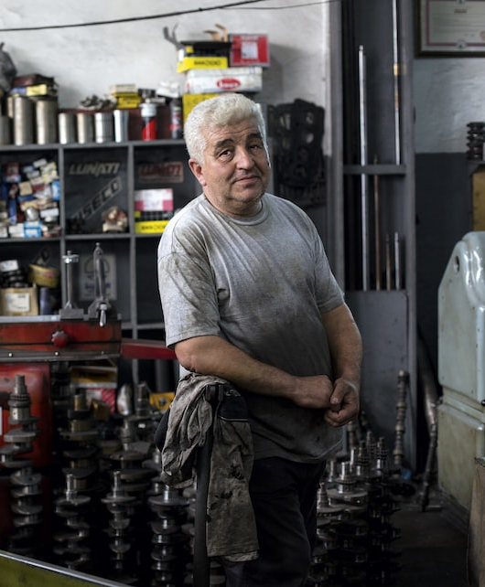
Build partnerships with Employers
Look for second chance employers
Recovery-friendly workplaces
Understand the night shifts may not be appropriate for all people in early recovery

Slide 27
Integrate Employment into Recovery Plans
Not just about getting a job, but building sustainable employment
Help them set goals for education and training
Connect with a financial planner or help with budgetting
Have open conversations about money and if it may be a trigger
Offer additional support around the time that people get their first paycheck

Slide 28
Transportation is a Barrier
Only 51% of people moving out of recovery housing have a driver’s license
Even in metro areas, it can take hours to get to jobs on a bus line, if a bus line is available
Some operators have come up with creative solutions – like bike programs, ride-sharing among residents, etc. but it remains a huge barrier

Slide 29
Recovery Housing Capacity Needs

Slide 30
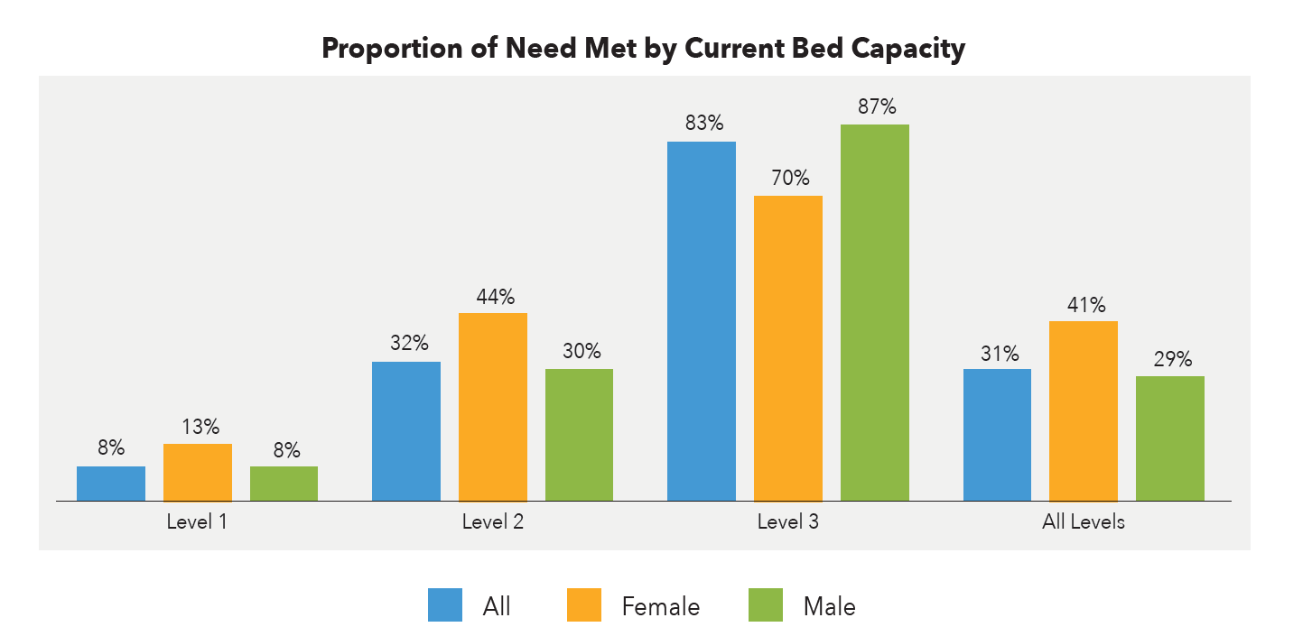
Notes:
Ohio is only meeting about 31% of total need statewide. That is a large gap.
The largest area of need is for Level I housing.
Even for Level III housing, where Ohio appears do be doing better – capacity does not meet access. Many Level III recovery homes in this analysis require that residents participate in other services or programming in order to maintain housing. So, a person is not eligible for those programs, or is not interested in those programs, they are not going to be allowed to have the same access to the housing option.

Slide 31
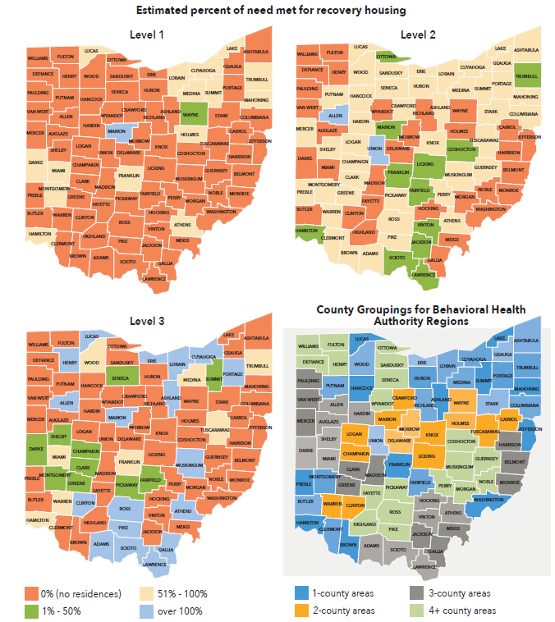
Notes:
We also see wide variation of availability by region. Some areas in the state have higher concentration of recovery residences and this imbalance is contributing to an inequitable distribution of resources and widening the gap.
We need there to be choices for people in recovery. Some people may need to stay closer to their family of orgin, supportive friends, and others in order to assist them on their recovery journey. Others may need to leave their community and establish themselves in a new community where they do not have the same lived experiences. When recovery housing is all concentrated in one area, that areas resources to serve everyone are tapped out, causing local strain and a rise in NIMBY issues.

Slide 32
Lack of adequate Recovery housing costs state money
If Ohio could increase enrollment by 25% we would see nearly $21.5 million in cost savings
We would also see an additional $8.7 million in cost benefits – mostly due to higher employment rates

Slide 33
Questions?
Danielle Gray
Danielle@ohiorecoveryhousing.org
614-453-5133

