Slide 1
Labor Market Data for Appalachia
Julie Hatch Maxfield
U.S. Bureau of Labor Statistics

Slide 2
Background Demographic Data from the Census Bureau
Notes:
The sources used for the following background slides are the 2020 Census, the Population Estimates Program, and the American Community Survey.

Slide 3
Percentage distributions of total population by sex and age,
2020 Census
Notes:
The ARC has a somewhat older age profile than the U.S. as a whole. As of the 2020 Census, its median age was 41.5 years, 2.7 years above the national median of 38.8 years. The modal sex-age category for the ARC was women ages 60–64, while the modal category for the U.S. was women ages 55–59.
Both the Census Bureau and BLS recognize the county status of independent cities in Virginia, so the data being attributed to the ARC throughout this presentation reflect aggregation across 431 counties and equivalents constituting the region, including the 8 independent cities in Virginia. (The geography being used comes from the arc.gov website https://www.arc.gov/appalachian-counties-served-by-arc/, but because the ARC rolls VA independent cities in with their surrounding counties, the agency describes its region as consisting of 423 counties.)
These population pyramids reflect BLS processing of data from the 2020 Census Demographic Profile (https://www.census.gov/data/tables/2023/dec/2020-census-demographic-profile.html).

Slide 4
Percentage distributions of the population 16+ by intermediate age, April 2010, April 2020, and July 2022
Notes:
Sometime during the 2010s, the share of the 16 and older population in the prime working-age range of 25–54 years dropped below half for the U.S. The prime working-age share of the 16+ population in the ARC already was slightly below half as of 2010, and it has since declined by about 5 percentage points. Maine is the only state in the country so far with the plurality share of its 16+ population in the 55+ age range instead of the 25–54 age range, but West Virginia in the heart of the ARC has one of the narrowest share gaps still favoring prime working-age as of 2022, 44.1 percent for 25–54 years old versus 42.1 percent for 55+ years old.
This chart reflects BLS processing of Vintage-2020 and Vintage-2022 estimates from the Population Estimates Program of the Census Bureau.
[NOTE: This was the last population data slide added, almost as an afterthought. Maybe an either/or with respect to the previous slide with the population pyramids. Both communicate simply that the ARC is a relatively older part of the country, although maybe this slide’s formulation dovetails better with availability of household data from BLS in the form of employment status by intermediate age.]

Slide 5
Percent change in population by selected age,
July 2010–July 2022
Notes:
Total population growth in the ARC has been less than half that of the U.S. since 2010. Weighing particularly on the ARC’s growth was the decline of 4.1 percent in its prime working-age population of 25–54 years old.
This chart reflects BLS processing of Vintage-2020 and Vintage-2022 estimates from the Population Estimates Program of the Census Bureau.
[NOTE: These data reflect splicing between Vintage 2020 (i.e., the last vintage extrapolated from the 2010 Census) and Vintage 2022 (i.e., the most recent available, which reflects a blended base for the current decade), in order to have the most recent possible endpoint. The Census Bureau seems to be telegraphing that they do not believe the 2020 Census went particularly well, so it probably would be problematic to view the count-to-count changes as more definitive.]

Slide 6
Percentage distributions of total population by race and ethnicity, April 2010, April 2020, and July 2022
Notes:
The population of the ARC is generally less racially and ethnically diverse than that of the U.S. as a whole, with the White alone, non-Hispanic share running approximately 20 percentage points higher than the national average. Hispanics constitute a considerably below-average share of the ARC’s population.
The relatively older profile of the ARC, and the relatively low share of Hispanics there, are demographic factors that likely contribute to below-average participation in the labor force.
Using the1997 OMB classification standards:
Black = Black or African American (alone)
AIAN = American Indian and Alaska Native (alone)
NHPI = Native Hawaiian and Other Pacific Islander (alone)
Hispanic = Hispanic or Latino ethnicity
This chart reflects BLS processing of Vintage-2020 and Vintage-2022 estimates from the Population Estimates Program of the Census Bureau.

Slide 7

Educational attainment of the population 25 years and older, 2017–21 American Community Survey
Notes:
With respect to the educational attainment of the population ages 25 and older, the shares of high school graduates with no college and those with at least a bachelor’s degree are essentially reversed between the ARC and the U.S. as a whole. Whereas a little more than one-third of the ARC’s population completed high school but undertook no additional schooling, about one-quarter of the U.S. population consists of high school graduates with no college. And whereas roughly one-quarter of the ARC’s population has at least a bachelor’s degree, the share of the U.S. population in this highest-educated category is about one-third.
The relatively lower educational attainment of the ARC’s population is another demographic factor that likely contributes to below-average participation in the labor force there. BLS has national and state data, but not county-level data, on labor force participation by educational attainment. In 2022, the annual-average participation rates in the U.S. for the civilian noninstitutional population ages 25 and older by the four main educational attainment categories were as follows (from the Current Population Survey):
Less than a high school diploma 45.4%
High school graduates, no college 56.4%
Some college or associate's degree 63.0%
Bachelor's degree and higher 72.9%
(The U.S. LFPR for total ages 25+ in 2022 was 63.4 percent, which can be thought of as reflecting the largest weight being on the highest educational attainment category.)
These two pie charts reflect BLS processing of data from the Census Bureau’s American Community Survey, 5-year dataset for 2017–21.

Slide 8
Shares of pop. ages 25+ with just a high school education by county
(ARC share = 34.0%; U.S. share = 26.5%)
Notes:
Fifteen ARC counties had 50 percent or more of their populations ages 25 and older in the high school-only educational attainment category. There is a north-south divide evident within the ARC along this demographic dimension, whereby most of the counties with the highest shares of their populations in the high school-only category are in the northern part of the region, while most of the counties with the lowest shares of their populations in the high school-only category are in the southern part of the region.
The median share for high school-only in the 2017–21 ACS 5-year dataset across the 431 ARC counties was 38.5 percent.
This map reflects BLS processing of data from the Census Bureau’s American Community Survey, 5-year dataset for 2017–21.

Slide 9
Shares of population 18–64 years old with a disability by county
(ARC share = 13.8%; U.S. share = 10.3%)
Notes:
111 of the 431 ARC counties have disability rates of at least 20 percent for their 18–64-year-old populations, which is about twice the national average prevalence rate of 10.3 percent. In the center of the region, there is a cluster of counties (encompassing eastern Kentucky, southwestern Virginia, and southern West Virginia) where the disabled shares of 18–64-year-olds are 25 percent or higher.
The closest age group for which CPS data on employment status by disability status readily are available is 16–64 years old. In 2022, the labor force participation rate for disabled 16–64-year-olds was just 37.8 percent (see https://www.bls.gov/news.release/disabl.t01.htm), which was about half the participation rate (74.0 percent) for the total population ages 16–64. Hence, the higher average prevalence of disability in the ARC is another factor that likely contributes to below-average participation in the labor force there.
This map reflects BLS processing of data from the Census Bureau’s American Community Survey, 5-year dataset for 2017–21.

Slide 10
Background Household Data from BLS

Slide 11
BLS Sources for Household Data
Current Population Survey (CPS)
  Comprehensive body of data on the demographic and economic characteristics of the national labor force
Local Area Unemployment Statistics (LAUS) program
  State and local area data on total labor force and unemployment (about 7,600 unique subnational areas)
  Consistent with and comparable to the total labor force and unemployment data from the CPS

Slide 12
Unemployment rates by state, October 2023, seasonally adjusted
(U.S. rate = 3.9%)
Notes:
From the LAUS program, monthly unemployment rates are available by state on a seasonally-adjusted basis. For the most recent month of October 2023, across the 13 states overlapping the ARC, unemployment rates ranged from a low of 1.7 percent in Maryland to a high of 4.2 percent each in Kentucky and New York. Alabama, Maryland, Pennsylvania, South Carolina, and Virginia all had October unemployment rates significantly below the 3.9-percent rate for the U.S., while none of the other eight ARC states had rates that were significantly different from that of the U.S.

Slide 13
Labor force participation rates by state, October 2023, seasonally adjusted
(U.S. rate = 62.7%)
Notes:
Also available for states from the LAUS program are monthly labor force participation rates. In October 2023, across the 13 states overlapping the ARC, participation rates ranged from a low of 53.9 percent in Mississippi to high of 66.8 percent in Virginia. Participation rates were significantly lower than the 62.7-percent rate for the U.S. in eight of the ARC states:
Alabama 57.0%
Kentucky 57.3%
Mississippi 53.9%
New York 61.6%
North Carolina 60.9%
South Carolina 57.0%
Tennessee 59.4%
West Virginia 55.2%
Participation rates were significantly higher than that of the U.S. in Maryland (65.2 percent) and Virginia (66.8 percent), while the rates in the remaining three ARC states (Georgia, Ohio, and Pennsylvania) were not significantly different from that of the U.S.
The LAUS monthly series for states begin in January 1976. West Virginia recorded the lowest labor force participation rate among all states in every month through April 2020. Since May 2020, Mississippi either has recorded the lowest rate by itself or has tied with West Virginia for the lowest rate 16 times. But no non-ARC state ever has had the lowest labor force participation rate.

Slide 14
Unemployment rates by county, Nov. 2022–Oct. 2023 averages
(ARC average = 3.4%; U.S. average = 3.6%)
Notes:
The LAUS program publishes unemployment rates, but not labor force participation rates, by county. Like the Census Bureau, BLS recognizes the county status of independent cities in Virginia, so this map depicts data for the 431 counties and equivalents constituting the ARC, including the 8 independent cities in Virginia. Because LAUS county-level data are not available on a seasonally-adjusted basis, we tend to depict and analyze them in the form of 12-month averages, the latest of which pertain to the November 2022–October 2023 period. County unemployment rates across the ARC during this period ranged from 1.7 percent in Shelby County, AL, to 9.4 percent in Magoffin County, KY. You can see on the map the concentrations of relatively low-rate counties in the northern Alabama portion of the ARC and relatively high-rate counties in the eastern Kentucky portion of the ARC.
On a 12-month moving-average basis, the current 3.4-percent unemployment rate for the ARC is a series low. (The series begins with the January–December 1990 period, and note that the 3.4-percent rate for November 2022–October 2023 is tied with that of the prior 12-month moving-average period of October 2022–September 2023.)

Slide 15
Unemployment rates, January 1990–October 2023, not seasonally adjusted
Notes:
Prior to the end of the pandemic recession in April 2020, the ARC had recorded an unemployment rate below that of the U.S. for only one month in the history of the series going back to January 1990. (This was in September 2003, 5.7 percent for the ARC versus 5.8 percent for the U.S.) Of the 42 monthly observations from May 2020 through October 2023, the ARC has recorded an unemployment rate below that of the U.S. 34 times. Over time, it has gone from being a notably higher-rate area of the country to a slightly below-average-rate area.

Slide 16
Background Establishment Data from BLS

Slide 17
BLS Sources for Establishment Data
Quarterly Census of Employment and Wages (QCEW)
  Census of employers covered by unemployment insurance tax laws, with data published down to the county level on a 6-month lag
Current Employment Statistics (CES), State & Area program
  Monthly payroll survey of nonfarm establishments providing current estimates of employment, hours, and earnings by industry
Job Openings and Labor Turnover Survey (JOLTS)
  Monthly data on job openings, hires, and separations

Slide 18
Total covered employment, January 2001–March 2023, not seasonally adjusted (in thousands)
Notes:
The total covered employment base of the ARC is approximately 10 million jobs, out of about 150 million nationally. It might be somewhat difficult to see on this chart, because of the different vertical-axis scales (for the ARC on the left and for the U.S. on the right), but the ARC is a slower-growing part of the country with respect to covered employment. QCEW data are not available on a seasonally-adjusted basis. Nor are they considered to be time series in a strict sense. But if you calculate the net percentage changes from the beginnings of the series in January 2001 through the most recent January of 2023, they come to 5.2 percent for the ARC versus 17.1 percent nationally.

Slide 19
Index of total covered employment, January 2019–March 2023, not seasonally adjusted
Notes:
Here, the same total covered employment series are being converted to indexes from January 2019 forward, with the bases set to the jobs levels as of February 2020, which was the official start of the pandemic recession. Total covered employment for the ARC had rebounded from the steep losses of the recession as of April 2022, five months after the rebound nationally. Overall, the national recovery has been considerably stronger, with the February 2023 index reading 102.1 for the U.S. versus 100.6 for the ARC. (The index readings through February 2023 are being used, rather than through the latest month of March 2023, in an attempt to control for potentially differing seasonality between the ARC and the U.S.)

Slide 20
Percent change in total covered employment by county, 2021–22
(ARC change = +2.8%; U.S. change = +4.3%)
Notes:
Drilling down to the county level in the QCEW, this map depicts percent change in total covered employment on an annual-average basis from 2021 to 2022. 85 of the 431 ARC counties had net job growth rates above the corresponding national average of +4.3 percent. The highest net growth rate was in Jackson County, GA (+30.7 percent, corresponding to +10,771 jobs). 63 of the ARC counties experienced net job declines, with the sharpest contraction in Wirt County, WV (-19.2 percent, corresponding to -171 jobs). The 2021–22 net growth rate was slightly higher, on average, for the 156 counties of the ARC delineated within metropolitan areas (+3.0 percent, corresponding to +201,927 jobs) than the 275 non-metropolitan counties of the ARC (+2.6 percent, corresponding to +72,148 jobs).

Slide 21
Percent change in total nonfarm employment by selected MSA,
October 2022–October 2023, seasonally adjusted
Notes:
The MSAs (Metropolitan Statistical Areas) selected for inclusion are the 44 as of OMB Bulletin No. 18-03 for which all or most of the population is in ARC counties. 42 of the 44 MSAs are wholly located within the ARC, while in the cases of the Greenville-Anderson-Mauldin, SC and Winston-Salem, NC MSAs, the population proportions overlapping the ARC were 92.9 percent and 74.9 percent, respectively, as of 2022. The 122 ARC counties across these 44 MSAs accounted for 54.8 percent of the ARC’s total population and 61.5 percent of the ARC’s QCEW employment as of 2022. So, through the CES State & Area program, BLS has timely data pertaining to demand for workers in local labor markets within the ARC where collectively the majority of the population lives. The over-the-year percent changes in total nonfarm employment across these 44 MSAs in October 2023 ranged from +3.8 percent in Huntsville, AL, to -1.3 percent in Hagerstown-Martinsburg, MD-WV. The corresponding change for the U.S. was +1.9 percent.

Slide 22
Over-the-year change in payroll employment by industry,
October 2022–October 2023, not seasonally adjusted
Notes:
Pittsburgh, PA, is by far the most populous MSA located in the ARC, which is why we are using it as an example here to show the kind of detailed information that is available from the CES. This chart compares over-the-year growth rates by industry sector between the MSA and the U.S., with the sorting from highest to lowest growth rates at the MSA level. Manufacturing had the strongest over-the-year job growth in the Pittsburgh MSA, while mining and logging had the sharpest contraction. The CES State & Area program provides the timeliest data that BLS has for gauging the demand side of local labor markets.

Slide 23
Percentage distribution of payroll employment by industry,
2022 annual averages
Notes:
This chart compares the percentage distributions of payroll jobs by industry sector between the Pittsburgh MSA and the U.S., sorted from highest to lowest shares of total nonfarm at the MSA level as of 2022. The Pittsburgh MSA has a considerably above-average share of jobs in education and health services and a notably below-average share of jobs in government.

Slide 24
Job openings rates by state, September 2023, seasonally adjusted
(U.S. rate = 5.6%)
Notes:
Net changes in establishment employment, such as from the QCEW or CES, are indirect measures of the demand for workers by businesses. BLS also has the Job Openings and Labor Turnover Survey, or JOLTS, to measure demand for workers more directly. Currently, monthly JOLTS data are available for the U.S. and states. In the most recent month of September 2023, job openings rates across the 13 states overlapping the ARC ranged from a high of 8.5 percent in Tennessee to a low of 4.6 percent in New York. The U.S. job openings rate was 5.6 percent in September (as revised on 12/05/2023—the preliminary rate in the chart package associated with the state JOLTS news release at https://www.bls.gov/charts/state-job-openings-and-labor-turnover/state-job-openings-rates.htm# will be showing as 5.7 percent until 12/15/2023).

Slide 25
Number of unemployed people per job opening,
December 2000 to September 2023, seasonally adjusted
Notes:
This chart depicts a popular blended metric, for which the numerator is the unemployed level (from the LAUS program for West Virginia and from the CPS for the U.S.) and the denominator is the job openings estimate from JOLTS. Following the pandemic recession, this ratio reached new lows for both West Virginia (0.4 in March 2022) and the U.S. (0.5 in 11 months between December 2021 and April 2023), and they remain historically low through the latest month.

Slide 26
Occupational Employment and Wage Statistics (OEWS)
Employment and wage estimates for over 800 occupations
Nonfarm business establishment (employer) survey
Sample drawn from Quarterly Census of Employment and Wages
Total sample of 1.1 million establishments collected over a 3-year period
Data published annually with a May reference date
National, state, and metropolitan and nonmetropolitan area data for all industries combined; national data by industry
Data elements: employment; mean wages; 10th, 25th, 50th (median), 75th, and 90th percentile wages; measures of sampling error; jobs/1,000 and location quotients
Website: www.bls.gov/oes/
Notes:
For each occupation, OEWS publishes employment estimates; mean wage estimates; percentile wages for the 10th, 25th, 50th (median), 75th, and 90th percentiles; and measures of sampling error for the employment and mean wage estimates.
The state and area data also include information on location quotients and the number of jobs in each occupation per 1,000 area jobs. This information can be used to compare local staffing patterns with staffing patterns for the nation or other states and areas.
Data are available from the OEWS home page at the link shown.

Slide 27
Largest occupations in West Virginia, May 2022
Notes:
The first two slides look at OEWS data for the largest occupations in West Virginia, the only state entirely within the Appalachia region.
Although most of these occupations were also among the 10 largest occupations nationally, their order is somewhat different at the state level.
Registered nurses was the largest occupation in West Virginia in May 2022, with a little over 21,000 jobs. Nationally, registered nurses was the sixth-largest occupation.
The largest occupations in West Virginia also included retail salespersons (which was the largest occupation nationally), cashiers, and home health and personal care aides.
Eight of these 10 occupations typically require either a high school diploma or the equivalent for entry (shown by the darker blue bars) or no formal educational credential (light blue bars).
The remaining two occupations, registered nurses and general and operations managers, typically require a bachelor’s degree for entry (green bars).
Typical entry-level educational requirements are based on categories assigned to each occupation by the BLS Employment Projections program. These designations represent the most typical education level required for entering the occupation. For a variety of reasons, the typical entry-level requirement may be different from the actual education levels of workers employed in the occupation.

Slide 28
Annual mean wages for the largest occupations in West Virginia, May 2022
Notes:
In May 2022, the annual mean wage for all occupations combined was $49,170 in West Virginia, compared with $61,900 nationally.
This overall wage difference reflects differences in the mix of high- and low-paying occupations, as well as differences in the wages for individual occupations.
Of the occupations shown, only general and operations managers ($86,950) and registered nurses ($72,230) had annual mean wages above the state and U.S. averages.
These were also the two occupations with the highest typical entry-level educational requirements.
The remaining eight occupations had below-average wages, ranging from about $22,000/year for fast food cooks to about $37,000/year for customer service representatives.

Slide 29
Employment distribution by typical entry-level educational requirement, United States and selected areas in Appalachia, May 2022
Notes:
This slide shows the distribution of employment by typical entry-level educational requirement for the nation and several metropolitan and nonmetropolitan areas in the Appalachia region.
These data come from a special OEWS data set that groups occupations based on the typical entry-level educational requirements assigned by the Employment Projections program.
The areas shown were selected from among those with 90 percent or more of their employment in Appalachia. They include two larger metropolitan areas (Pittsburgh, PA, and Birmingham-Hoover, AL), two small metropolitan areas (Elmira, NY, and Gadsden, AL), two larger nonmetropolitan areas (North Georgia and Southern Pennsylvania), and two small nonmetropolitan areas (Southern West Virginia and Northwest Alabama).
As you can see, the employment distribution in the two larger metropolitan areas—particularly Pittsburgh—is relatively similar to the national distribution.
But as we move down to the two smaller metropolitan areas and the nonmetropolitan areas, the distributions generally show higher shares of employment in occupations that typically require a high school diploma or no formal educational credential for entry (shown in blue) and lower shares of employment in occupations that typically require some type of postsecondary education for entry (shown in green).
For example, occupations that typically require no formal educational credential for entry made up 28 percent of employment in Gadsden, AL, compared with about 22 percent of employment nationally. On the other hand, occupations that typically require a bachelor’s degree for entry made up 16 percent of employment in Gadsden, compared with over 24 percent nationally.

Slide 30
Occupations with the highest employment concentrations in Gainesville, GA, May 2022
Notes:
The remaining slides look at occupations with the highest employment concentrations in three different areas in Appalachia.
We use a measure called a “location quotient” to compare a local area’s staffing pattern to the national average. Location quotients are calculated by dividing the occupation as a percentage of local employment by the occupation as a percentage of national employment.
For example, if an occupation makes up 10 percent of local employment and 2 percent of national employment, then the occupation has a location quotient of 10/2, or 5, in that area.
That is, as a share of employment, the area has five times as many jobs in the occupation compared with the national average.
Although Appalachia may have some commonalities as a region, when we look at the location quotient data, we also see diversity among individual areas.
According to Wikipedia, Gainesville, GA, is nicknamed the “Poultry Capital of the World.” [The QCEW 2022 annual average location quotient for poultry processing (NAICS 311615) as an industry was 55.1 in this MSA.]
We can see this reflected in the location quotient data: the occupations with the highest employment concentrations in this area include several production occupations common in food manufacturing industries, as well as occupations like graders and sorters of agricultural products and food science technicians.
For example, the employment share of meat, poultry, and fish cutters and trimmers in Gainesville was about 28.6 times the national average.
When using location quotients, one thing to keep in mind is that a high location quotient doesn’t necessarily imply a large absolute number of jobs in an occupation. For this reason, you may want to use location quotients in conjunction with the corresponding employment estimates.
In this case, meat, poultry, and fish cutters and trimmers was one of the largest occupations in the Gainesville area, with estimated May 2022 employment of 2,440.
But even though they had high employment concentrations in Gainesville, the estimated number of jobs in each of the remaining occupations was less than 500.

Slide 31
Occupations with the highest employment concentrations in the East Kentucky nonmetropolitan area, May 2022
Notes:
By comparison, data for the East Kentucky nonmetropolitan area show high concentrations of occupations related to mining activity.
For example, the employment concentration of mining roof bolters in this area was 150 times the national average.
The occupations with the highest location quotients in the East Kentucky nonmetropolitan area also included several other mining and extraction occupations; mining and geological engineers; and two occupations related to death care services: embalmers and funeral home managers.

Slide 32
Occupations with the highest employment concentrations in Huntsville, AL, May 2022
Notes:
For a very different example, here’s a look at occupations with the highest employment concentrations in Huntsville, AL.
The Huntsville metropolitan area has one of the highest concentrations of STEM occupations nationally.
Based on the specific definition of STEM used in the OEWS STEM data set, STEM occupations made up 17.7 percent of employment in Huntsville in May 2022, compared with 6.6 percent of national employment.
We can see this reflected in the location quotient data, which shows high employment shares of occupations like aerospace engineers, aerospace engineering and operations technologists and technicians, atmospheric and space scientists, and several more engineering occupations.

Slide 33
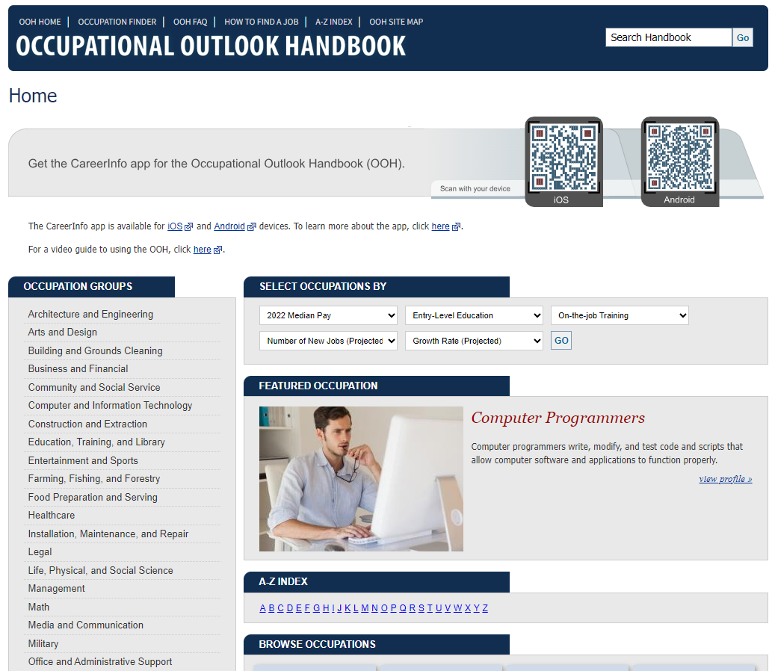

BLS Career Information Products
Occupational Outlook Handbook (OOH), as a website and as an app
Career Outlook
Long-term employment projections by industry and occupation
Education and training requirements
Notes:
The U.S. Bureau of Labor Statistics (BLS) produces a number of career information products that highlight data relevant in a career search.
The Occupational Outlook Handbook (OOH) is the BLS’s flagship career information resource offering information on the hundreds of occupations in the United States. The OOH includes job outlook information, job descriptions, education and training information, and wage data. The projections and wage data in the OOH are updated annually. The OOH app, "CareerInfo", is also available for Apple iOS and Android devices.
Career Outlook contains supplemental career information articles that are published throughout the year and includes practical information on jobs and careers.
BLS produces 10-year projections by industry and occupation that serve as the foundation for the job outlook information in the OOH.
BLS also produces information on education and training requirements for detailed occupations.
All products are available on the BLS website: www.bls.gov/emp/.

Slide 34
Occupational Outlook Handbook
www.bls.gov/ooh
Notes:
The Occupational Outlook Handbook (OOH) includes job descriptions, education and training requirements, wage data, and job outlook information. The OOH is updated in “real-time”, online, and includes over 300 occupational profiles covering more than 500 detailed occupations. (Many profiles cover multiple similar occupations.)
Information about an occupation can be found by:
Using the A-to-Z index on the homepage, which is in the blue bar near the top of the screenshot.
Using the “Search Handbook” function on the top, right-hand side.
Navigating major occupational categories on the left-hand side.

Slide 35
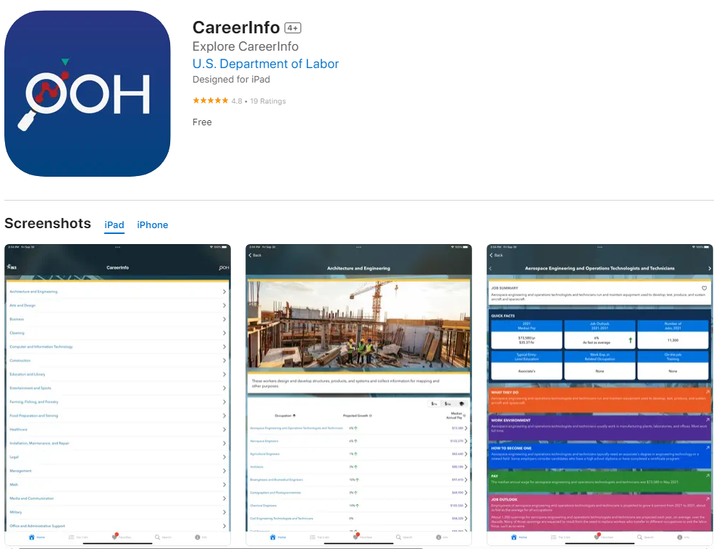
Occupational Outlook Handbook App
Available for download as the CareerInfo app for Apple iOS and Android
Notes:
The Occupational Outlook Handbook is now available for free download for Apple iOS and Android devices.
Career Info provides information about occupations, including:
What workers do
Typical entry-level education, training, and other qualifications needed
Workers’ pay
Job outlook
Related state and area data
And more!
The 300+ profiles cover about 4 out of 5 jobs in the economy.
Each profile is in a standard format, which makes it easy to compare occupations.
Search:
Occupations you are interested in with the simple search
Related occupational information—and share it, or save your searches
Occupational data for cities near you (using your phone’s GPS)

Slide 36

Using the OOH for Your Career Search
Notes:
This video describes how to use the OOH in a career search.

Slide 37
Career Outlook
www.bls.gov/careeroutlook
  Career Outlook is published throughout the year, and includes practical information on jobs and careers
  Includes feature articles, interviews with workers, and “You’re a what?” – describes careers people may not know about
Notes:
The “Career Outlook” includes articles about education, careers, and BLS data. Career Outlook articles are released throughout the year.
Examples of past articles:
“City careers on the move: Occupations in urban transportation”
“Interview with a…Personal chef”
“Prime options: High-paying math careers with projected fast growth”
“Projected openings in occupations that require a college degree”
“Some growth projected for the U.S. economy, 2020–30”
“Interview with a…Butcher”
“Education pays, 2020”
“Interview with a…Housing case manager”
“STEM education facilitator”
“Effects of the pandemic on projected employment in selected industries, 2019–29”
“Linking college majors to careers”

Slide 38
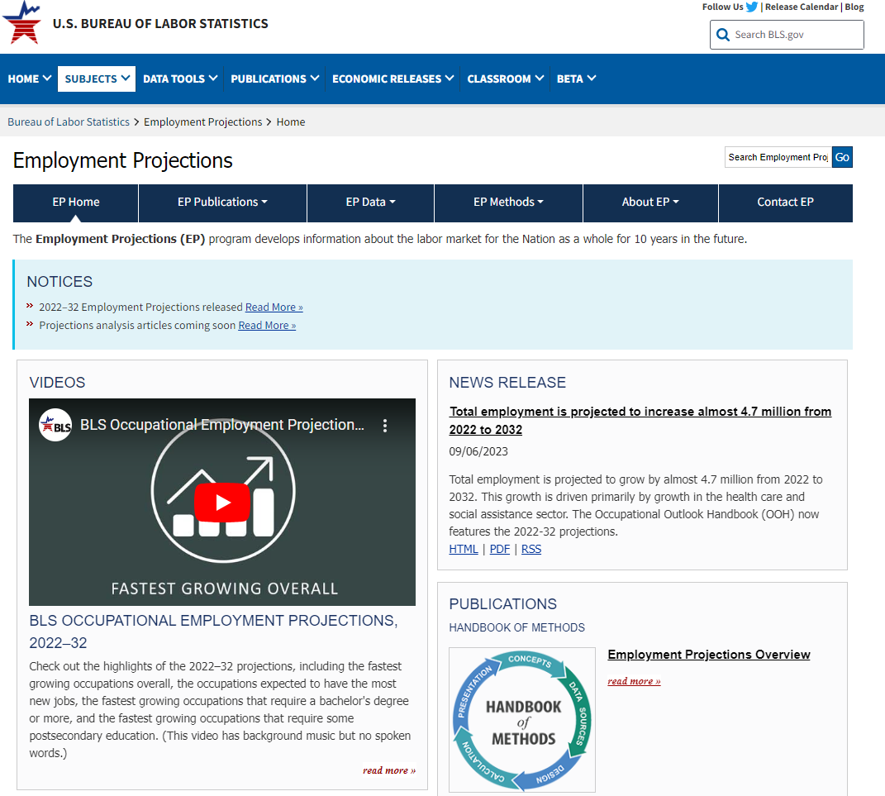
Employment Projections Data
www.bls.gov/emp
2022–32 projections cover 832 occupations and 292 industries at the national level only
The projections form the basis for data and outlook information in the Occupational Outlook Handbook (OOH)
Notes:
The Employment Projections homepage provides access to the detailed projections data and information about occupational separations rates and education and training categories.
The 2022–32 projections cover 832 occupations and 292 industries at the national level only.

Slide 39
State and Local Area Projections
BLS prepares projections only for the nation as a whole
Projections of industry and occupational employment are prepared by each state, using input from the BLS national projections
State projections data, and links to each state’s projections site, are available
  https://www.projectionscentral.org/
Notes:
While the BLS projections are only for the nation, each state government makes projections for their state.
Because the BLS national projections are an input to state projections, publication of the state projections lags behind publication of the BLS national projections.

Slide 40
Contact Information
Julie Hatch Maxfield
U.S. Bureau of Labor Statistics
Associate Commissioner
Office of Employment and Unemployment Statistics
hatch.julie@bls.gov

