Slide 1
Enhanced Wage Records:
Texas Perspective
Labor Market Information Department
Information Innovation & Insight Division
Mariana Vega, Director
Labor Market Information

Slide 2
Why This Work Matters
Growing demand for workforce outcome data
Need for better labor market insights
Legacy systems not designed for this level of analysis
Notes:
There is a growing demand for better, more timely workforce data.
We’re being asked:
What happens after someone completes training?
Are they working in the occ they trained for?
Are credentials leading to good jobs?
Are we meeting regional labor demand?
Current systems that weren’t originally designed for that level of insight.

Slide 3
Texas Context: SB 1786
Legislation
HB 5 in 2013
HB 3767 in 2021
SB 1786 in 2025
Enhanced Wage Records
Wage
Industry
Occupational field
Full-time/Part-time status
County of primary employment
Remote work status
Labor Demand Assessment
Identify industries and occupations leading to a self-sufficient wage
Analyze current and projected workforce needs
Notes:
HB 5 - a bill aimed to promote college and career readiness and reform to the school accountability system
HB 3767 - Tri-Agency Bill
SB 1786 – 2025
Focus:
Workforce alignment
Returns on education
Self-sufficiency wage
Performance-based funding
TWC 2 primary duties
Enhanced Wage Records (EWR)
Biennial Labor Demand Assessment report

Slide 4
Key Decisions
Use existing BLS location data or develop a new approach
1
Collect job titles or require SOC code assignment
2
Use UI wage data only or also collect wage rate
3
Collect hours worked or directly capture full-/part-time status
4
Determine approach for employer support and outreach
5
Identify how data will support broader TWC programs
6
Notes:
We are designing the structure of the data collection system but have key decisions to make.

Slide 5
Real-World Challenges
Multiple divisions involved
Cross-agency coordination required
Balancing feasibility, quality, and policy
Notes:
Multiple divisions involved:
UI Tax
LMI
IT
External stakeholders
We try to balance:
what is technically possible
what is useful, and
and what employers can realistically do.

Slide 6
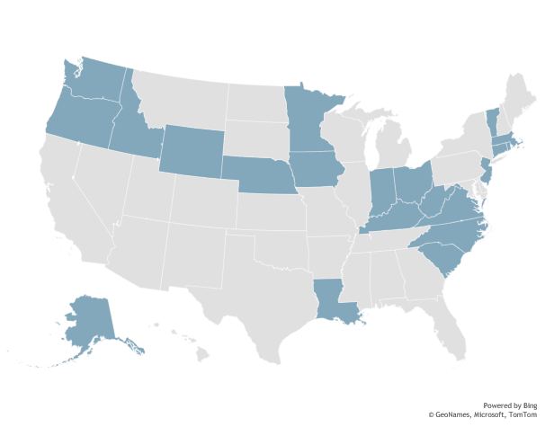
Learning from Other States
Key Findings:
  No plug-and-play model
  Simplicity leads to better data
  High reporting ≠ high-quality data
  Work location is critical
  Hours worked valuable
  Employer engagement is critical
Notes:
There is no national model - Each state’s UI system is set up differently
Implementation varies significantly based on:
statute,
system capacity
staffing,
Scale
States collect different combinations of:
Occupational data (SOC or job title)
Hours worked
Work location
High submission rates ≠ high data quality
Work location is essential for county-level and regional-level analysis
Penalties were rarely enforced

Slide 7
Strategic Opportunity
Reduce employer survey burden
Improve data quality
Better align education and workforce outcomes
Notes:
We’re creating the potential to:
Reduce employer survey burden
Improve data quality and consistency
Better align education and workforce outcomes

Slide 8
Our Approach
Three Principles:
Reduce employer burden
Align with BLS programs
Leverage existing systems and staff
Notes:
Reduce employer burden—we don’t want to make reporting more complicated. Prioritizing data elements that employers are more likely to already have.
Align with BLS programs— Thos programs already provide a strong statistical foundation.
Create opportunities to:
reduce duplication,
improve consistency,
3. Leverage existing systems and staff - ur systems, our staff, and our existing data infrastructure.

Slide 9
Stakeholder Engagement
Engaging with the business community
Coordinating with education partners
Ongoing outreach to support implementation
Notes:
Includes employers, payroll providers, business organizations
Education partners –
Texas Education Agency
Higher Education Coordinating Board
Data will directly support education and workforce outcomes.

Slide 10
Key Wins:
Legislative Support
Funding secured
Clear authority to move forward
Collaboration
Cross-division collaboration
Learning from other states
Alignment
Aligning with BLS programs
Leveraging federal resources
Notes:
1. Legislative and funding support.
Gives us the ability to:
invest in systems,
hire staff,
to take a long-term approach to this work.
Collaboration across divisions within our agency, across various external agencies and across states.
And lastly, we are not quite there yet, but we do have a seat at the table – and are pushing for the collection of data in a way that aligns with BLS programs.

Slide 11
Next Phase
Finalizing data element specifications
Completing system development
Conducting employer outreach and implementation planning
Notes:
Texas is currently in the design phase of Enhanced Wage Records implementation.
Focus in on:
Defining data elements
Building the reporting system
Engaging with business, to support implementation
Will include:
system readiness,
guidance,
operational workflows

Slide 12
LMI  Texas Workforce Commission
Contact Us for More Information
  Toll Free: 1-866-938-4444
  Phone: 512-936-3278
  Website: TexasLMI.com
  Email: lmci.users@twc.texas.gov

