Slide 1
AMCC Webinar
14 May 2020
Bharat Shyam, Rich Tong

Slide 2
Our Mission
Responsibly restart the economy
To save lives and livelihoods
By empowering your community

Slide 3
Agenda
In a Nutshell
Consumer Confidence enables Restart
The Solutions for the next 90-120 days
Model, Adoption, Resources
The Model

Slide 4
But first a Disclaimer
We are not medical experts, we are not policy experts, we are just concerned citizens.
The models done here require complete validation and consultation with the appropriate bodies.
The numbers here are representative and are not necessarily applicable to your situation.
The main goal is to demonstrate just one way of thinking about an impossibly complex problem.

Slide 5
In a Nutshell
Possible to protect everyone and restart the economy
Guidance from WHO, CHI, DOH, IHME, AWB, Commerce, Pierce County, Chambers of Seattle and Bellevue. Handed off to OFM (Marc Baldwin – Asst Director of Forecasting)
But, make it practical with tools for your community
A data-driven model that’s complete and enables anticipation of demand
Ensure adoption: Develop the right messages, campaign-in-a box, policy & framework for the most vulnerable
Training and resources for even the smallest organizations to restart smoothly
Next steps, be helpful, validate needs and move forward from there

Slide 6
Consumer Confidence depends on people feeling safe.
If they don’t feel safe, the economy will not restart

Slide 7
Three parts to a solution:
Demand Model
Adoption Tools
Resources & Training
Today: We will focus on Model

Slide 8
A spreadsheet that models COVID-19 equipment needs with FIVE METHODS based on WHO, CDC, WA DOH, actual data in this state and around the world.
Notes:
By healthcare provider
Gross top down (Bharat model)
By six-digit NAICS
By 2-digit NAICS
By SOC
Then two smaller summaries:
By Vulnerable
By Small Business

Slide 9
WHO Model Usage (Units/Day/Person) | HCW | Hygienist | Caretaker | Ambulancier | Patient
Gloves, heavy duty | 0 | 0.1 | 0 | 0 | 0
Gloves, examination | 6 | 0 | 4 | 4 | 0
Gloves, surgical | 1 | 0 | 0 | 0 | 0
Face shield | 1 | 0 | 0 | 0 | 0
Mask, particulate respirator | 1 | 2 | 0 | 0 | 0
Mask, medical | 4 | 0 | 2 | 2 | 0
Mask, medical patient | 0 | 0 | 0 | 0 | 2
Scrubs, tops | 0.03 | 0.03 | 0 | 0 | 0
Scrubs, pants | 0.03 | 0.03 | 0 | 0 | 0
Gown, protective | 1 | 1 | 0 | 2 | 0
Apron, disposable | 1 | 0 | 0 | 2 | 0
Apron, heavy duty, reusable | 0 | 0.05 | 0 | 0 | 0
Goggles, protective | 0.1 | 0 | 0 | 0.1 | 0
Gum boots | 0 | 0.01 | 0 | 0 | 0

Slide 10
Protection levels normalized for healthcare
Protection levels | Source |  | Level |  |  | N95 + Mask | N95 | ASTM 3 Mask | ASTM 1-2 Mask | Non ASTM Mask | Face Shield | Gowns | Gloves
Likely Contact (Lab, Outpatient) | WHO |  | 5.0 |  |  |  | 0.50 | 2.00 | 1.00 | 0.00 | 0.18 | 2.00 | 3.00
Healthcare Worker | DOH, WHO |  | 6.0 |  |  | 1.18 |  | 3.51 | 2.00 | 0.50 | 0.27 | 3.07 | 4.50

Slide 11
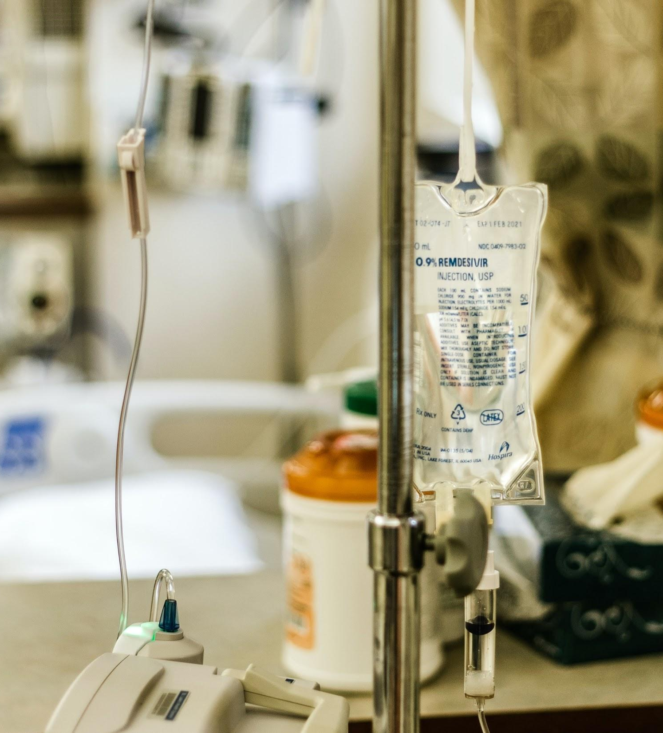
Multicare Data.
Second to Providence in size for Washington-based hospital providers.
4,000 healthcare providers, 17,000 employees of 440K in Washington
Mask usage pre-COVID-19 was 25K/day. Currently 15K/day with all electives and non-critical cancelled
Estimated return to normal 25K with extended conservation methods.

Slide 12
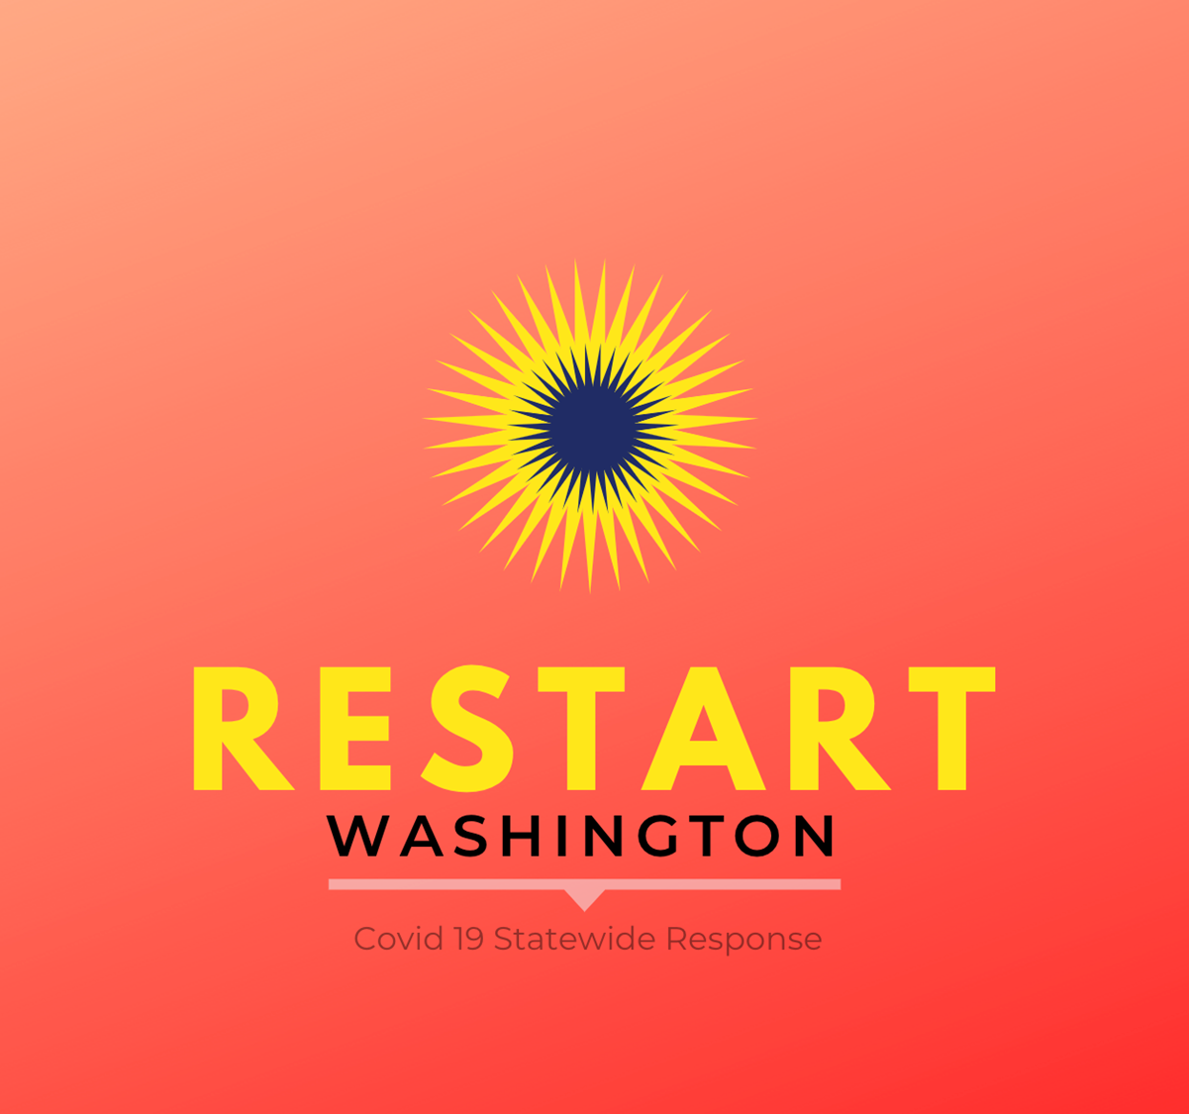
Multicare Data
WHO raw model estimates 100K at max surge Model estimates 45K for healthcare workers
Pieces (000s) | N95 + Mask | N95 | ASTM3 Mask | ASTM12 Mask | NoASTM Mask | Face Shield | Gowns | Gloves
Patients | 0.0 | 0.0 | 0.0 | 0.0 | 6.0 | 0.1 | 0.1 | 3.0
Office Worker | 0.0 | 0.0 | 0.0 | 0.0 | 8.5 | 0.2 | 0.2 | 4.3
Customer Facing | 0.0 | 0.0 | 0.0 | 3.4 | 6.8 | 0.3 | 0.2 | 6.8
Blue Collar | 0.0 | 0.1 | 1.7 | 0.0 | 5.1 | 0.2 | 0.9 | 5.1
Lab, Outpatient | 0.0 | 1.7 | 6.8 | 3.4 | 0.0 | 0.6 | 6.8 | 10.2
Healthcare Worker | 5.0 | 0.0 | 14.9 | 8.5 | 2.1 | 1.1 | 13.1 | 19.1
Total | 5.0 | 1.8 | 23.4 | 15.3 | 28.5 | 2.5 | 21.2 | 48.5

Slide 13
WHO to WA Data.
Surge forecast based on prior epidemic experience.
Washington model just as % of US and also with specific parameters for us
For non-healthcare workers, e.g., use Taiwan experience 10M masks for 21M population as rough guide.

Slide 14
WHO Resurgence 30-day Stockpile Requirements
One Month Stockpile | US | Washington | WA Specific
Population | 327,160 | 7,600 | Tuned
Gown, protective | 49,777,284 | 1,156,337 | 760,020
Scrubs, tops | 1,725,897 | 40,093 | 44,461
Scrubs, pants | 1,725,897 | 40,093 | 44,461
Apron, disposable | 30,819,098 | 715,935 | 319,304
Apron, heavy duty, reusable | 385,022 | 8,944 | 5,110
Gum boots | 385,022 | 8,944 | 5,110
Gloves, heavy duty | 385,022 | 8,944 | 5,110
Gloves, examination | 1,053,197,578 | 24,466,015 | 25,684,499
Gloves, surgical | 27,988,955 | 650,190 | 306,361
Goggles, protective | 1,471,092 | 34,174 | 40,571
Face shield | 28,685,905 | 666,380 | 321,191
Mask, particulate respirator | 49,866,387 | 1,158,407 | 471,245
Mask, medical | 790,257,575 | 18,357,860 | 17,312,893
5M masks/week for Tier 1 needed is high resurgence case 7M masks/week ordered is not unreasonable given uncertainty
Shortly we will have week by week estimates for a surge like this and this is changeable in the model

Slide 15
State Stockpile Using This Model
As a check, total stockpile required 20M Masks for a month or 5M/week. Assuming resurgence at high rate and rapid spread
Big assumption is EMD stockpile handles 30% of the peak, need to validate this with actual first surge figure
30-day Need | Respirator+Mask 1860-70 | Respirators 8210,8511 | ASTM 3 Mask | ASTM 1-2 Mask | Non ASTM Mask | Face Shield | Gowns | Gloves | Shoe Covers | Total
Pieces (000s) | 4,626 | 0 | 13,767 | 7,834 | 1,959 | 1,058 | 12,040 | 17,628 | 4,701 | 63,613

Slide 16
If this works then apply to the broader community

Slide 17
Protection levels for the entire population
Protection levels (units/day/person) | Source |  | Level |  |  | N95 + Mask | N95 | ASTM 3 Mask | ASTM 1-2 Mask | Non ASTM Mask | Face Shield | Gowns | Gloves
No Protection |  |  | 0.0
Resident or Patient | TW, MC |  | 1.0 |  |  |  |  |  |  | 1.00 | 0.02 | 0.02 | 0.50
Office Worker |  |  | 2.0 |  |  |  |  |  |  | 2.00 | 0.04 | 0.04 | 1.00
Customer Facing Worker |  |  | 3.0 |  |  |  |  |  | 1.00 | 2.00 | 0.08 | 0.06 | 2.00
Blue Collar Worker | LNI, WHO |  | 4.0 |  |  |  | 0.05 | 1.00 |  | 3.00 | 0.12 | 0.50 | 3.00
Likely Contact (Lab, Outpatient) | DOH, WHO |  | 5.0 |  |  |  | 0.50 | 2.00 | 1.00 | 0.00 | 0.18 | 2.00 | 3.00
Healthcare Worker | DOH, WHO |  | 6.0 |  |  | 1.18 |  | 3.51 | 2.00 | 0.50 | 0.27 | 3.07 | 4.50

Slide 18
One What-if Analysis for Washington State
Full PPE for all healthcare workers & all civilians get a mask
Average of 2 masks/person/day Cost is $2.50/person/day or 1.2% of pre-COVID-19 GDP
Daily | People | N95+Mask | N95 | ASTM 3 Mask | ASTM 1-2 | Non-ASTM | Shields | Gowns | Gloves | TOTAL
Healthcare Workers 000s | 435 | 514 | 0 | 1,530 | 870 | 218 | 118 | 1,338 | 1,959 | 6,546
Rest of State (000s) | 7,180 | 0 | 0 | 0 | 0 | 10,769 | 215 | 215 | 5,385 | 23,765
Total Cost |  | $2,570 | $0 | $1,530 | $522 | $5,494 | $999 | $6,213 | $1,469 | $18,796
%GDP |  | 0.15% | 0.00% | 0.09% | 0.03% | 0.33% | 0.06% | 0.37% | 0.09% | 1.12%
$/Person |  | $0.34 | $0.00 | $0.20 | $0.07 | $0.72 | $0.13 | $0.82 | $0.19 | $2.47

Slide 19
Industry Classification
Simplest measure of employment using NAICS coding of every employer in Washington state.
Each employer class gets a protection level. Spreadsheet can assign different levels to 2-digit, 3-digit or 6-digit NAICS levels

Slide 20
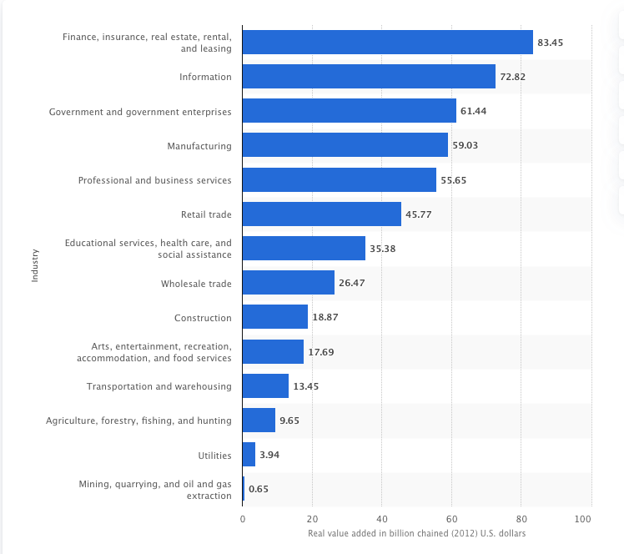
Sector-based Staged Restart
Criteria for restart prioritization: 1. Can’t be run from home 2. Easy to physically distance 3. Workers living paycheck to paycheck
4. Size of economic impact
Start order, every two weeks start 1. Healthcare 2. Manufacturing, Construction 3. Agriculture, Fishing, Hunting 4. Wholesale, Transportation 5. Education, Social Assistance

Slide 21
Sample NAICS coding with Level and Score
Sector | NAICS codes |  | Level | People | Essential
Total Nonfarm (Private + Government) |  |  |  | 3,507.2
Total Private |  |  | 4.0 | 2,913.7 | 1
Goods Producing |  |  | 4.0 | 524.2 | 2
Mining and Logging |  |  | 4.0 | 5.5 | 2
Logging | NAICS 1133, 1151, 1152 |  | 4.0 | 3.4 | 2
Mining | NAICS 21 |  | 4.0 | 2.1 | 2
Construction | NAICS 22 |  | 4.0 | 227.0 | 2
Construction of Buildings |  |  | 4.0 | 57.4 | 2
Residential Building Construction |  |  | 4.0 | 33.2 | 1
Nonresidential Building Construction |  |  | 4.0 | 24.2 | 2
Heavy and Civil Engineering |  |  | 4.0 | 21.5 | 2
Specialty Trade Contractors |  |  | 4.0 | 148.1 | 2

Slide 22
Analysis by Industry for WA State
For each industry sector set its protection and restart
GDP hit higher due to manufacturing/construction than base
1.3% GDP and less than $3.50 per day to get back to work
Daily Need | Respirator+Mask 1860-70 | Respirators 8210,8511 | ASTM 3 Mask | ASTM 1-2 Mask | Non ASTM Mask | Face Shield | Gowns | Gloves | Shoe Covers | Test Kits | Disinfection | TOTAL
Pieces (000s) | 514 | 27 | 1,019 | 2,192 | 10,472 | 399 | 741 | 8,992 | 1,171 | 210 | 14,051 | 39,788
Cost ($000s) | $2,570 | $106 | $1,019 | $1,315 | $5,236 | $1,197 | $3,703 | $1,798 | $176 | $421 | $2,810 | $20,351
%GDP | 0.15% | 0.01% | 0.06% | 0.08% | 0.31% | 0.07% | 0.22% | 0.11% | 0.01% | 0.03% | 0.17% | 1.22%
$/Person/Day | $0.41 | $0.02 | $0.16 | $0.21 | $0.83 | $0.19 | $0.59 | $0.28 | $0.03 | $0.07 | $0.45 | $3.23

Slide 23
By Industry with Conservation - WA State
50% of Civilians use a washable cloth mask 80% of civilians using a cloth mask that is 60% effective will stop spread 0.8% of GDP and $1.90/person/day
Disinfected | Respirator+Mask 1860-70 | Respirators 8210,8511 | ASTM 3 Mask | ASTM 1-2 Mask | Non ASTM Mask | Face Shield | Gowns | Gloves | Shoe Covers | Test Kits | Disinfection | TOTAL
Pieces (000s) | 64 | 3 | 1,019 | 2,192 | 175 | 25 | 741 | 8,992 | 1,171 | 210 | 14,051 | 28,643
Cost ($000s) | $514 | $23 | $1,019 | $1,315 | $89 | $100 | $3,703 | $1,798 | $176 | $421 | $2,810 | $11,968
%GDP | 0.03% | 0.00% | 0.06% | 0.08% | 0.01% | 0.01% | 0.22% | 0.11% | 0.01% | 0.03% | 0.17% | 0.72%
$/Person/Day | $0.08 | $0.00 | $0.16 | $0.21 | $0.01 | $0.02 | $0.59 | $0.28 | $0.03 | $0.07 | $0.45 | $1.90

Slide 24
Model based on Job Types
There are 800+ SOC codes so analyse what jobs need what level of protection to “get back on the playing field” and urgency to get them back to work

Slide 25
Washington SOT | SOC | Type | Protection level | Employment | Essential Index
Advertising & Promotions Managers | 11-2011 | Office | 2 | 447 | 0
Marketing Managers | 11-2021 | Office | 2 | 6,076 | 0
Sales Managers | 11-2022 | Office | 2 | 7,342 | 0
Public Relations & Fundraising Managers | 11-2031 | Office | 2 | 2,167 | 0
Administrative Services Managers | 11-3011 | Office | 2 | 5,027 | 0
Computer & Information Systems Managers | 11-3021 | Office | 2 | 13,691 | 0
Financial Managers | 11-3031 | Office | 2 | 13,006 | 0
Industrial Production Managers | 11-3051 | Office | 2 | 2,745 | 2
Purchasing Managers | 11-3061 | Office | 2 | 1,797 | 2
Transportation, Storage & Distribution Managers | 11-3071 | Office | 2 | 2,357 | 3
Compensation & Benefits Managers | 11-3111 | Office | 2 | 308 | 1
Human Resources Managers | 11-3121 | Office | 2 | 3,318 | 0
Training & Development Managers | 11-3131 | Office | 2 | 750 | 0
Farmers, Ranchers & Other Agricultural Managers | 11-9013 | Farm | 1 | 152 | 2
Construction Managers | 11-9021 | Construction | 4 | 8,564 | 2
Educ Administrators, Preschool/Childcare Center/Program | 11-9031 | Education | 3 | 1,450 | 2
Education Administrators, Elementary & Secondary School | 11-9032 | Education | 3 | 5,329 | 2
Education Administrators, Postsecondary | 11-9033 | Education | 3 | 2,277 | 2
Education Administrators, All Other | 11-9039 | Education | 3 | 903 | 2

Slide 26
By Industry with Conservation - WA State
Slightly higher than the by industry type, more detailed
1.6% GDP or $3.50 a day/person
1.1% GDP or $2.40/day/person with washing
Gross Need | Respirator+Mask 1860-70 | Respirators 8210,8511 | ASTM 3 Mask | ASTM 1-2 Mask | Non ASTM Mask | Face Shield | Gowns | Gloves | Shoe Covers | Test Kits | Disinfection | TOTAL
Daily Need | 215 | 174 | 2,057 | 2,010 | 11,898 | 441 | 1,735 | 10,236 | 1,551 | 223 | 14,287 | 21,831
Daily Cost | $1,077 | $695 | $2,057 | $1,206 | $5,949 | $1,324 | $8,677 | $2,047 | $233 | $445 | $2,857 | $26,567
%GDP | 0.06% | 0.04% | 0.12% | 0.07% | 0.36% | 0.08% | 0.52% | 0.12% | 0.01% | 0.03% | 0.17% | 1.59%
$/Person/Day | $0.14 | $0.09 | $0.27 | $0.16 | $0.78 | $0.17 | $1.14 | $0.27 | $0.03 | $0.06 | $0.38 | $3.49

Slide 27
People In Need: Non-Profit Employees, Homeless, Unemployed (WA State)
118K employees of Social Assistance NAICS 624
22K homeless, 152K unemployed pre-COVID, 38K migrant farm workers, 57K in state-support home services, 16K in nursing facilities for 403K overall plus 1.5M school kids
Total Amount needed: $211K per day. 60-day need of $12M covers them for most critical period
With Washing | Respirator+ Mask 1860-70 | Respirators 1810 | ASTM 3 Mask | ASTM 1-2 Mask | Non ASTM Mask | Face Shield | Gowns | Gloves | Shoe Covers | Test Kits | Disinfection | TOTAL
Pieces (000s) | 0 | 0 | 0 | 119 | 11 | 1 | 8 | 447 | 6 | 0 | 0 | 592
Cost ($000s) | $0 | $0 | $0 | $72 | $6 | $4 | $39 | $89 | $1 | $0 | $0 | $211
%GDP | 0.00% | 0.00% | 0.00% | 0.00% | 0.00% | 0.00% | 0.00% | 0.00% | 0.00% | 0.00% | 0.00% | 0.01%
$/Person/Day | $0.00 | $0.00 | $0.00 | $0.05 | $0.00 | $0.00 | $0.03 | $0.06 | $0.00 | $0.00 | $0.00 | $0.14

Slide 28
Funding PPE: Some Ideas
In Washington State Insurance Commissioner Kreidler decreed that Covid19 testing had to be covered by Health Insurance Plans in WA
Should health insurance should pay for PPE? For example: Insurance could pay for 2 cotton masks or a pack of disposable masks up to $XX every quarter. Every saved hospitalization will pay for a lot of masks
Should health insurance pay for PPE for all healthcare (dentist offices, physical therapist, physicians, imaging techs etc.)?
Healthcare spending is down in a big way already but premiums are not!
Can the state get federal funding for Medicaid to fund masks? For homeless people? For low income elderly?

Slide 29
Next Steps for the Model
Technology
Enable all States, Counties and Cities in the US (In progress, days)
Model Expansion: Connect Econometric & Epidemiological Models
Validation
Data cleaning for every state, Bottoms-up check, support for everyone (In progress, state by state when approached)

Slide 30
Thanks!
Info@restart.partners for more

