Slide 1
COVID-19
Manufacturing Emergency Response Team
Of Massachusetts
“MERT”
December 2020

Slide 2

OUR MISSION
We strengthen the competitiveness of the tech and innovation economy
by driving strategic investments, partnerships, and insights
that harness the talent of Massachusetts.

Slide 3



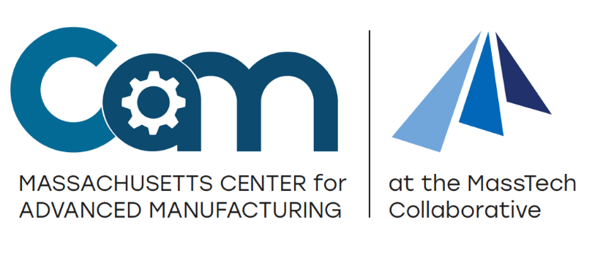

masstech.org
Title

Slide 4

Advanced Manufacturing Collaborative @
Co-Chairs:
Executive Branch
Industry
~30 members:
Government:
  Executive Branch
  Legislature
  Quasi-Gov
Industry
  SMEs
  OEMs
  Start ups / Incubators/Accelerators
  Associations
Academia
  R&D
  Higher Ed
Advanced Manufacturing Collaborative
Innovation Ecosystem Working Group
Talent/Branding Working Group
Business Environment Working Group

Slide 5
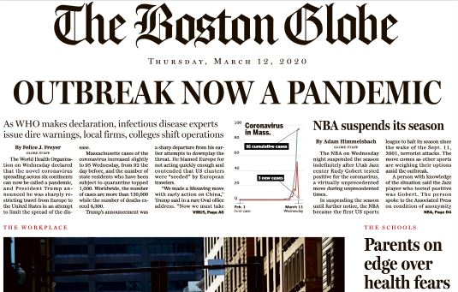

Slide 6
Manufacturing Emergency Response Team (MERT)
MISSION:
Mobilize, organize and operationalize
critical path work streams necessary for MA manufacturers to pivot their operations to produce needed materials in response to COVID-19 pandemic.
Mission accomplished by activating the Advanced Manufacturing Collaborative (AMC) – the network, the infrastructure that was in place, and ready to respond.

Slide 7
Speed of the MERT Rollout was Critical to Success
Within 10 days of the state of emergency, the MERT was convened.
At 19 days, the PPE portal for pivoting manufacturers was launched.
First test run on PPE testing by MIT conducted within 22 days.
At 30 days, orders were placed with 99 Degrees and Merrow – both companies had pivoted, obtained raw materials, retrained their workforce, implemented COVID-19 safety protocols, and committed to a delivery schedule for 1 million gowns each.
A little over a month (34 days), the MERT grant program was launched.
Within 43 days and 60 days respectively, PPE testing equipment ordered, installed and was operational at MIT Lincoln Labs and UMass Lowell’s PPE testing centers.
Within 90 days, the millionth mask rolled off the production lines at New Balance.

Slide 8
PPE Portal and Readiness to Pivot: To date 940 companies have come through the MERT PPE portal with 558 from Massachusetts
M-ERT Supporting Resources
Triage of
Companies
Product Managers:
PPE
Sanitizers
Ventilators
Nasal Swabs
M-ERT Program Office Central triage and pre-sort prior to referring to a sub group
Assign Green companies to M-ERT Product Manager
Low Probability
(not Mfg-ready;
Limited short-term capability)
Manufacturing Subgroup:
Guidance on kitting, labeling, packaging, assembly, sterilization status, etc.
All types of manufacturing and products; woven, non-woven, piece parts, textiles, 3D printing, etc.
Product quarterbacks for Ventilators, Textiles, Sanitizers, Faceshields, Masks, etc.
Medium Probability
(capable of providing PPE components)
High Probability
(Mfg-ready PPE product line)
Market Ready
About 50 companies made it through the MERT gauntlet and have produced 12 million pieces of PPE at last count.
Regulations and Testing Subgroup:
FDA approvals and other regulatory performance requirements
Physical specs and requirements for products
Rapid Design Testing and vetting (against the above)
Product testing of manufacturing products

Slide 9
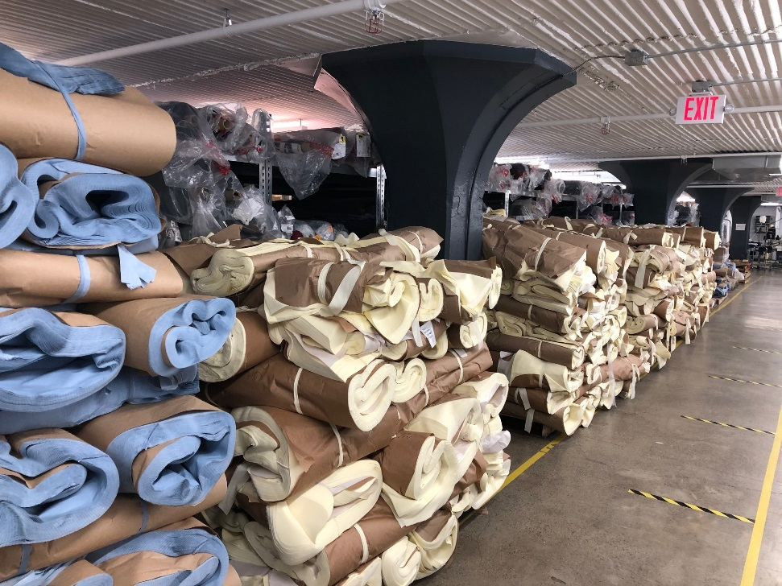

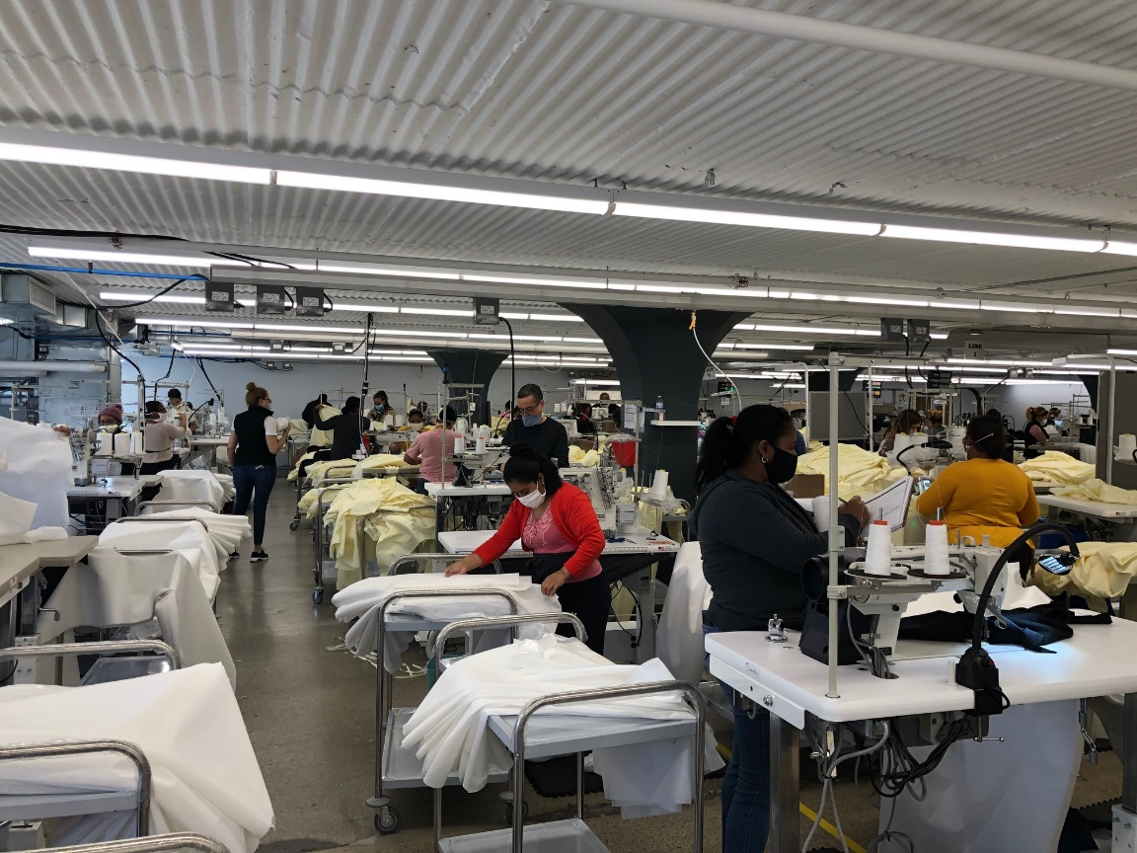
State signs contract with 99 Degrees in Lawrence, MA
Example Requirements for a State Contract:
Product test results;
FDA/EUA certifications;
Confirmed delivery schedules.

Slide 10

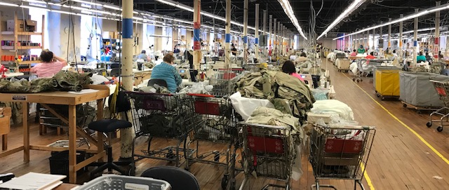
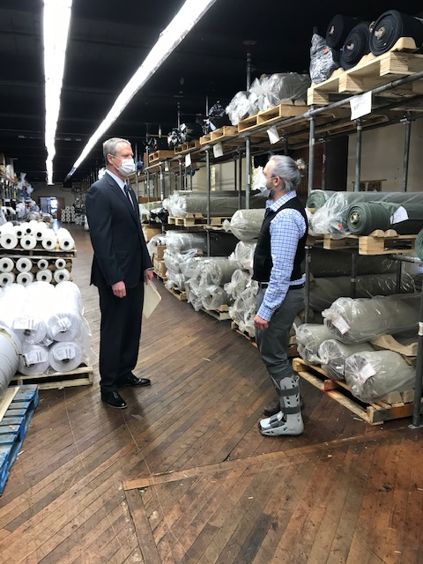
State signs contract with Merrow in Fall River, MA
Each contract for 1 million
medical gowns.

Slide 11
MERT Grant Program
The Manufacturing Emergency Response Funding is a partnership between a number of state agencies, and investments aligned with priorities identified by COVID -19 Command Center as being in short supply.
Ventilators
Gowns
N-95 Masks
Surgical & Procedure Masks
  89 Applications Received
  $53.6M Total Requests
  29 Applications Approved to Contract
  $16M in Awards
Swabs
Transport Medium
Sanitizing Wipes
Other

Slide 12
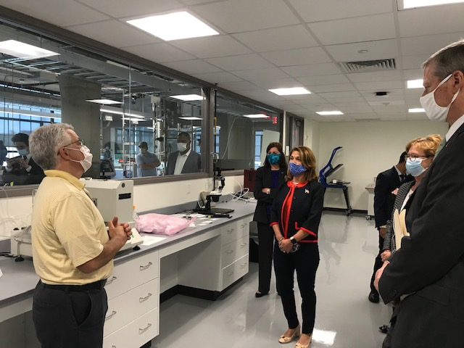
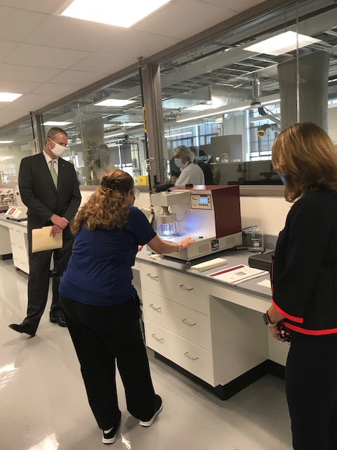
PPE Testing Infrastructure
UMass Lowell
Set up PPE testing infrastructure in collaboration with local laboratories (MIT, MITLL, UMass Lowell)
Thousands of respirators tested to date
Testing findings leading to informed decisions for State and National agencies, hospitals, and manufacturers developing new PPE
Rutledge Aerosol Testing Lab

Slide 13
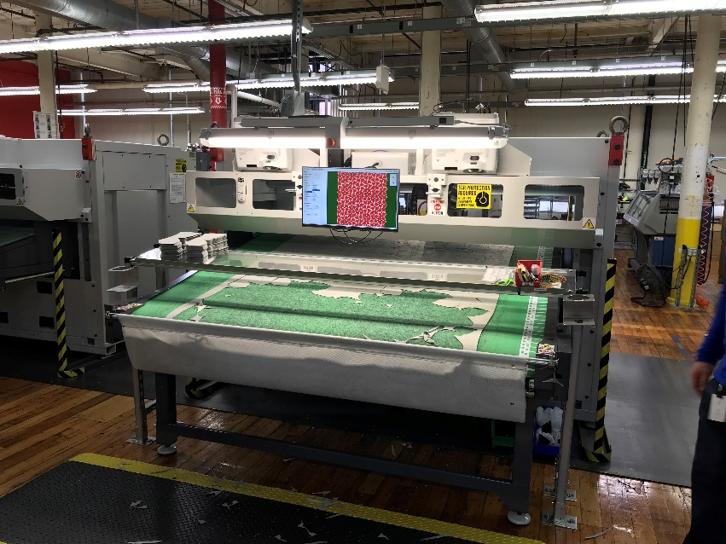
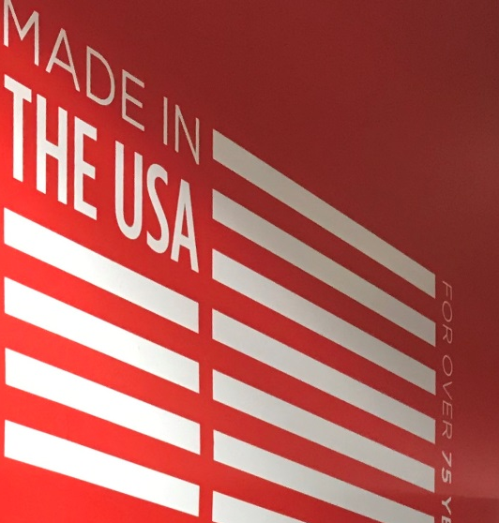
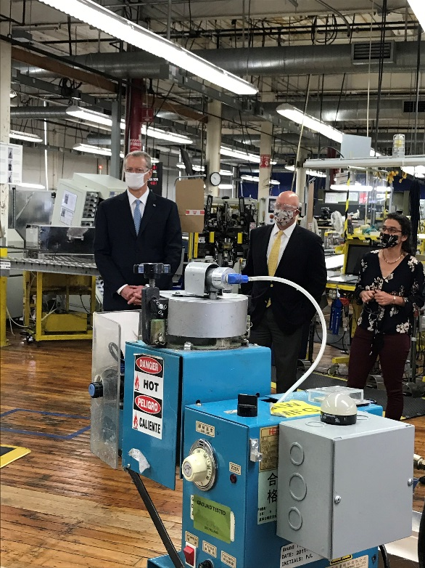
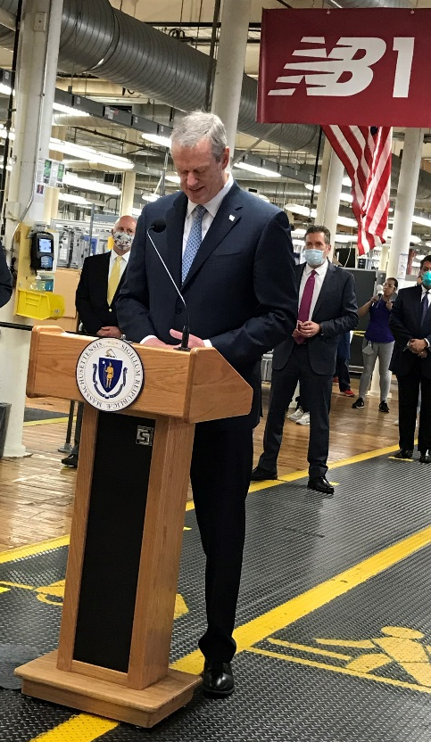
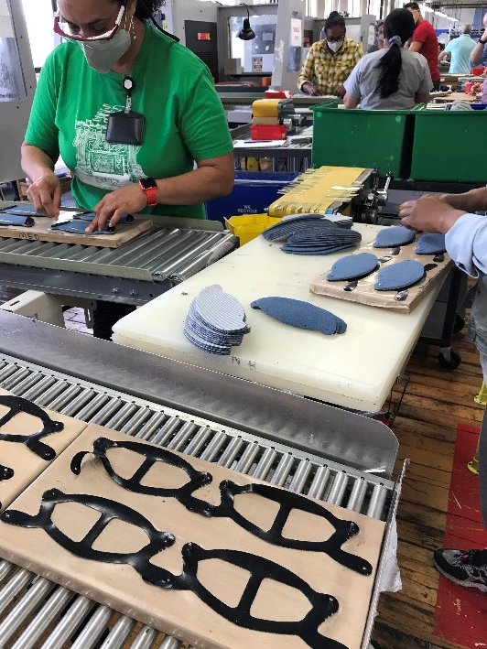
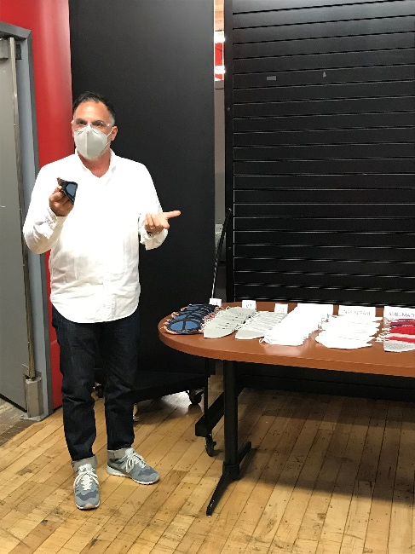
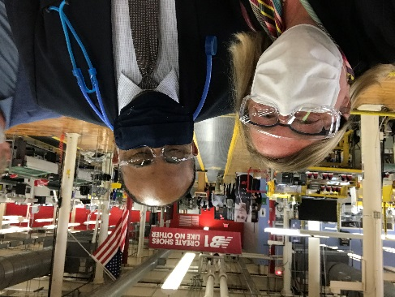

One Millionth Mask Rolls off Press at New Balance

Slide 14
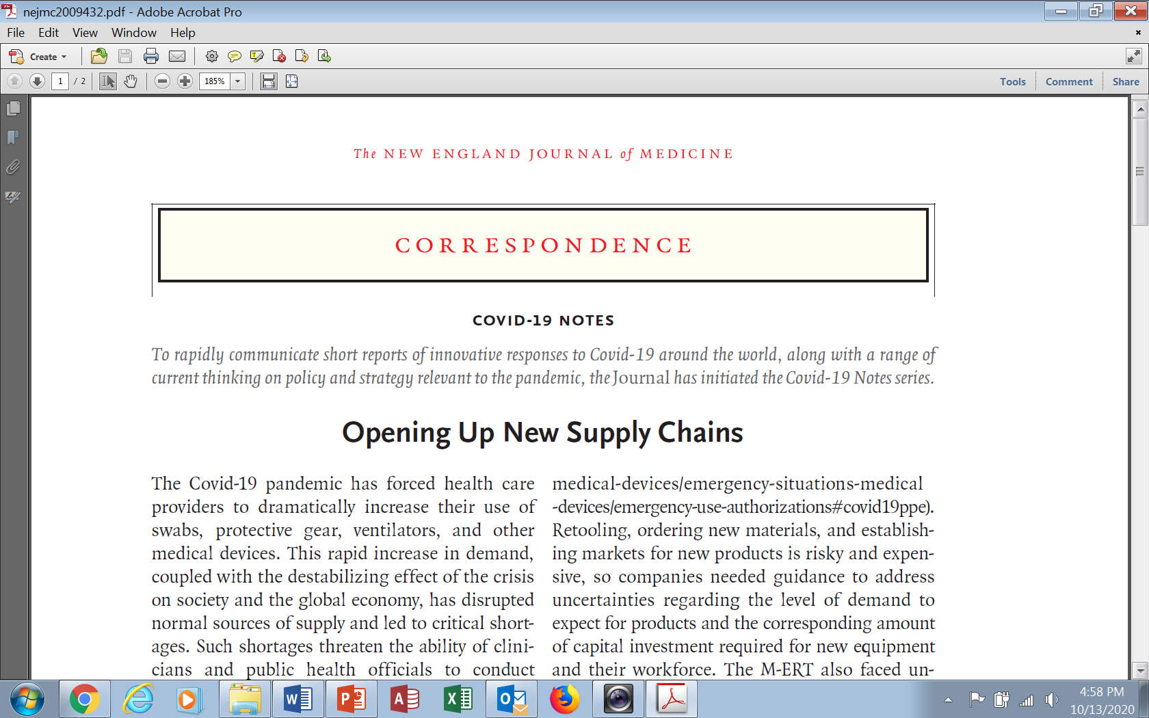
The New England Journal of Medicine
“Correspondence” COVID-19 Notes – Published May 6, 2020
Mark L. Zeidel, M.D.
Beth Israel Deaconess Medical Center
Boston, MA
Carolyn Kirk, B.A.
MassTech Collaborative
Westborough, MA
Ben Linville‑Engler, S.M.
Massachusetts Institute of Technology
Cambridge, MA

Slide 15

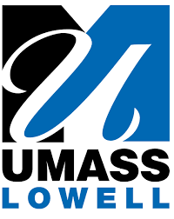


NSF Future Manufacturing Networks Grant:
Rapid-Execution for Scaling Production Of Needed Designs (RESPOND)
Massachusetts Awarded
‘Future of Manufacturing’ Grant
from National Science Foundation
Project RESPOND Will Help Massachusetts Manufacturers Pivot Operations to Address Crises
$500,000 Grant Builds on the Success of the Massachusetts Manufacturing Emergency Response Team
BOSTON – Today, the National Science Foundation (NSF) announced a new ‘Future of Manufacturing’ grant of $499,955 awarded to a collaboration of Massachusetts organizations, which will help the region’s manufacturers pivot their operations to address emerging crises.
The project, called ‘Rapid Execution for Scaling Production Of Needed Designs’ or RESPOND, will create a diverse network of transdisciplinary stakeholders across academia and state government that will support and sustain critical ‘super nodes’ that will boost communication between organizations, help accelerate product development, and drive increased manufacturing capacity to address crises like the ongoing COVID-19 pandemic.

Slide 16
Highlighted Products and Companies | 2020 Expected | 2021 & Beyond Forecast
Ventilators: Cogmedix - contract manufacturer for Zoll. Worcester | 10,000 (Contracted for 10,000) | Volume TBD
N95 Respirators/Masks: Gerson – existing manufacturer that was provided expansion support. Boyd Technologies – pivoting medical device manufacturer. Virudefense – surgical mask style for N95. Standard Materials/Shawmut – new venture | Ramp up Ramp up / 3,000 3,200,000 Ramp up | 16,300,000 30,000,000 (annualized) 10,000,000 60,000,000
Isolation Gowns: 99 Degrees – Produced 2 million to date. POs in place for additional 2 million. Merrow – Sees market reverting to overseas in 2021. Lovepop – Ramping down production. Western MA but manufacturing in Vietnam Contollo – won 12 million unit order from Federal govt. CareAline – won $25,000 first prize in Mass Tech’s Intrapreneur Challenge. | 2,000,000 5,000,000 2,000,000 100,000 5,500 | 2,000,000 9,750,000 TBD 12,000,000 100,000
Face Shields: Fraen, FLEXcon, PolymerShapes, Lacerta, Brownmed, Pyxis, Sparx, Lovepop & more. | 5,000,000 | 7,000,000
Other: Boyd Technologies – surgical masks Face Masks – New Balance, Lawrence MA. Production ramped down. Viral (Kits) / Transport Medium – Mat Tek Corp. PPE Testing Hand Sanitizer (approximately 12 companies) | Ramp up 1,000,000+ 500,000 4,267 70,000+ gallons | 30,000,000 (annualized) 0 1,000,000 1,200 140,000+ gallons
TOTAL PRODUCTIVITY | >15 million items (minus Lovepop) | >170 million items

