Slide 1




Enhancing State-Local ​
Economic Development ​
Planning and Engagement
CREC Presentation to NADO Annual Training Conference​
Tuesday, October 19, 2021
Bob Isaacson
Notes:
Add note to this slide

Slide 2


State Partnerships – Poll Time
Scan the QR code with your smartphone to participate in the survey.
We appreciate your feedback.
Notes:
Instructions to start live polling
- Go to https://www.polleverywhere.com/
- Login:
Username: mhagos@crec.net
Password: CRECEDA2021!
Under my activities, select ‘Enhancing State-Local ​Economic Development ​Planning and Engagement Survey’
Once the survey is up, select ‘Present’ (top right) to start the poll
The first slide is a progress slide, showing how many surveys are completed or underway. Use the arrows towards the bottom of the screen to advance to the next question (similar to a slide deck)
Building back better means investing in projects that will promote equity and develop local economies that will be resilient to future economic shocks and climate change.
Through the Statewide Planning, Research & Networks program, EDA is supporting states in planning efforts by allocating $59 million for Statewide Planning Grants.
In addition, the program will allocate $31 million for Research and Networks Grants to invest in research that assesses the effectiveness of EDA’s programs, and provides support for stakeholder communities around key EDA initiatives.
If you or anyone in your regional network are collaborating or have collaborated with your state as they consider how to use EDA's $1 million grant per state for economic development planning, please contact me….

Slide 3
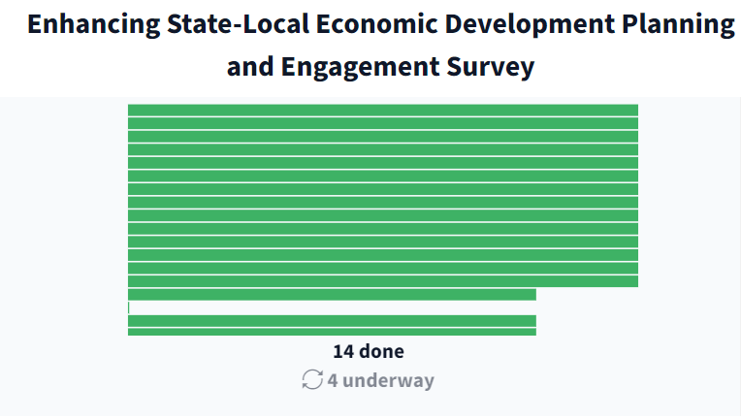
State Partnerships – Poll Time
18 conference responses; 118 total
Notes:
Instructions to start live polling
- Go to https://www.polleverywhere.com/
- Login:
Username: mhagos@crec.net
Password: CRECEDA2021!
Under my activities, select ‘Enhancing State-Local ​Economic Development ​Planning and Engagement Survey’
Once the survey is up, select ‘Present’ (top right) to start the poll
The first slide is a progress slide, showing how many surveys are completed or underway. Use the arrows towards the bottom of the screen to advance to the next question (similar to a slide deck)
Building back better means investing in projects that will promote equity and develop local economies that will be resilient to future economic shocks and climate change.
Through the Statewide Planning, Research & Networks program, EDA is supporting states in planning efforts by allocating $59 million for Statewide Planning Grants.
In addition, the program will allocate $31 million for Research and Networks Grants to invest in research that assesses the effectiveness of EDA’s programs, and provides support for stakeholder communities around key EDA initiatives.
If you or anyone in your regional network are collaborating or have collaborated with your state as they consider how to use EDA's $1 million grant per state for economic development planning, please contact me….

Slide 4
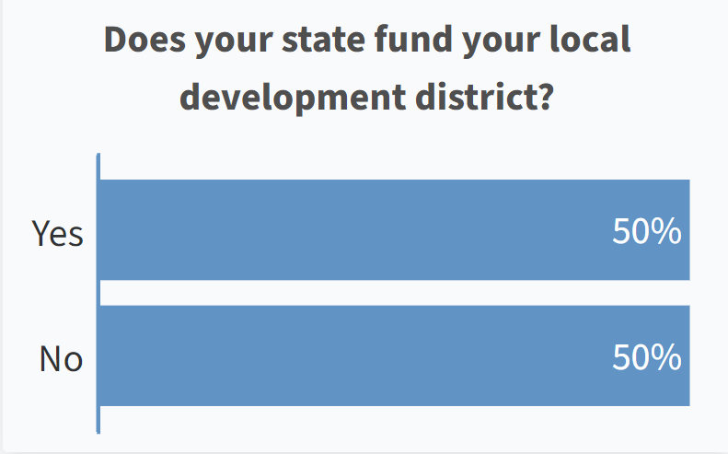
State Partnerships – Poll Time
Notes:
Instructions to start live polling
- Go to https://www.polleverywhere.com/
- Login:
Username: mhagos@crec.net
Password: CRECEDA2021!
Under my activities, select ‘Enhancing State-Local ​Economic Development ​Planning and Engagement Survey’
Once the survey is up, select ‘Present’ (top right) to start the poll
The first slide is a progress slide, showing how many surveys are completed or underway. Use the arrows towards the bottom of the screen to advance to the next question (similar to a slide deck)
Building back better means investing in projects that will promote equity and develop local economies that will be resilient to future economic shocks and climate change.
Through the Statewide Planning, Research & Networks program, EDA is supporting states in planning efforts by allocating $59 million for Statewide Planning Grants.
In addition, the program will allocate $31 million for Research and Networks Grants to invest in research that assesses the effectiveness of EDA’s programs, and provides support for stakeholder communities around key EDA initiatives.
If you or anyone in your regional network are collaborating or have collaborated with your state as they consider how to use EDA's $1 million grant per state for economic development planning, please contact me….

Slide 5
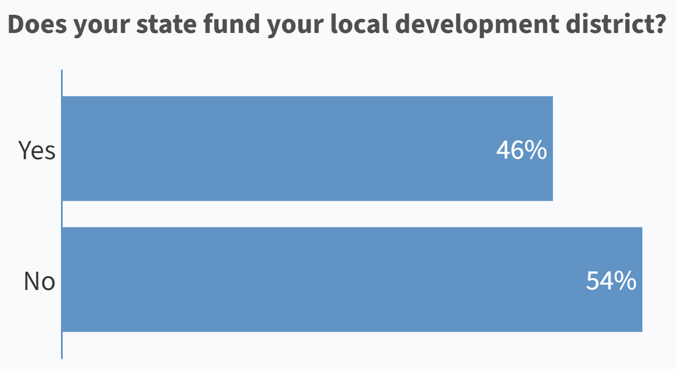
State Partnerships – All Results
Notes:
Instructions to start live polling
- Go to https://www.polleverywhere.com/
- Login:
Username: mhagos@crec.net
Password: CRECEDA2021!
Under my activities, select ‘Enhancing State-Local ​Economic Development ​Planning and Engagement Survey’
Once the survey is up, select ‘Present’ (top right) to start the poll
The first slide is a progress slide, showing how many surveys are completed or underway. Use the arrows towards the bottom of the screen to advance to the next question (similar to a slide deck)
Building back better means investing in projects that will promote equity and develop local economies that will be resilient to future economic shocks and climate change.
Through the Statewide Planning, Research & Networks program, EDA is supporting states in planning efforts by allocating $59 million for Statewide Planning Grants.
In addition, the program will allocate $31 million for Research and Networks Grants to invest in research that assesses the effectiveness of EDA’s programs, and provides support for stakeholder communities around key EDA initiatives.
If you or anyone in your regional network are collaborating or have collaborated with your state as they consider how to use EDA's $1 million grant per state for economic development planning, please contact me….

Slide 6
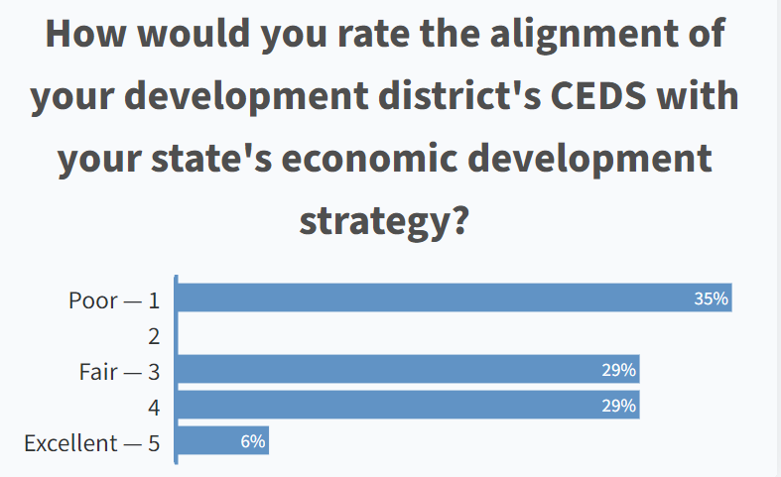
State Partnerships – Poll Time
Notes:
Instructions to start live polling
- Go to https://www.polleverywhere.com/
- Login:
Username: mhagos@crec.net
Password: CRECEDA2021!
Under my activities, select ‘Enhancing State-Local ​Economic Development ​Planning and Engagement Survey’
Once the survey is up, select ‘Present’ (top right) to start the poll
The first slide is a progress slide, showing how many surveys are completed or underway. Use the arrows towards the bottom of the screen to advance to the next question (similar to a slide deck)
Building back better means investing in projects that will promote equity and develop local economies that will be resilient to future economic shocks and climate change.
Through the Statewide Planning, Research & Networks program, EDA is supporting states in planning efforts by allocating $59 million for Statewide Planning Grants.
In addition, the program will allocate $31 million for Research and Networks Grants to invest in research that assesses the effectiveness of EDA’s programs, and provides support for stakeholder communities around key EDA initiatives.
If you or anyone in your regional network are collaborating or have collaborated with your state as they consider how to use EDA's $1 million grant per state for economic development planning, please contact me….

Slide 7
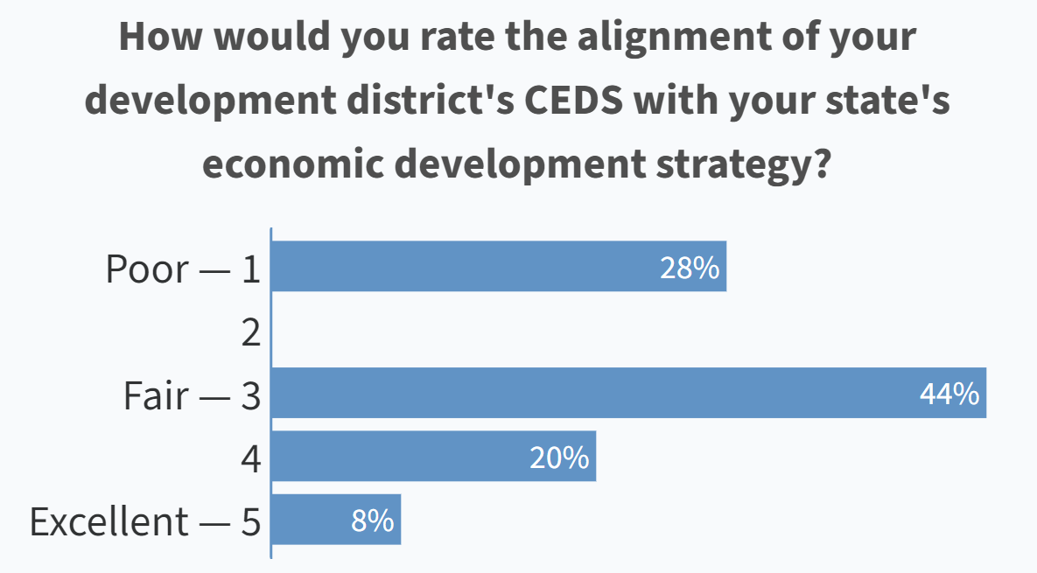
State Partnerships – All Results
Notes:
Instructions to start live polling
- Go to https://www.polleverywhere.com/
- Login:
Username: mhagos@crec.net
Password: CRECEDA2021!
Under my activities, select ‘Enhancing State-Local ​Economic Development ​Planning and Engagement Survey’
Once the survey is up, select ‘Present’ (top right) to start the poll
The first slide is a progress slide, showing how many surveys are completed or underway. Use the arrows towards the bottom of the screen to advance to the next question (similar to a slide deck)
Building back better means investing in projects that will promote equity and develop local economies that will be resilient to future economic shocks and climate change.
Through the Statewide Planning, Research & Networks program, EDA is supporting states in planning efforts by allocating $59 million for Statewide Planning Grants.
In addition, the program will allocate $31 million for Research and Networks Grants to invest in research that assesses the effectiveness of EDA’s programs, and provides support for stakeholder communities around key EDA initiatives.
If you or anyone in your regional network are collaborating or have collaborated with your state as they consider how to use EDA's $1 million grant per state for economic development planning, please contact me….

Slide 8
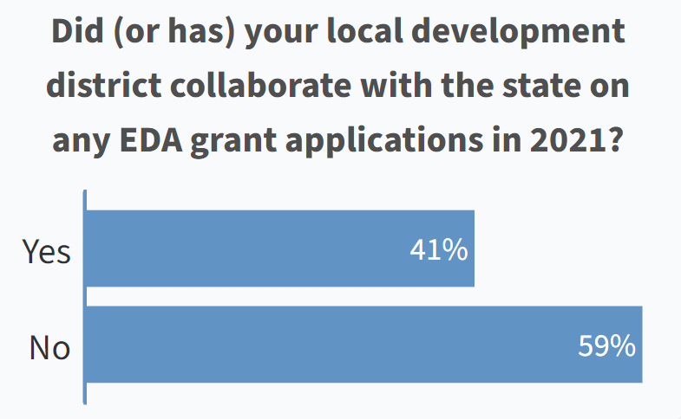
State Partnerships – Poll Time
Notes:
Instructions to start live polling
- Go to https://www.polleverywhere.com/
- Login:
Username: mhagos@crec.net
Password: CRECEDA2021!
Under my activities, select ‘Enhancing State-Local ​Economic Development ​Planning and Engagement Survey’
Once the survey is up, select ‘Present’ (top right) to start the poll
The first slide is a progress slide, showing how many surveys are completed or underway. Use the arrows towards the bottom of the screen to advance to the next question (similar to a slide deck)
Building back better means investing in projects that will promote equity and develop local economies that will be resilient to future economic shocks and climate change.
Through the Statewide Planning, Research & Networks program, EDA is supporting states in planning efforts by allocating $59 million for Statewide Planning Grants.
In addition, the program will allocate $31 million for Research and Networks Grants to invest in research that assesses the effectiveness of EDA’s programs, and provides support for stakeholder communities around key EDA initiatives.
If you or anyone in your regional network are collaborating or have collaborated with your state as they consider how to use EDA's $1 million grant per state for economic development planning, please contact me….

Slide 9
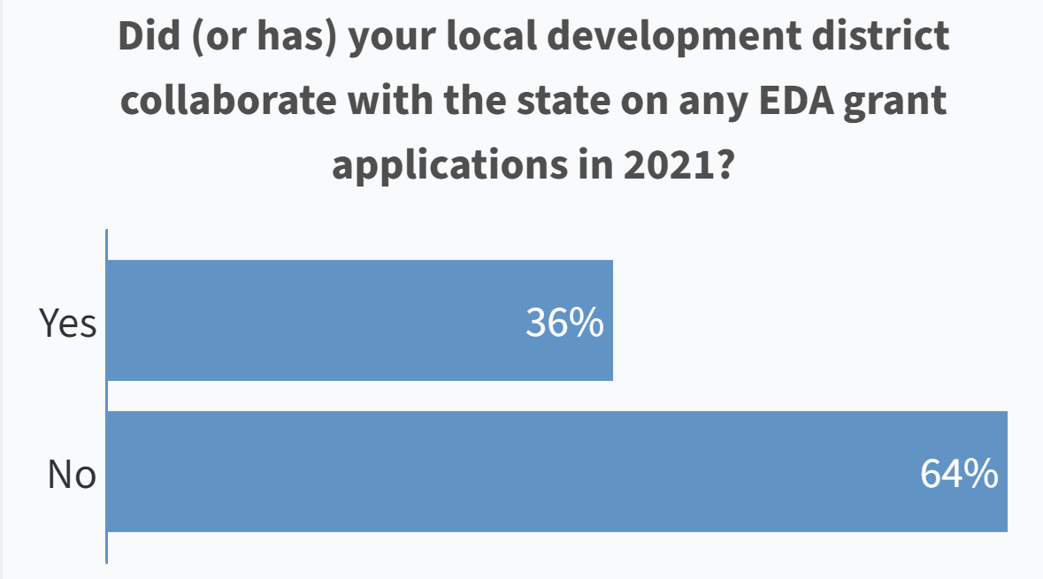
State Partnerships – All Results
Notes:
Instructions to start live polling
- Go to https://www.polleverywhere.com/
- Login:
Username: mhagos@crec.net
Password: CRECEDA2021!
Under my activities, select ‘Enhancing State-Local ​Economic Development ​Planning and Engagement Survey’
Once the survey is up, select ‘Present’ (top right) to start the poll
The first slide is a progress slide, showing how many surveys are completed or underway. Use the arrows towards the bottom of the screen to advance to the next question (similar to a slide deck)
Building back better means investing in projects that will promote equity and develop local economies that will be resilient to future economic shocks and climate change.
Through the Statewide Planning, Research & Networks program, EDA is supporting states in planning efforts by allocating $59 million for Statewide Planning Grants.
In addition, the program will allocate $31 million for Research and Networks Grants to invest in research that assesses the effectiveness of EDA’s programs, and provides support for stakeholder communities around key EDA initiatives.
If you or anyone in your regional network are collaborating or have collaborated with your state as they consider how to use EDA's $1 million grant per state for economic development planning, please contact me….

Slide 10
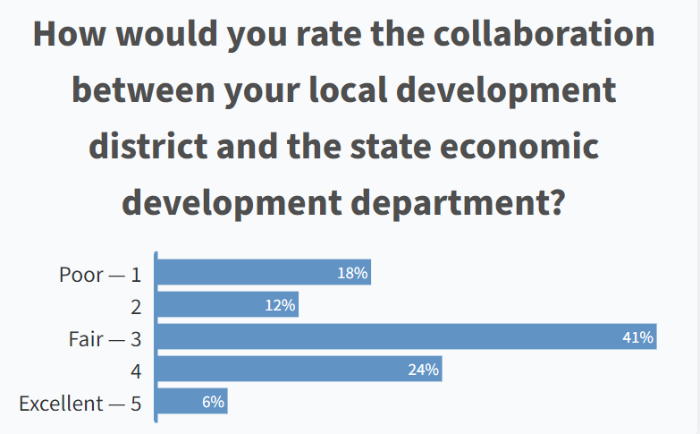
State Partnerships – Poll Time
Notes:
Instructions to start live polling
- Go to https://www.polleverywhere.com/
- Login:
Username: mhagos@crec.net
Password: CRECEDA2021!
Under my activities, select ‘Enhancing State-Local ​Economic Development ​Planning and Engagement Survey’
Once the survey is up, select ‘Present’ (top right) to start the poll
The first slide is a progress slide, showing how many surveys are completed or underway. Use the arrows towards the bottom of the screen to advance to the next question (similar to a slide deck)
Building back better means investing in projects that will promote equity and develop local economies that will be resilient to future economic shocks and climate change.
Through the Statewide Planning, Research & Networks program, EDA is supporting states in planning efforts by allocating $59 million for Statewide Planning Grants.
In addition, the program will allocate $31 million for Research and Networks Grants to invest in research that assesses the effectiveness of EDA’s programs, and provides support for stakeholder communities around key EDA initiatives.
If you or anyone in your regional network are collaborating or have collaborated with your state as they consider how to use EDA's $1 million grant per state for economic development planning, please contact me….

Slide 11
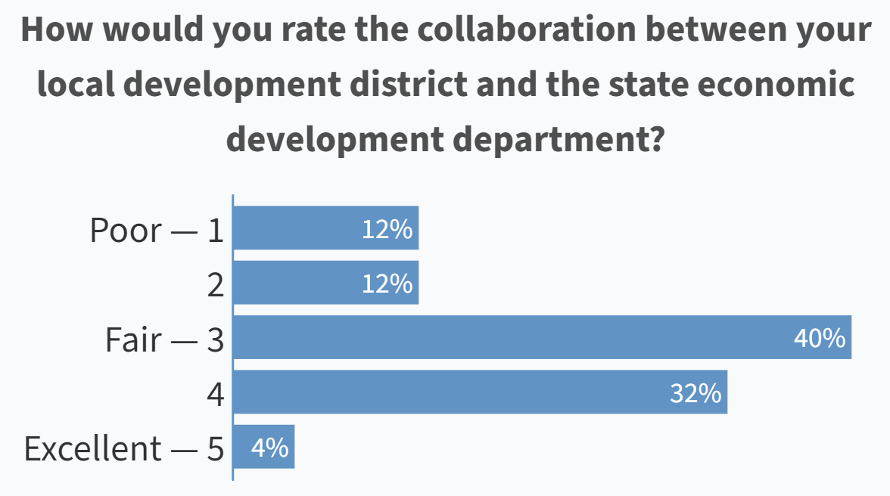
State Partnerships – All Results
Notes:
Instructions to start live polling
- Go to https://www.polleverywhere.com/
- Login:
Username: mhagos@crec.net
Password: CRECEDA2021!
Under my activities, select ‘Enhancing State-Local ​Economic Development ​Planning and Engagement Survey’
Once the survey is up, select ‘Present’ (top right) to start the poll
The first slide is a progress slide, showing how many surveys are completed or underway. Use the arrows towards the bottom of the screen to advance to the next question (similar to a slide deck)
Building back better means investing in projects that will promote equity and develop local economies that will be resilient to future economic shocks and climate change.
Through the Statewide Planning, Research & Networks program, EDA is supporting states in planning efforts by allocating $59 million for Statewide Planning Grants.
In addition, the program will allocate $31 million for Research and Networks Grants to invest in research that assesses the effectiveness of EDA’s programs, and provides support for stakeholder communities around key EDA initiatives.
If you or anyone in your regional network are collaborating or have collaborated with your state as they consider how to use EDA's $1 million grant per state for economic development planning, please contact me….

Slide 12
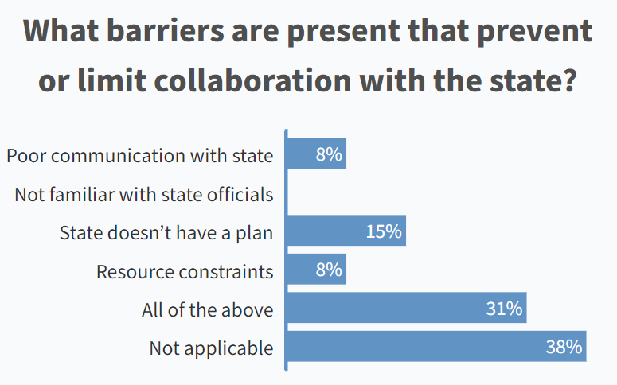
State Partnerships – Poll Time
Notes:
Instructions to start live polling
- Go to https://www.polleverywhere.com/
- Login:
Username: mhagos@crec.net
Password: CRECEDA2021!
Under my activities, select ‘Enhancing State-Local ​Economic Development ​Planning and Engagement Survey’
Once the survey is up, select ‘Present’ (top right) to start the poll
The first slide is a progress slide, showing how many surveys are completed or underway. Use the arrows towards the bottom of the screen to advance to the next question (similar to a slide deck)
Building back better means investing in projects that will promote equity and develop local economies that will be resilient to future economic shocks and climate change.
Through the Statewide Planning, Research & Networks program, EDA is supporting states in planning efforts by allocating $59 million for Statewide Planning Grants.
In addition, the program will allocate $31 million for Research and Networks Grants to invest in research that assesses the effectiveness of EDA’s programs, and provides support for stakeholder communities around key EDA initiatives.
If you or anyone in your regional network are collaborating or have collaborated with your state as they consider how to use EDA's $1 million grant per state for economic development planning, please contact me….

Slide 13
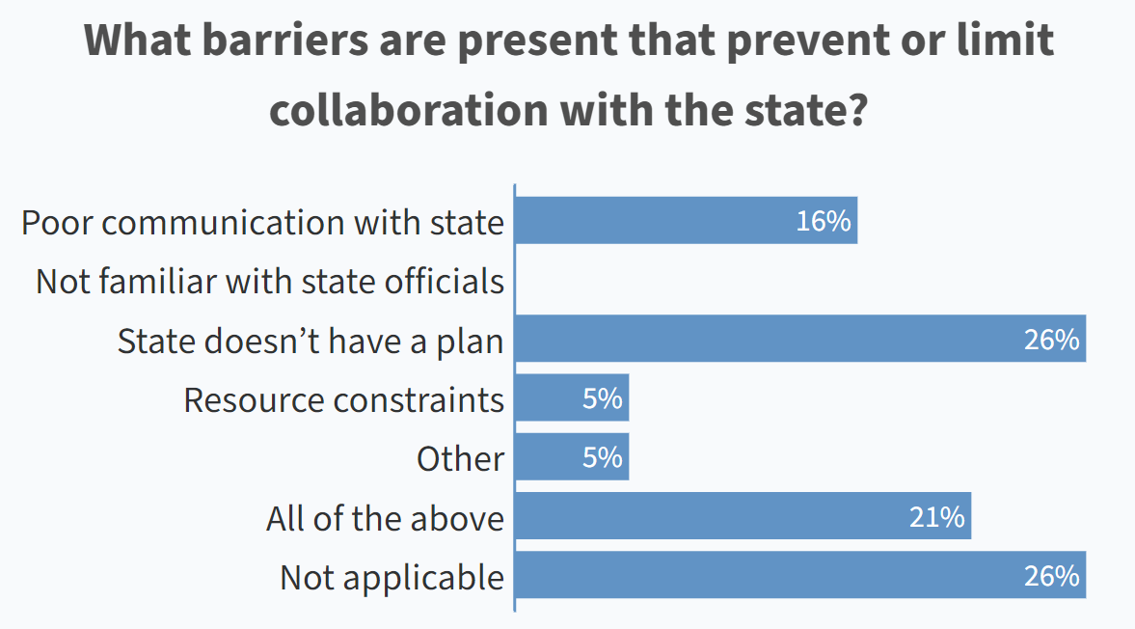
State Partnerships – All Results
Notes:
Instructions to start live polling
- Go to https://www.polleverywhere.com/
- Login:
Username: mhagos@crec.net
Password: CRECEDA2021!
Under my activities, select ‘Enhancing State-Local ​Economic Development ​Planning and Engagement Survey’
Once the survey is up, select ‘Present’ (top right) to start the poll
The first slide is a progress slide, showing how many surveys are completed or underway. Use the arrows towards the bottom of the screen to advance to the next question (similar to a slide deck)
Building back better means investing in projects that will promote equity and develop local economies that will be resilient to future economic shocks and climate change.
Through the Statewide Planning, Research & Networks program, EDA is supporting states in planning efforts by allocating $59 million for Statewide Planning Grants.
In addition, the program will allocate $31 million for Research and Networks Grants to invest in research that assesses the effectiveness of EDA’s programs, and provides support for stakeholder communities around key EDA initiatives.
If you or anyone in your regional network are collaborating or have collaborated with your state as they consider how to use EDA's $1 million grant per state for economic development planning, please contact me….

Slide 14
State Partnerships – Poll Time
Notes:
Instructions to start live polling
- Go to https://www.polleverywhere.com/
- Login:
Username: mhagos@crec.net
Password: CRECEDA2021!
Under my activities, select ‘Enhancing State-Local ​Economic Development ​Planning and Engagement Survey’
Once the survey is up, select ‘Present’ (top right) to start the poll
The first slide is a progress slide, showing how many surveys are completed or underway. Use the arrows towards the bottom of the screen to advance to the next question (similar to a slide deck)
Building back better means investing in projects that will promote equity and develop local economies that will be resilient to future economic shocks and climate change.
Through the Statewide Planning, Research & Networks program, EDA is supporting states in planning efforts by allocating $59 million for Statewide Planning Grants.
In addition, the program will allocate $31 million for Research and Networks Grants to invest in research that assesses the effectiveness of EDA’s programs, and provides support for stakeholder communities around key EDA initiatives.
If you or anyone in your regional network are collaborating or have collaborated with your state as they consider how to use EDA's $1 million grant per state for economic development planning, please contact me….

Slide 15


Thank You!
Bob Isaacson
bisaacson@CREC.net
Questions?
Notes:
Add note to this slide

