Slide 1
Deploying our way to a Clean Energy Future

Slide 2
Critical Minerals for Electric Vehicles and Clean Energy Technologies
2

Slide 3
Innovation and Infrastructure
research and development
deploy, deploy, deploy!

Slide 4
$550 billion in new spending ($1.2 trillion total authorization) is the largest long-term investment in our infrastructure in nearly a century.
Transportation:
Manufacturing:
Devotes $42 billion to strengthen
ports, airports, and rail
Appropriates $110 billion for roads and bridges
Invests more than $750 million in electric vehicle and sustainable transportation initiatives
Invests > $7 billion in batteries supply chain
$750 million to support clean energy
manufacturing and recycling
Buy America provision to build infrastructure projects with American iron, steel, and construction materials.
Clean Energy Demonstrations:
Broadband:
$8 billion for clean hydrogen
>$10 billion for CCUS, direct air capture, industrial emission reduction
$2.5 billion for advanced nuclear
Appropriates $42.45 billion for reliable high-speed internet across the country
Resilience and Longevity of the Grid:
High Quality Jobs
Invests $11 billion to enhance grid resilience
Provides $1 billion for modernizing
electric generation facilities
Expected to create nearly half a million manufacturing jobs
>80% of funding covered by prevailing wage
provisions. ~75% of jobs do not require an
advanced degree.
4

Slide 5
Largest climate and clean energy investment in American history
Provides 10 years of certainty and support to manufacturers, installers, and investors
Focused investment in energy communities and historically underserved communities; specific benefits for low- and middle-income consumers
Delivers a historic focus on domestic job creation with strong incentives for prevailing wages and apprenticeships
Expected to reduce greenhouse gas (GHG) pollution to ~40% below 2005 levels by 2030
Saves American families thousands of dollars in home and transportation energy costs

Slide 7
Goals for Funding Opportunities
Equitable access to wealth building opportunities
Benefit disadvantaged communities
Impacted workers and communities have a voice throughout the process
Good jobs and career-track training

Slide 8
Justice40 Disadvantaged Communities
Where are the disadvantaged
communities (DAC)?
Community can be either:
people in geographic proximity or
people experiencing a common condition.
Disadvantage was measured based on a score across 36 indicators.
Census tracts with at least 30% low- income households and disadvantage scores higher than 80 percent of those in their state are DACs.

Slide 9
40209 Energy Communities
Live Map Link
PROCUREMENT SENSITIVE – DOE INTERNAL DOCUMENT

Slide 10
DOE’s Office of Manufacturing & Energy Supply Chains, in context
Under Secretary for Science and Innovation (S4)
Under Secretary Demonstration & Deployment (S3)
Research & Development focus
Includes EERE, OE,
and SC
Demonstration & Deployment focus
Includes OCED, LPO, and MESC

Slide 11
MESC’s Place in the DOE Ecosystem
DOE Innovation, Demonstration, Manufacturing Landscape
Basic Research
Applied Research and Development
Large-Scale
Demonstration
Manufacturing
Basic Energy Sciences (BES)
Fundamental
research
Applied Research Programs (EERE, FECM,…) Applied Research and Development | Office of Clean Energy Demonstrations (OCED) Large-scale clean energy demonstration projects accelerate market adoption and deployment of technologies | Loan Program Office (LPO) Debt financing for the commercial deployment of large-scale energy projects to support U.S. manufacturing
Advanced Manufacturing Office (AMO) Innovative manufacturing technology RD&D
 | Office of Manufacturing and Energy Supply Chains (MESC) Support Scale-Up and Deployment of manufacturing infrastructure critical to the Nation’s energy supply chains
s Research Agency–Energy (ARPA-E) ” Transformational R&D
Advanced Project
“Off-roadmap

Slide 12
MESC Distinctives
Mission: Strengthen and secure domestic clean energy and manufacturing supply chains
Objectives: Catalyze resilient and sustainable energy sector industrial base (ESIB)
Scale-Up and Deployment of new manufacturing infrastructure to fill critical ESIB gaps
Support Manufacturing Facility Upgrades to achieve ESIB decarbonization Goals
Bolster small and medium manufacturing enterprises and support communities in energy transition.
Develop domestic manufacturing clean energy workforce capabilities and resources

Slide 13
MESC Distinctives
Mission: Strengthen and secure domestic clean energy and manufacturing supply chains
Install Critical Supply Chain Manufacturing Capacity
Reduce Industrial Base Carbon Emissions
Increase Clean Energy Jobs
~$6B – battery supply chains
~$6B – industrial decarbonization
~$10B – ITC (48c)

Slide 14
Industrial Assessment Centers (IAC) Program
For more than four decades, the federal government has worked with four-year IHEs through the IAC Program to:
Provide technical assistance to small- and medium-sized manufacturing firms in areas including energy efficiency, smart manufacturing, cybersecurity, and more
Train the next generation of energy- savvy engineers

Slide 15
Background: Battery Supply Chain and BIL, IRA, DPA
BIL | IRA
BIL FOA 2678
Sec. 40207(b) Battery Material Processing Grants
Total $3 Billion Federal over 5 years
2022 FOA: $1.5 Billion Federal (matched by Applicant)
Sec. 40207(c) Battery Manufacturing and Recycling Grants
Total $3 Billion Federal over 5 years
2022 FOA: $1.6 Billion Federal (matched by Applicant)

Slide 16
ESIB: Supply Chain Modeling and Analysis
Provide a comprehensive and upgradeable framework for modeling and analysis
Current modeling and analysis is disparate and focused on individual needs in programmatic areas
Example Modeling Framework: SMART Mobility
Typically sponsored by technology offices in individual areas
Often emphasizes R&D instead of manufacturing supply chain and strategic investments
Key supporting work to set priorities and direction
Supply Chain Analysis
Supporting models, data, and analysis for energy related minerals, materials, and components
Produced
Sub-
Materials
components

Slide 17
Thank you!
Zack.Valdez@hq.doe.gov

Slide 18
Clean Energy Infrastructure Stakeholders
Communities
States and Tribes
Utilities
Industry
Manufacturers
Non-profits
Universities
K-12 Schools

Slide 19
Infrastructure Projects Create Jobs and Local Benefits
Creating good jobs and boosting energy supply chains and domestic manufacturing
Advancing world- class, next generation clean energy technology demonstrations
Lowering energy bills for households and businesses
Making the energy system more secure, reliable, and resilient
GROWING THE CLEAN ENERGY ECONOMY

Slide 20
Phase
Research & Development
Demonstration
Deployment
Diffusion
Occupations
Research
Design & Engineering
Construction, Installation, Manufacturing,
Production, Repairs, Operations & Maintenance,
Sales & Service
Who is the Clean Energy Workforce?
Training
4-year or advanced degree, professional license
Technical degree, Apprenticeship, Certification
Clean Energy Corps #WHLatinoCSUSB

Slide 21
DOE’s Office of Manufacturing & Energy Supply Chains
Engage with ALL stakeholders
Develop clean domestic manufacturing
Create
Jobs
Energy Sector Industrial Base
Responsible for strengthening and securing manufacturing and energy supply chains needed to modernize the nation’s energy infrastructure and support a clean and equitable energy transition.

Slide 22
OCED Role Across Research, Development, Demonstration & Deployment
(RDD&D) Continuum
Technology Readiness Level (TRL)
RDD&D Steward
Basic and applied
research & experiments
[TRL 1-3]
Development & lab- scale prototyping
[TRL 4-5]
Pilot, sub and full- scale demonstration
[TRL 6-7]
Commercial-scale demonstration
[TRL 8]
At-scale long term commercial operations
[TRL 9]
Research
Development
Demonstration
Deployment
Office of Technology Transitions (OTT)
Science SBIR/STTR
ARPA-E
DOE Office FY22 Funding Map
Applied Offices
Loan Programs Office
OCE
Technical Risk
Project Risk
Market Risk
Risk Profiles
Technology Commercialization

Slide 23
Relevant Questions within Segment
Permitting, Mapping Extraction methods Community effect
Existing and emerging production Processing challenges
Existing and emerging production Manufacturing methods
Manufacturing methods usage
Design-for- recycling Logistics
Mapping the lithium-ion battery supply chain
Critical Minerals
Sub Components
System or
Applications
Material
Components
Devices
Lithium Nickel Cobalt Silicon Graphite Copper
Refined materials Active materials High-grade metal films
Electrodes Electrolytes Films Separators
Battery cells
Battery packs Fuel cell
Electric vehicles Grid storage Electric flight Other transportation
Refining, Processing, or Qualifying
MaMnuafnaucftaucritnugring
MaMnaunfaucftaucrttiunrging
IncIonrcpoorpraotrioantion
Processing or Qualifying
Cross-cutting Questions/Concerns

Slide 24
DOE’s Office of Manufacturing
Research &
Development
Demonstration
& Deployment

Slide 25
Executive Order 14017: America’s Supply Chains
(February 2021–2022)
Deep-Dive Assessment Report Topics
Carbon capture materials
Electric grid including transformers and high voltage direct current
Energy storage
Fuel cells and electrolyzers
Hydropower including pumped storage
hydropower
Neodymium magnets
Nuclear energy
Platinum group metals and other catalyst
Semiconductors
Solar photovoltaics
Wind
Commercialization and competitiveness
Cybersecurity and digital components
DOE released 14 reports on the energy sector supply chains, including 13 issue- specific deep dive assessments and an overarching strategy report
“America’s Strategy to Secure the Supply Chain for a Robust Clean Energy Transition” is the first-ever comprehensive
U.S. government strategy to secure our domestic energy supply chains and an Energy Industrial Base
Lays out dozens of critical strategies and actions to build secure, resilient, and diverse domestic energy supply chains
Part of a larger whole-of-government
^{approach on supply chai}h^{n}t^{s}tps://www.energy.gov/policy/ securing-americas-clean-energy-supply-chain
25

Slide 26
Manufacturing & Energy Supply Chain BIL Funding
Facility and Workforce Assistance: Address regional manufacturing and supply chain challenges and train the next generation of energy engineers
Industrial Assessment Centers, Expansion, and Implementation ($550M)
Manufacturer/Industrial/ Recycling Grants in Distressed Communities ($750M)
State Manufacturing Leadership ($50M BIL)
Battery and Critical Materials: Support Scale-Up and Deployment of manufacturing
infrastructure critical to the Nation’s energy supply chain
Battery Manufacturing, Material Processing, and Recycling (>$6B)
Rare Earth Element Demo Facility ($140M)
Energy Sector Industrial Base: Assess and identify national and regional energy sector supply chain gaps and challenges, and strategies to address those issues
Transformer and EPS Rebates ($20M)

Slide 27
Inflation Reduction Act (IRA)
Various provisions to support domestic materials sourcing and battery production, including credits for clean vehicles with domestic content, and other provisions that can help increase the number of vehicles that qualify and are designed to support domestic materials sourcing and battery production themselves.
Grants:
$2 billion in Domestic Manufacturing Conversion Grants to support the transition of domestic manufacturing facilities to manufacture EVs, hybrids, and hydrogen fuel cell vehicles
$6 billion to reduce emissions from energy intensive industries and support the greatest GHG reduction benefit & greatest benefit to largest number of people
Credits:
A new Advanced Manufacturing production tax credit is created for battery components and
critical minerals, along with other critical technology component categories
The new and expanded Advanced Energy Project Credit credits up to 30 percent of the qualified investment in property used in a qualifying advanced energy project.

Slide 28
Decarbonizing Is Part Of a Broader Approach
Affordable
Affordable (for consumers) and competitive for industry by supporting economy/jobs
Meet Everyone’s Needs
Reliable energy solutions for people and goods recognizing diverse needs of different communities and stakeholders
Environmental Quality
High quality local air and water in addition to GHG emissions

Slide 29
National Blueprint for Lithium Batteries
By 2030, the United States and its partners will establish a secure battery materials and technology supply chain that supports long-term U.S. economic competitiveness and job creation, enables decarbonization goals, and meets national security requirements.

Slide 30
Identifying Battery Supply Chain Criticalities
Lithium Hydroxide
Impact of supply disruption
Separator
Binder
Copper Foil Lithium Electrolyte
Coating machines Assembly equipment
Graphite
Lithium Carbonate
Manganese
Ni-Rich Cathode
Fluorine
s
Class I
Nickel
LFP Cathodes
Nickel
Cobalt
Battery materials
Silicon Anodes
Lithium metal foil
Testing machines
Battery components
Manufacturing
equipment
Criticality Regime
Supply
Risk

Slide 31
Critical Minerals Institute – DOE National Labs
Expanding sources, transformative processes, new uses
Diversifying Supply
for co-products
Synthesize materials that meet needs, use less
Developing Substitutes
Available materials more efficiently, reducing waste in mfg. processes
Driving Reuse and Recycling
Research tools to forecast future critical minerals
Crosscutting Research

Slide 32
Supply Chain Adventures
January 31, 2023
HELPING WISCONSIN MANUFACTURERS GROW.
Buckley Brinkman

Slide 36
Of course…

Slide 37
The Pandemic taught us…
The danger of long supply chains originating in unfriendly places
Our addiction to lower prices over secure supply
Difficulty of coordinating multi-state initiatives Supply Chains don’t recognize state borders
Ultimately → Resilience = Flexibility

Slide 38
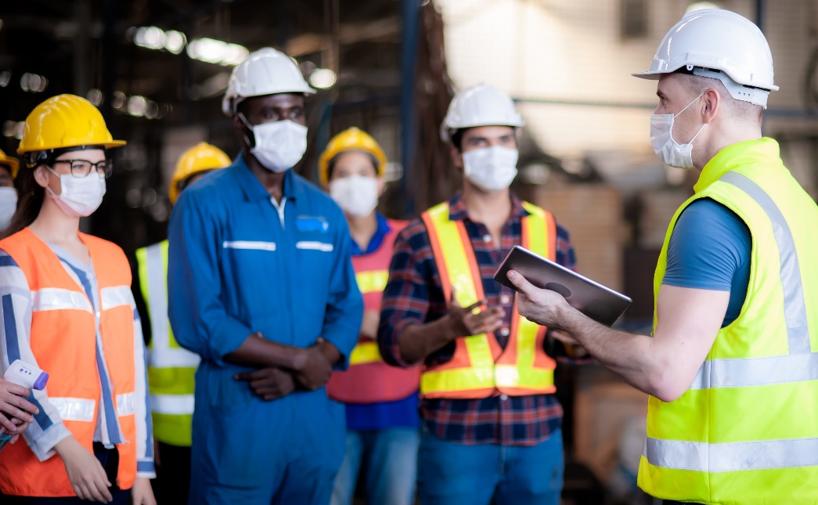
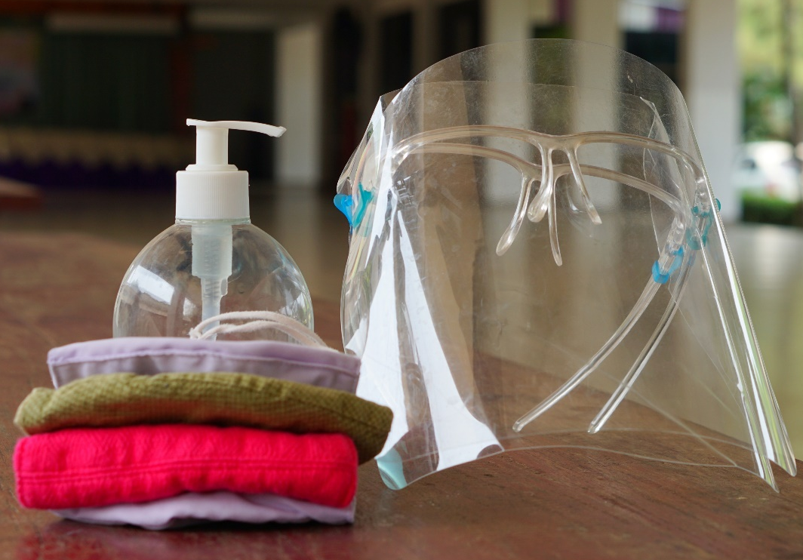
Short-Term: Engage & Pivot

Slide 39
Long-Term: Reshore/Nearshore/Friendshore

Slide 40
Manufacturing = Innovation
“As the manufacturing process becomes more complex, new chip designs require tight coordination with fabrication processes to ensure manufacturability. The challenge of moving designs and R&D to commercial production, sometimes called the “lab to fab” problem, threatens to shut out smaller firms and startups, deterring innovation.”

Slide 41
Resilience = Flexibility
Small- and Medium-sized Manufacturers make up 98% of the U.S. manufacturing base
These manufacturers form the backbone of most domestic supply chains
Critical to keep SMMs strong
That’s the MEP mission!

Slide 42
Thank You!
Buckley Brinkman
brinkman@wicmp.org (608) 729-4160

Slide 43
State Role in Supporting Short-Term Economic Dynamism to Respond to Shortages
Nikhil Kalathil, M. Granger Morgan, Erica R.H Fuchs
1/31/23
nkalathi@andrew.cmu.edu
For more information see:
Kalathil, Morgan, Fuchs, 2023, “ Short-Term Economic Dynamism as a Policy Tool to Address Supply Shortages During Crises”, Working Paper
Notes:
Thank you! Today, I am going to talk about how states can support the rapid entry and expansion of firms into new product spaces, or what we call short-term economic dyansism, as a tool to address supply shortages during a crisis. State economic development actors can be especially helpful in accelerating how quickly small and medium sized firms can retool and pivot production, as well as helping them find high-volume sales channels to help alleviate shortages.

Slide 44
Nations face a variety of options to ensure access to critical supplies
Leveraging economic dynamism may have unique advantages during global crises
Possible Strategies:
Pros:
Cons:
Ready access to supplies if needed
Strategic restocking can support industrial base
Opportunity cost
Supplies expire
Ill-matched to novel needs
May be insufficient in scale
Stockpile Resources
Rely on established firms making product
Expert, trusted sources
May be able to respond quickly (stress tests)
Defense Production Act
International supplies may be inaccessible (e.g. global shortages, geopolitical crises)
Dependency on select firms
Existing scale(-up) insufficient
Economic Dynamism
May add capacity
May diversify the source of supply, reduce market or geopolitical power issues
Novel ideas, approaches
Unvalidated sources
Difficult to coordinate
Time delay in standing or scaling up new production
- Existing Companies
- De Novo Firms
Notes:
During crises, nations need reliable and timely access to critical supplies, especially health and safety critical products, and have three traditional strategies they can pursue to ensure access.
Stockpiling resources may allow for ready access to supplies and strategic restocking can help support a robust industrial base, however there is an inherent opportunity cost in the decision of what to stockpile, where resources may expire, be ill matched to novel needs, or insufficient to scale.
A country may be able to rely on established firms already manufacturing products of interest to ramp-up or onshore production, ensuring that supplies come from experienced sources. This strategy risks dependency on a few, select firms, whose supply could be inaccessible or insufficient.
A third underexplored and undersupported option, is the role that economic dynamism, or the entry and expansion of frims in other markets entering into products experiencing shortagess. Such entry can be accomplished by existing firms or new entrants, and may offer benefits in the form of additional capacity, diversification of supply, and introduction of novel ideas and approaches. Firm entry and expansion, however, takes time, can be difficult to coordinate, and involves potentially unvalidated sources.
In this talk, I am going to focus on the role of short-term economic dynamism in alleviating shortages during a crisis, and how states can support and accelerate such economic dynamism.

Slide 45
Missing from current playbook: the role of short-term economic dynamism in responding to product shortages
Crisis playbooks focus on stockpiling, DPA, stress testing
(Huang et al., 2017, CRS, March 2020, Handfield et al., 2020, CRS, June 2020, Simchi-Levi and Simchi-Levi, 2020)
Economic dynamism focuses on long-term business/product cycles, growth
(Decker, Haltiwanger, Jarmin, and Miranda, 2014, Gordon, 2016, Agarwal, Sarakr, and Echambadi, 2002; Klepper 2002)
Role of state support for manufacturers focuses on responding to technological shocks, new organizational paradigms
(McEvily and Marcus, 2005; Whitford and Zeitlin, 2004; Brandt and Whitford, 2017; Helper and Stanley 2010)
New concept: short-term economic dynamism
the rapid entry and expansion of firms into product areas experiencing shortages
Notes:
The role that short-term economic dynamism can play in alleviating shortages is underexplored in the literature, and undersupported by federal policy. Traditional crisis playbooks focus on stockpiling, using the defense production act, or stress-testing in advance of a crisis. Similarly, existing research on economic dynamism focuses on firm entry and exit over long-term business and product cycles, and contributions of such entry, expansion, and exit to productivity and growth. Work on state and EDO support for manufacturers focuses on responding to technological shocks and new organizational paradigms. We introduce a new concept: short-term economic dynamism, or the rapid entry and expansion of firms into product areas experiencing shortages. Using the case study of manufacturing critical medical supplies in response to the COVID-19 pandemic, I am going to talk about how small and medium sized firms played an important and underappreciated role in alleviating shortages, and how state support can accelerate and amplify the efforts of such firms, contributing to resilient, flexible regional supply chains.

Slide 46
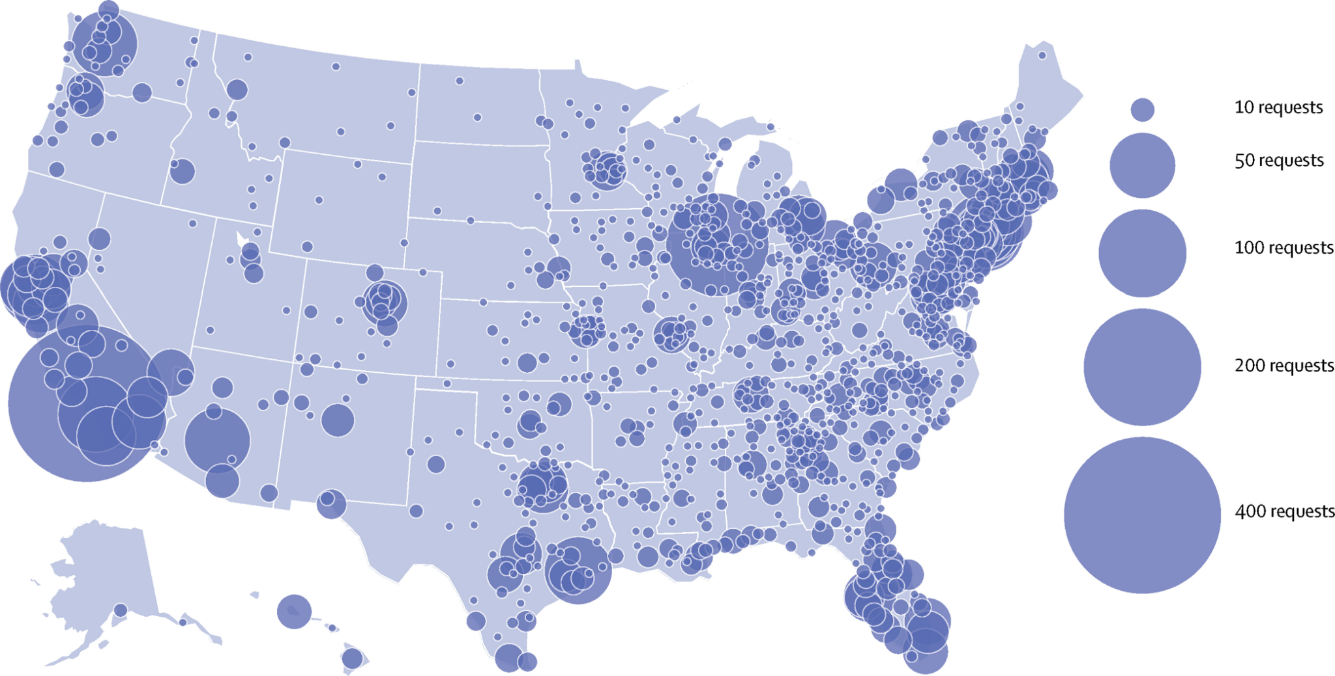
An unprecedented spike in domestic AND global demand led to shortages of critical medical supplies, and unreliable imports
Requests for Personal Protective Equipment by County (May, 2020)
GLOBAL DEMAND
SPIKES
ACCESS to GLOBAL SUPPLY FALLS
(export restrictions)
U.S. Pre-Pandemic:
80% of PPE Imported
NEW DOMESTIC PRODUCTION CAPACITY NEEDED
Gondi, et al., 2020. “Personal Protective Equipment Needs in the USA During the COVID-19 Pandemic” The Lancet, DOI:https://doi.org/10.1016/S0140-6736(20)31038-2
Notes:
In the early months of 2020, the onset of the COVID-19 pandemic caused an unprecedented spike in domestic and global demand for medical supplies. Across the US, by May, more than 6,000 organizations had submitted PPE requests, with more than 8500 requests for N95 respirators and surgical masks.
Normally, the US would import additional supplies to bridge this gap, however, the global nature of the pandemic meant that every nation was facing the same problem. States in particular had to scramble to secure access to personal protective equipment, often paying large sums for goods that never materialized.
In China, by March of 2020, factories were running at 20x the previous year’s volume, and were still struggling to meet national, let alone global demand. Countries began implementing export restrictions, and in the U.S. with 80% of PPE being imported prior to the pandemic, new production capacity was needed to meet these critical supply shortages.

Slide 47
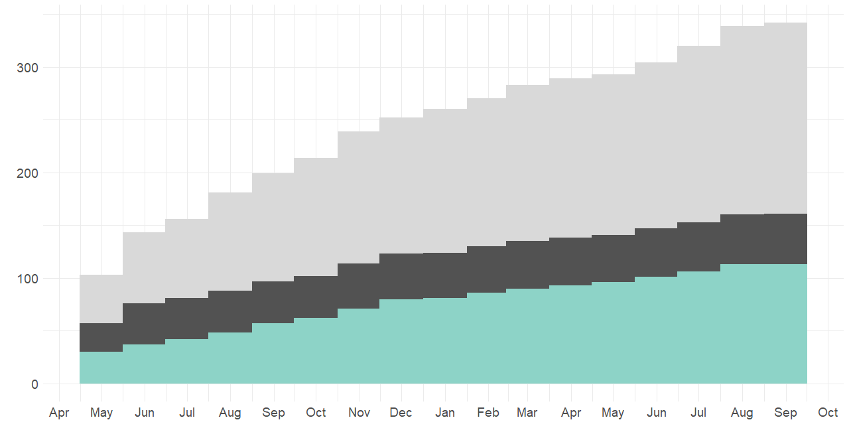
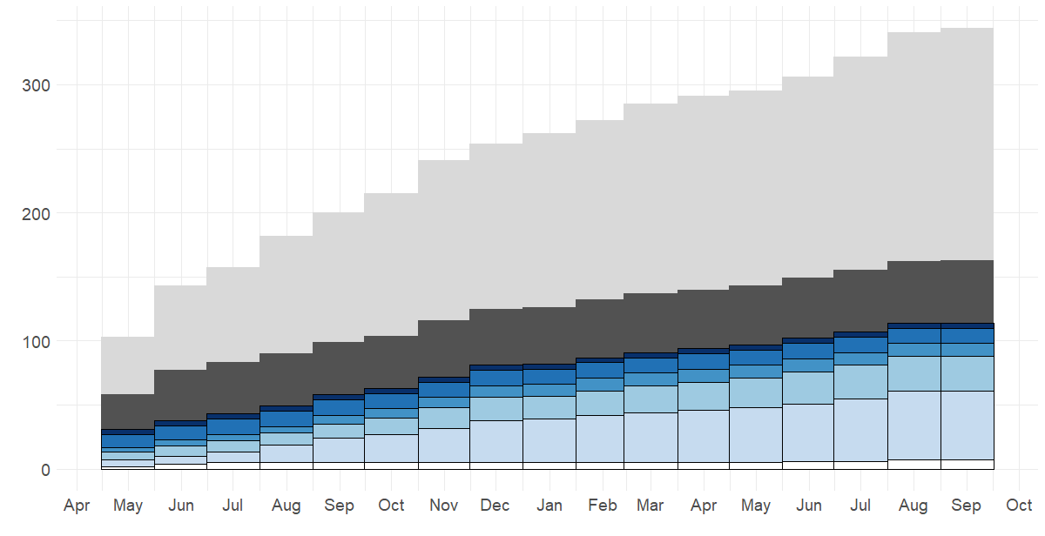
Significant number of SME firms enter industry in response to shortages
Intense Supply Shortages
Supply Normalizing
Imports Resume
In June, 2020, capacity estimates of just 7/18 SME manufacturers added ~ 10-20% to White House estimated capacity
Medical Masks and Respirator Suppliers
(Self-Reported)
Non-US Manufacturers
1B+
50M- 1B
10M-50M
1M to
10M
An.
Sales:
($)
Under 1M
Confirmed. U.S Located Manufacturer
NA
[ -------------------------------2020 -----------------------------]
[ -------------------------------2021 ------------------------------]
Source: Thomasnet.com
Notes:
Using the industrial sourcing platform Thomasnet.com, we were able to identify, in real-time, small and medium sized firms as they entered into production of surgical masks and respirators in response to the needs of the pandemic. As of June 2020, capacity estimates from just 7 out of the 18 small and medium sized manufacturers we were able to identify added 10-20% to White House estimates of US manufacturing capacity, which focused on the efforts of large, medical manufactures and ignored the contributions of these small and medium sized firms.
Only some of the firms on Thomasnet.com had us domestic manufacturing facilities, but state economic development networks could easily verify which listed firms are confirmed US manufacturers, allowing for easy identification, and ultimately support, for small and medium sized firms as they pivot their production in response to product shortages.

Slide 48
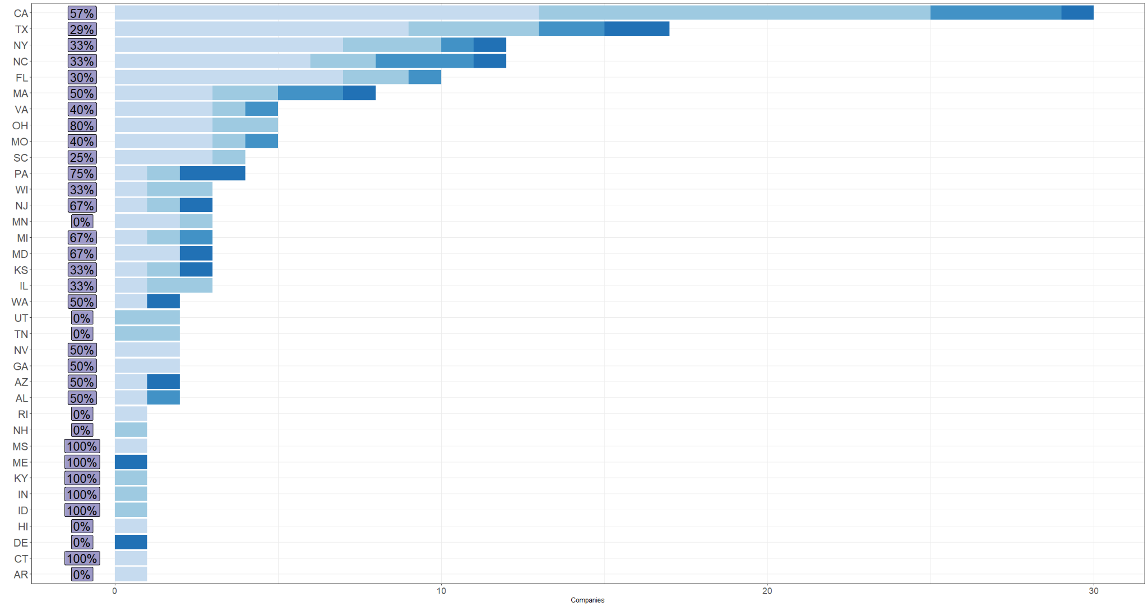
Why did entry by SMEs across states vary so much?
Reg apprv.
Under $1M
$1M to $10M
$10M - $50M
$50M-$1B
Notes:
However, entry by small and medium sized firms varied substantially across states. At the top of this graph, we see large economies such as california and texas having the highest number of entering firms, however we also see smaller states such as north carolina, MA, missouri, and pennsylvania having an impressively high number of small and medium firms entering into production of masks and respirators.
Our research suggests that state economic development networks played an important role in helping small and medium sized firms re-tool in response to the pandemic, and contribute to alleviating shortages. As such variation in entry of firms across states appears to be related to how effectively state economic development networks were in aiding small and medium sized firms in navigating the challenges of entering and expanding into production of medical masks and respirators.

Slide 49
SMEs slowed by lack of knowledge, machines, certification $
Challenges
Access to funds
Lack of easily accessible information on how to make medical-grade masks
Machine Access: quality, shipping delays or costs, assembly and run knowledge, access to maintenance supplies
Commercializing and certifying novel products
Qualification and certificates: specification tests $75K-$100K; difficult getting FDA EUA or 510K approval, difficulty getting NIOSH approval
Sales: Breaking into mainstream hospital distributor supply chains, listing certifications on consumer sites
Notes:
Regardless of when they were able to operationalize, many of the small and medium enterprises in our sample experienced common challenges.
Companies were slowed by a lack of funds, such as one founder using his 401k savings to finance his operation.
Companies had difficulty accessing information on how to make medical grade masks, and faced major hurdles in access to machines. Most SME firms in our sample ordered their machines from China. While some used air freight to expedite the process, delivery of machines was slowed by cargo shipping delays. When the machines arrived, they were in pieces, and required creative engineering and problem solving to operationalize.
Companies also encountered difficulties in commercializing and certifying novel products, as both the market and regulators were not well positioned to rapidly absorb novel technologies.
In addition, qualification and certification costs and delays created a barrier for many companies, with companies struggling in getting NIOSH, FDA EUA, and/or FDA510K approval.
The most pervasive challenge faced by SME firms in our sample was in breaking into hospital purchasing systems, which were hesitant to turn to new suppliers. Firms also struggled to list products on retail sites such as Amazon, Etsy, and Google.

Slide 50
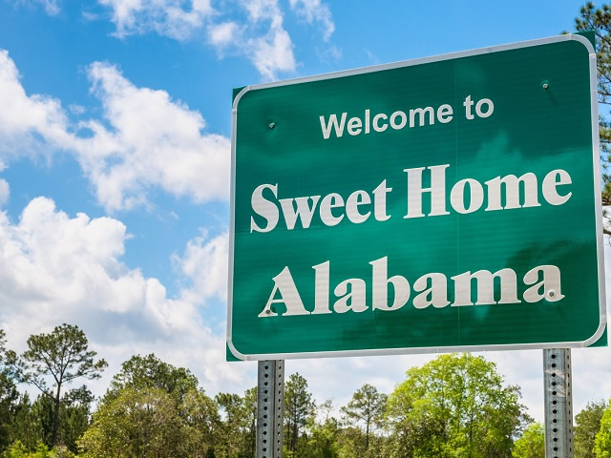
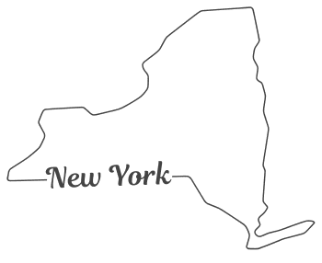
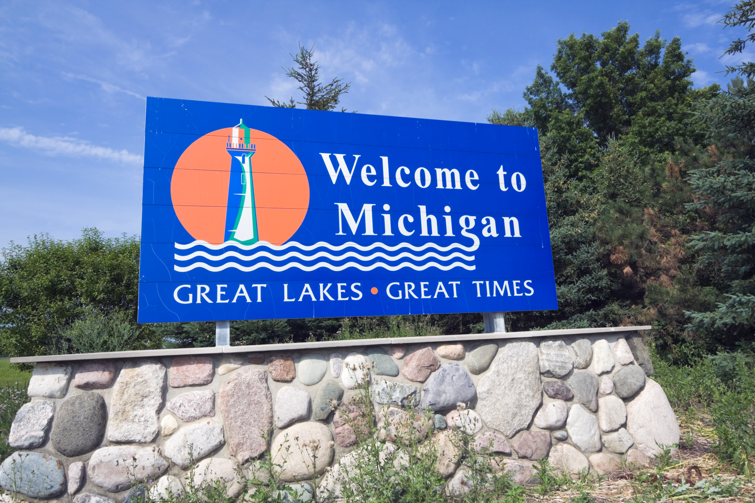
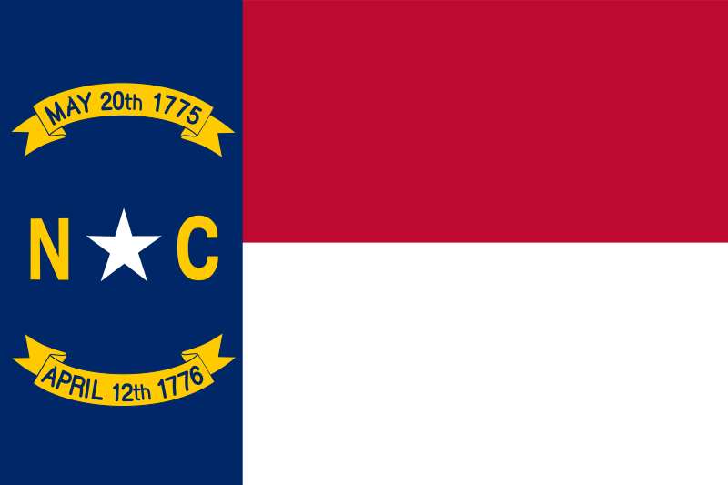
Effective state support: cross-region coordination, focus on leveraging & providing connections, filling missing capabilities, augmenting existing ones
More successful: AL, IN, NC
Less successful: NY, MI
Notes:
Effective state support was coordinated across regions, focused on leveraging existing knowledge of firms to connect firms appropriate partners, as well as helping these firms fill missing capabilities while augmenting existing ones, such as helping firms set-up and expand product lines, find workers, and distribute product to hospitals and other areas of demand.
Some of the more successful examples in our reserach were Alabama, Indiana, and North Carolina. Alabama was able to leverage a robust, existing economic development network based on strong regional economic development organizations that were able to identify firms well-position to respond to the crisis and connect them with state help. At the state level, Alabama coordinated effectively across the department of commerce and the department of health to identify the public health needs of the state as well as hospital requirements, and help manufacturers meet these requirements. They worked closely with companies that they identified, such as HomTex, and was able to support these firms in expanding product lines, building new factories, and finding workers.
Less successful examples in our research include states such as New York and Michigan. In the case of new york, each of new york’s five regions pursued a different strategy for supporting manufacturers, with some of them offering grants that manufacturers were unsure how to apply for. Even when manufacturers won some of these grants, funds were slow to arrive, delaying how quickly these firms were able to obtain necessary equipment and stand up a production line.

Slide 51
Support to improve firm outcomes should account for variation in size and firm connections, resources, & relevant competencies
Appropriate External Support
Large | Federal Government Trade + Manufacturing Policy | Federal Government Initiation/Push e.g. DPA, political pressure
Medium & Small | Federal Government Knowledge Aggregation/Brokerage e.g. central information, cost reduction, market brokerage/guarantee, regulatory adaptation
 | Regional Facilitation/Brokerage e.g. cost reduction, market brokerage/guarantee
 | Regional Upgrading e.g. provides raw material, regulatory assistance | Regional Augmentation e.g. funds or incentives for expansion
Firm Size
Federal Funding/Coordination
e.g. NIST MEP, Manufacturing USA, Dissemination of best practices
Regional Funding/Coordination
Connections, Resources
& Relevant Competencies
Notes:
Stepping back for a moment, our research highlights how support for short-term economic dynamism should account for variation in firm size, connections, resources, and relevant competencies. The federal government is best suited to supporting large manufacturers, either through the defense production act or other partnerships to coordinate production and distribution, or through government trade and manufacturing policy in advance of a crisis to build out domestic manufacturing capabilities.
For small and medium sized firms, the federal government can play a coordinating role in aggregating knowledge and brokering connections, as well as supporting regional actors through funding and dissemination of best practices. However regional economic development systems have an important role to play in augmenting the efforts of highly-resourced and competent firms when they are present, and upgrading the efforts of lower-resourced and less-well positioned firms if necessary. Importantly, the actions that regional actors should take varies with the intensity of shortages, with reliance and support on lower-resourced firms only occurring in cases of severe and extreme shortages.

Slide 52
Short-term economic dynamism is an important tool to meet product shortages during crises, state support important
State economic development networks can:
Before a crisis:
Foster cross-organizational transactive capacity (b/w manufacturing firms of different sizes, across different types of EDOs, across public/private entities)
Build knowledge of firm strengths/weaknesses
During a crisis:
Leverage federal government for central information, regulatory adaptation
Leverage brokerage network to ensure wise capital allocation, connect firms to markets, disseminate information
Notes:
Summarizing our work, short-term economic dynamism is an important component of flexible and resilient regional supply chains, and can alleviate product shortages during a crisis. State support for such short-term economic dynamism is particularly important for small and medium sized firms.
Before a crisis, state economic development networks can focus on building cross-organizaitonal transactive capacity, such as through fostering partnerships between manufacturing firms of different sizes, across different types of economic development organizations, and across public and private entities. Such efforts must focus on building knowledge of firm strengths and weaknesses and the ability to meet them where they are.
During a crisis, state EDOs should lean on the federal government for central information and regulatory adaptation to accelerate the certification and approval of small and medium firms, while leveraging their brokerage network to ensure wise capital allocation focused on augmenting firm investments, while connecting firms to markets and disseminating information to firms.
Thank you very much for your time, and please feel free to contact me with any questions

Slide 53
Acknowledgements and Thanks
nkalathi@andrew.cmu.edu
Funding for this project was provided by the Carnegie Mellon University College of Engineering Dean’s Fellowship, the Carnegie Mellon University Block Center for Technology and Society, the Northrupp Grumman Fellowship, CMU’s Critical Technology Moonshot, and the Bradford and Diane Smith Graduate Fellowship in Engineering
Thanks to the 56 manufacturers, government officials, and other individuals we interviewed for their time and insights
Thanks to the Fuchs Lab Research Group, the ISA conference, anonymous reviewers at Research Policy, and my colleagues and friends for feedback on this project

Slide 54
State support of surgical mask/respirator manufacturers highly uneven;
Cross Institution, Cross-Region, Cross-Agency Coordination & Relational Support
(Total Firms, M/R Firms [in Sample]) | Alabama (12, [2 in sample]), 1 Approved | Missouri (38, 11 [5 in sample]) 2 Approved | Washington (5, 1 [1 in sample, 1 in sample no assistance]), 1 Approved - Difficulty selling | New York (39 [12* in sample]), 4 Approved * = unmatched sample | North Carolina (40-60, [14* in sample]), 4 Approved *=unmatched sample
Use of Federal CARES act Funds | Support manufacturing re-tooling | Support manufacturing re-tooling | Not used for manufacturing retooling, difficult to distribute | Support manufacturing re-tooling; difficult to access, favored knowledgeable incumbents | Help companies navigate testing and regulatory process
Activities | Established two private-sector driven, government led task forces (procurement & business/manufacturing); worked to identify & validated companies that could pivot and work with companies to find resources, connected manufacturers to Alabama Hospital Association & placed Department of Health in charge of procurement for the state | Created a survey and spreadsheet to identify who could/was contributing to manufacturing PPE, partnered with Google to create a PPE marketplace, worked with a private consultant to run fusion cells to bring actors from across state government together. Worked to encourage state to procure from MO manufacturers | Created a survey and spreadsheet to identify who could/was contributing to manufacturing PPE, worked with NIST MEP center to create a safety plan to allow manufacturers to return to work quickly. Governor made promise: “if you make it we will buy it” but had difficulty in following through | Pursued a highly varied regional approach; established the Empire State Development Fund that provided manufacturers a grant to re-tool to produce PPE and medical supplies. City of New York ran operations through the Economic Development Cooperation which became a buyer for city hospitals, provided raw materials for manufacturers, some success in modified procurement rules but also hindered by inflexible procurement offices | Worked closely with emergency management services in early days of pandemic, coordinated between economic development institutions to provide informational & consulting services, leveraged local textile expertise to provide contract manufacturing/material assistance
Notes:
As discussed, state support of surgical mask/respriator manufactuers was highly even. Before diving into the state stories, I want to clarify that not all states chose to support local manufacturer retooling to specifically produce surgical masks and respirators. As such, we shouldn’t necessarily evaluate these results as an assessment of the state’s economic development and management capacity.
However, we do see that the states that were able to support surgical mask and respirator manufacturers were particularly competent at cross-isntitution, cross-regiona, and cross-agency coordination, along with relational support for manufacturers.
So we have five states that we talked to. In Alabama we spoke to the secretary of commerce, in Missouri the department of commerce, in Washington a joint conversation with department of commerce and the NIST MEP center, in New York the city economic development organization, and in North Carolina a NIST MEP center and an Economic development corporation.
Each group utilized Federal Cares money differently, and we also pursued highly heterogenous strategies that seem connected to the existing economic development ecosystem and industry clusters in that region.
Alabama did XX, Missouri did XX, Washington did XX, New York did XX, NC did XX (textile hub)

Slide 55
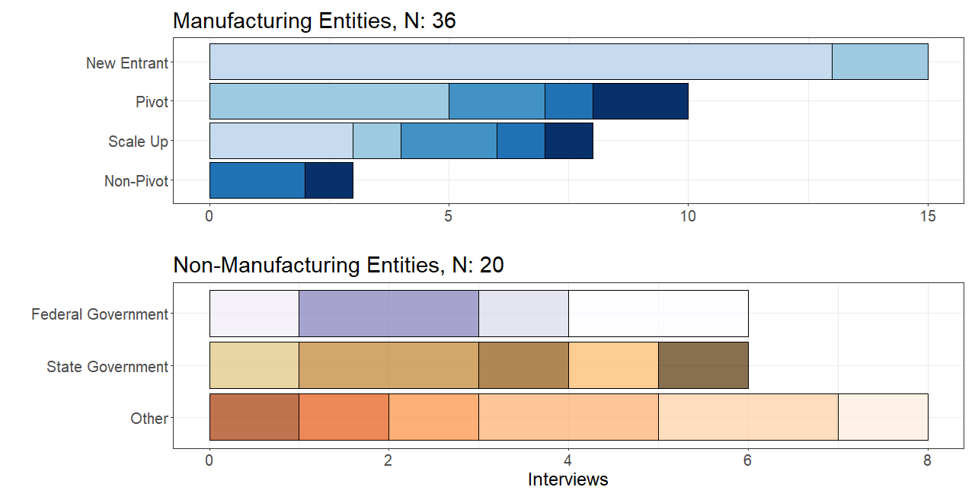
56 Semi-structured interviews Jan 2021 - Nov, 2021
(14% of industry sample, broadly representative in size & regulatory approval)
New Entrant
Annual Sales (D&B Hoovers Estimate): Under $1M
$1M to $10M
Diversifying firm
$50M-
$1B
$1B +
$10M-$50M
Incumbent
Existing & operational
manf. facility
No entry
FFRDC
Regulation: NIOSH
FDA
Response Coordination
WA
NC
AL
NYC
MO
EDO
Ind.
Assoc
Ind.
Data
Reg. Consultant
Testing/Support
Ind. Non-Profit
Notes:
We conducted 56 open-ended interviews totalling nearly 60 hours between January and October 2021. More than half of our interviews were with senior executives or founders of manufacturing companies. We note that our interviews represent 14% of our total sample of firms, and that the manufacturing entities that we interviewed were representative of this sample in terms of both size, location, and regulatory approval
We have interviews with entities that are new startups, pivoted production, or were existing companies in the space that scaled up production.
In our non-manufacturing entities, we have interviews with federal government officials in charge of response coordination, as well as regulatory approvals. We also interview state government officials and regional actors, including representatives from state departments of commerce, NIST MEP centers, regional economic development organizations, and industry observers.
Medium: 1-10M in annual ales
s
Altor, IFM, NFI, have 30-50 employees, compared to under 20 for most and under 10 most

Slide 56
State & Regional Economic Development and Assistance Ecosystems are Distributed & Fragmented, Often Unaligned
Governor's Office (Low Within Group Coordination)
State Level Department of Commerce, Health, etc.
Distribute Federal and State Funds Set State Strategies & Policies
Low coordination b/w entities
Some coordination b/w entities
State EDOs (High w/n Group Coordination)
MEPs, Economic Development Corporations
Interface with & support local businesses and manufacturers; Recruit companies
Regional EDOs & Other Organizations
Regional Non-Profits, Industrial Non-Profits & Associations, Universities
Set and execute regional strategies Coordinate multiple public & private entities; Coordinate with non-regional partners Provide resources, R&D, logistics, access to external capital, & other support
Notes:
Alabama (use all 3), NC (use bottom two), WA (use right), MO (use all three), NY (Use right)

Slide 57
How do regions mitigate the impact of supply chain disruptions?
State governments and small and medium sized enterprises (SMEs) are vulnerable to disruptions in global value chains
Large companies driven by clear demand signals might not be incentivized to respond to regional shortages
Traditional tools for nations to respond to critical shortages (stockpiles, reliance on existing manufacturers) might not be appropriate/available for states

Slide 58
State support for short-term economic dynamism as a foundation for resilient supply chains
Short-term economic dynamism: the rapid entry and expansion of firms into product areas experiencing shortages
Pros:
Cons:
Added capacity
Ability to respond to unforeseen challenges/retool as supply chains change
Novel ideas, approaches
Potentially unvalidated sources
Difficult to coordinate
Time delay
Less applicable for more complex products/less severe disruptions

Slide 59
State support for short-term economic dynamism as a foundation for resilient supply chains
Short-term economic dynamism: the rapid entry and expansion of firms into product areas experiencing shortages
State economic development networks can play a crucial role in supporting and potentially accelerating short-term economic dynamism, both before disruptions, and during
Brokerage and capital provision to fill missing capabilities, augment existing ones
Requires knowledge of firm capabilities, ability to meet them where they are

Slide 60
High variation in the effectiveness of support for manufacturers, little work on support for economic dynamism
SME firms heterogeneously benefit from state and regional institutional support, successful firms do well at leveraging external institutions
(Whitford and Zeitlen 2004, Helper and Stanley, 2010)
External support can help SME manufacturers to adapt to new shocks, technologies, organizational paradigms
(Chiung-Wen and Chiang, 2001; Helper and MacDuffie, 1997)
External support best when facilitating and encouraging collaborative relationships b/w and among suppliers - or, network formation
(McEvily and Marcus, 2005; Whitford and Zeitlin, 2004; Brandt and Whitford, 2017; Helveston et al., 2019)
States act independently of federal government (Hale et al., 2020), serve as laboratories for experimentation (Singerman, 2020; Morgan, 2017)
Effectiveness of support (and potentially type of support) dependent on structure & strength of existing manufacturing ecosystem (Reynolds et al., 2021)
COVID-19
Notes:
Using a novel data set of US domestic manufacturing entry into production of critical medical supplies (Kalathil, Morgan, and Fuchs, 2022) we can test the comparative efficacy of different state policies and regional ecosystems

Slide 61
Without external support, short-term economic dynamism depends on well resourced, highly competent local firms, still might not be enough
No regional capabilities
Large | No Entry / Market Failure | Rapid Network Re-Formation
Small | Network Failure | Medium Speed Novel Network Formation
Firm Size
Connections, Resources
& Relevant Competencies

Slide 62
Dynamic, networked SME firms fastest; augmenting government support useful
 | No State Support | Federal/State/Institutional Support
 |  | Assistance for capacity expansion (State Augmented) | Start-up financing (State Initiated)
 | Phase 1: Intense Shortages High resourced firms didn’t need help None - Firm Alpha* | Phase 1: Intense Shortages fastest firms enter or enter without state help, later benefit from state/federal assistance to expand AL - HomTex, NY - Altor Safety Fed - Amerishield, CA- Advoque* | Phase 2: Supply Normalizing Meltblown companies enter after prompted by the state (one ultimately exits) Indiana - IFM (Michigan - NFI)
 | Phase 2: Supply Normalizing New entrants with persistent founders and strong technical skills, (but may exit) Kona, RAMCO, Luosh, WMS (Breathe99) | Phase 2: Supply Normalizing One existing, innovative small company partnered with a large manufacturer to scale, later wins DLA award GSF/Avery Dennison One new entrant goes it alone and then uses state assistance to expand Missouri - Patriot | Phase 3: Imports Resume Funding too late NY - NYPPE, Ziel
Higher Connections, Resources, Relevant Competencies
Lower Connections, Resources, Relevant Competencies
Notes:
The SME firms that pivoted the fastest in our sample were well integrated into existing corporate networks, with existing access to substantial resources, including capital, expertise in highly automated manufacturing, and distribution. The green here represents the fastest firms that were operational in that first phase of intense supply shortages. The yellow represents firms that were operational in the second phase, where supply was normalizing between june and september of 2020. The red represents firms that were active in the final stage, where ready supply of cheap imports had resumed.
The fastest firms in our sample sometimes benefited from state support that augmented their efforts, in which state assistance helped the company expand their product lines. Our interviews with representatives from five states reveal five very different state economic development ecosystems, with a high degree of variation in the entity responsible for supporting manufacturers in retooling, and the strategy that entity employed.
In our sample, state initiated efforts had slower outcomes, for example, In New York, these two firms received the same grant that Altor safety did over here, but they needed the state funds to purchase machines, and thus were delayed substantially while waiting for those funds.

Slide 63
Building the Foundations of Flexible, Resilient Supply Chains
Before supply-chain disruptions occur
Monitor firm activity and product offerings through services such as Thomasnet.com
Connect firms to appropriate public and private entities to upgrade their existing capabilities
Engage in cross-organizational collaborations and initiatives, consider “stress-testing” inter-organizational responses
During supply-chain disruptions
Centralize information and best practices from across public and private actors, lower barriers to information (e.g. trusted equipment vendors, navigating regulatory certification)
Hold working groups and information sessions that bring together firms of different sizes with universities, state departments, other EDOs, etc.
Pair manufacturers organically entering into product spaces with distributors to ease market entry
If providing capital: coordinate funds at the state level (not regional), focus on rapid deployment to lower the cost of retooling (e.g. support equipment purchases, certification costs)

