Slide 1
Utah’s Statewide Planning Grant:
Relationships and Processes
Terrah Anderson
November 1, 2023
Notes:
Introduce myself, and Laura
The webinar will be focused on Planning due to your state's activities in this topic area:
Utah: Forming relationships and building on planning documents to inform current processes

Slide 2
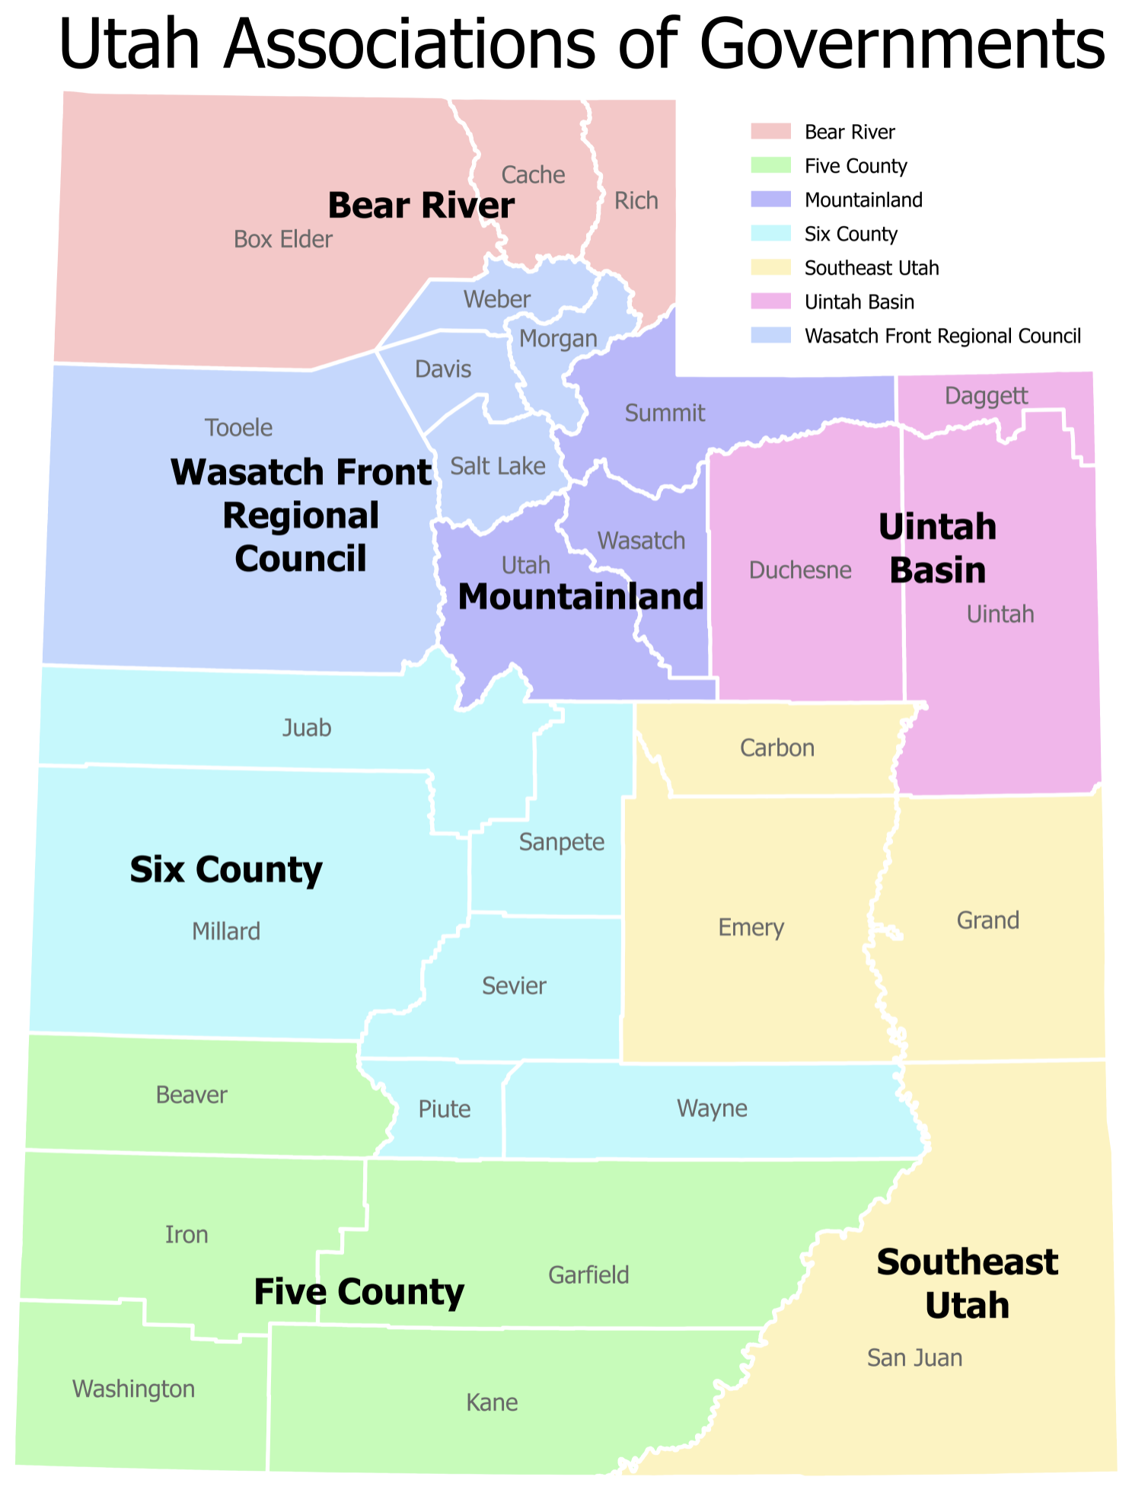
Project Overview - Two Parts
Subawards to Regional Governments
Statewide Planning Project
Utah’s Coordinated Action Plan for Economic Vision
2030
Notes:
Planning grant overview - two parts - and state landscape.

Slide 3
Subawards to Regional Governments
Projects in Seven Regions:
Disaster recovery coordinators
Freight study
Housing study and plans
Identifying capital improvement needs and develop action plans
Technical assistance
Technology assistance with GIS and zoning needs
Identify opportunities for grant eligible economic development projects
More data and metrics, dashboard for outreach
Notes:
Part 1: Scope of work menu - What does your region need most?

Slide 4
Utah’s Coordinated Action Plan for Economic Vision 2030
Align state, regional, and local efforts to accomplish local priorities through a comprehensive statewide economic development strategy
Notes:
Part 2: Coordinated Action Plan - goals, outcomes
AOG/EDD structure and state landscape and Statewide Planning Grant
Urban, rural, distinct regions;
Status of regional CEDS (all regions updating at the same time); desire to have a coordinated plan
Unified Plan: take advantage of the opportunity to have a statewide CEDS
All regions are updating their CEDS this year, great opportunity to think about a statewide CEDS - a statewide coordinated effort for economic development
Project partners: GOEO, regional associations of governments, consultants

Slide 5
Building Relationships - Players
Notes:
Highlight today: Relationships and Processes
Relationships:
You can see both parts of our project heavily involved our regional governments.
Great opportunity for building relationships with local leaders.
Utah is big! We were new at our positions, still new phase of relationships.
Opportunity to meet with rural leaders and community members
3 sets of on-site meetings in a one year period - defined purposes: First meeting: gather information/listen; Second meeting: share data/listen; Third meeting: Share strategies/listen
Buy in was crucial → Listen, listen, listen
Demonstrate willingness to learn and importance of project: Usually meetings are held virtually, they appreciated us travelling to be there in person.
Stakeholder interviews, communications about a business survey, stakeholder meetings, and procuring the subaward funding - all helped to communicate that we are interested in their success and success statewide
Previous administrations were not as focused on this. New governor’s background / emphasis→ new possibilities. Post-Covid, this was doable.

Slide 6
Building Relationships
Notes:
How we interacted

Slide 7
Building Relationships - Roles
Top down meets
State
Listen
Ask for input
Demonstrate interest and sincerity
Acknowledge local- initiated solutions
Provide resources
Regions
Provide data
Involve stakeholders
Arrange meetings
Increase inter-region connectivity
Provide insight on strategy feasibility
Bottom up
Notes:
Demonstrating genuine interest and concern; emphasizing we are there to listen and strategize together - top-down meets bottom up - Sweet spot / secret sauce. Utah Way
Emphasize this every meeting
Desire to understand local issues and economic development challenges and needs
Outcome: Foundational relationships for subsequent statewide and regional projects and organizational improvements where regional participation is critical for success.
For example: ROC, GOG, budget requests (Agripark), LAA - to increase coordination between regional and state govt

Slide 8
Building on Previous Work
Notes:
Our work doesn’t occur in a vacuum. Number one concern we had - don’t let this sit on the shelf like others. Built on these documents to help shape the questions we wanted to answer and governor and state priorities to focus on.
Relatively new Governor, State Planning Coordinator, employee, and Planning function back in Budget office. Lots of new pieces, but still foundations to build on.
-Laura - listening tour
-Economic Opportunity Commission - strong focus on statewide solutions / rural matters / collaboration. Unique! The Unified Economic Opportunity Commission develops, directs, and coordinates Utah’s statewide and regional economic development strategies. The commission informs policy decisions and builds consensus. Gov. Spencer J. Cox chairs the commission. It includes senior leaders from Utah’s legislative and executive branches, education, local government, and subject matter experts.
-Economic Vision 2030 document by UEOC and project partner Governor’s Office of Economic Development
-CEDS

Slide 9
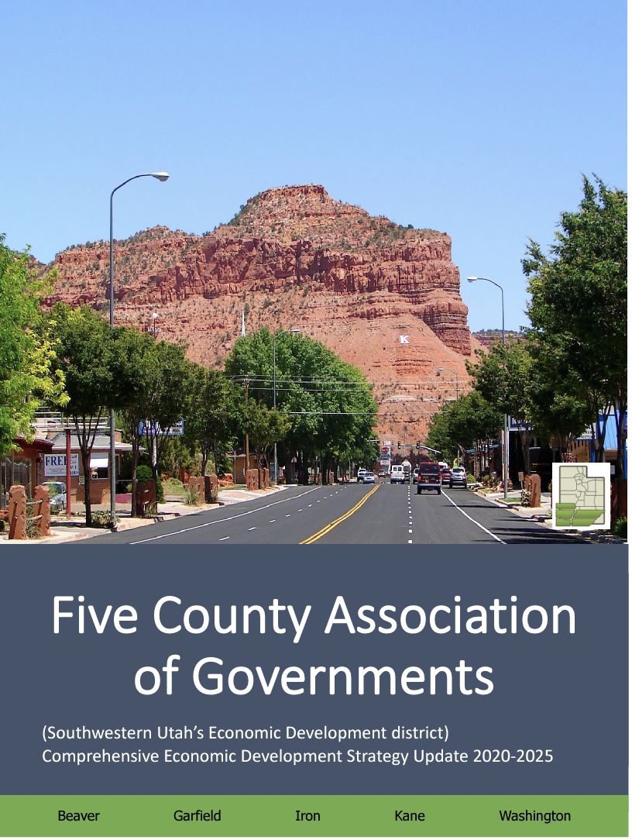
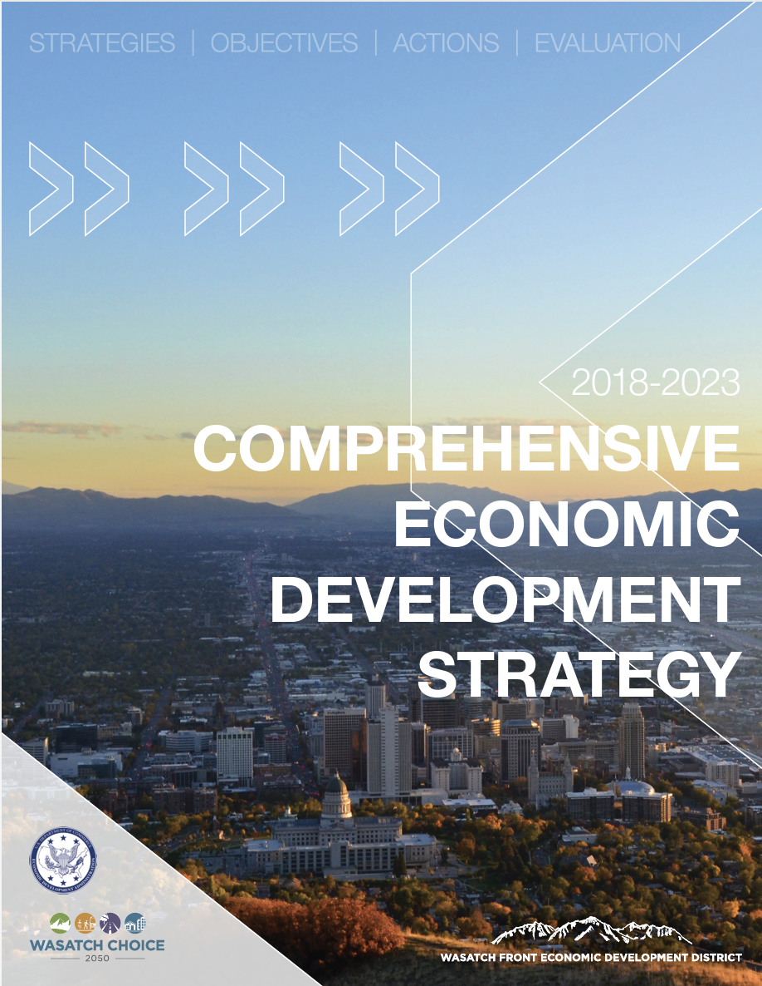
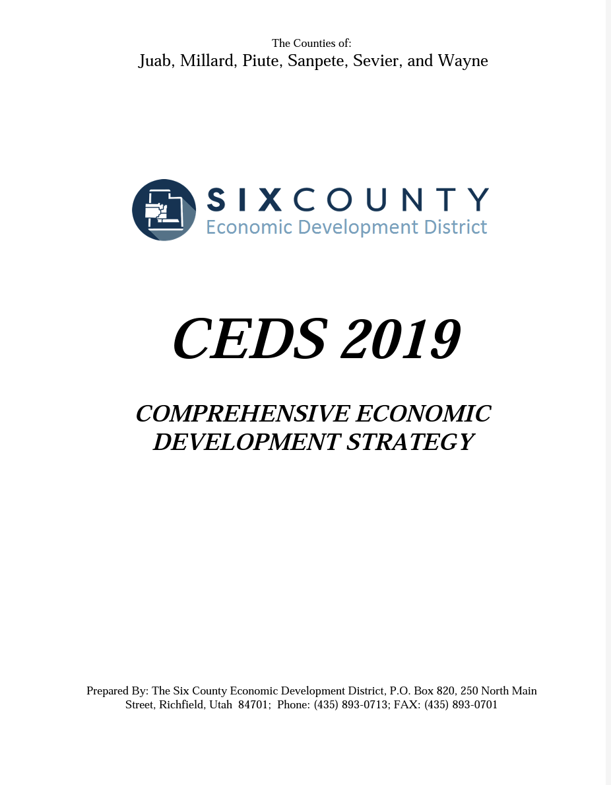
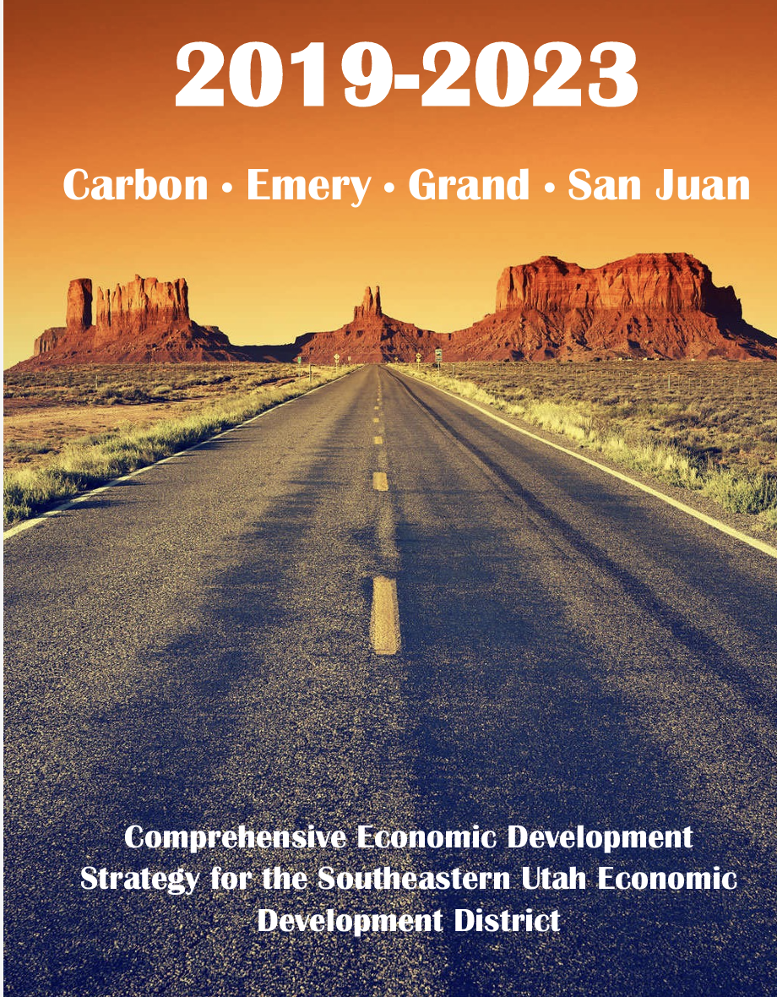
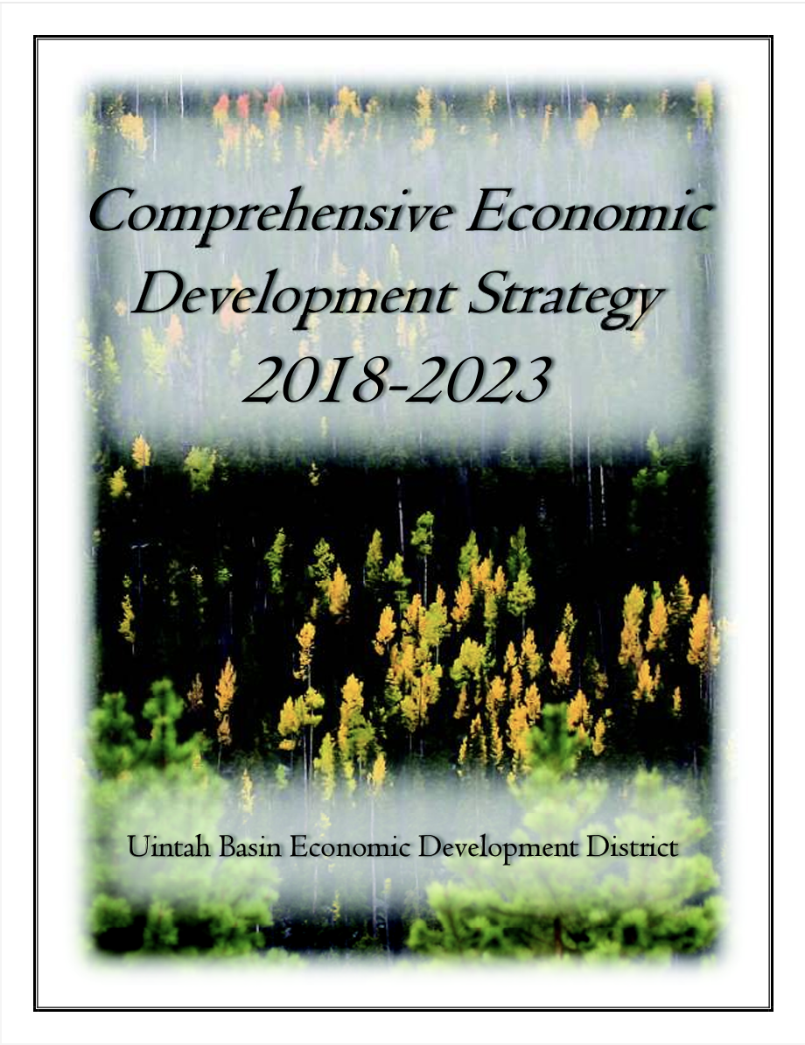
Statewide Coordination
Notes:
Statewide plan was informed by the regional CEDS, and now the regional CEDS updates are linking back to the Statewide plan.
All statewide CEDS were just updated in September 2023.
To increase relationships and coordination - We asked each CEDS to include a commitment to work with an EDD in another Region.

Slide 10
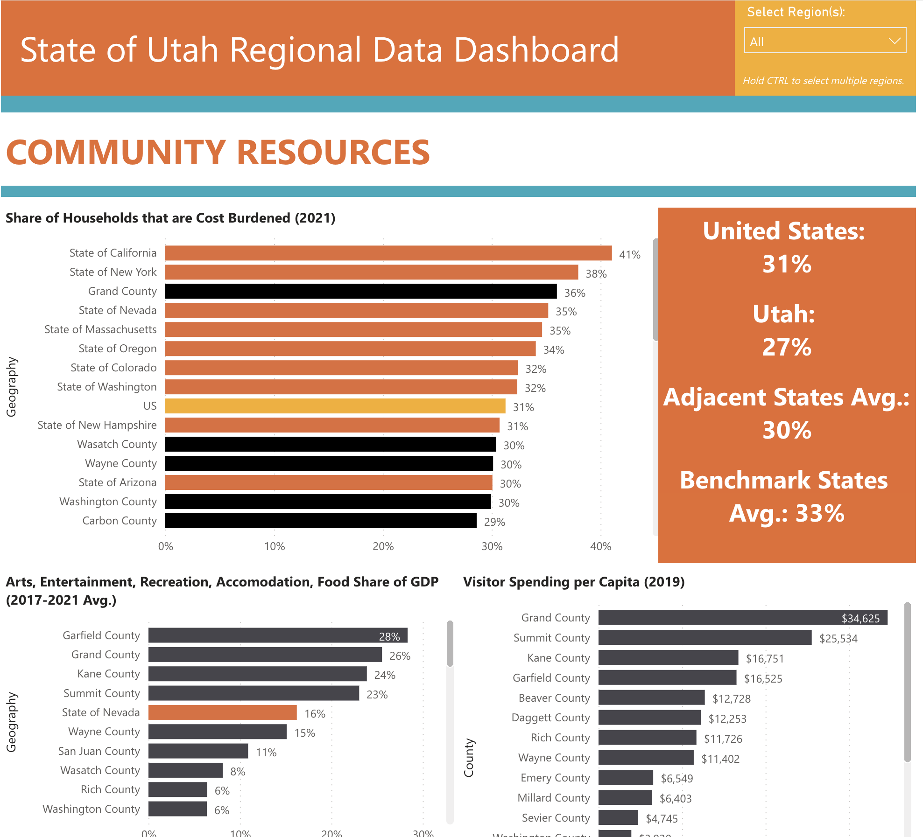
Recommendations - Areas of Focus
Create economic development data dashboard
Commit to work with another AOG on a regional project
Strengthen AOG economic development functions; increase collaboration and training opportunities
Increase communication between private sector leaders and regional government
Provide more opportunities for communication between state and local entities
Notes:
You may be interested in some of the recommendations that came out of the coordinated action plan. Still in the process of working with our project partners, and subaward work is not quite finished yet.
Some highlights from our projects and direction we’ll be going:
Dashboard - 16 common core data elements
Commitment to working with another AOG, leveraging opportunities
Strengthen AOG’s economic development functions
Increase collaboration between private sector leaders and regional government
Work to increase collaboration and training opportunities with county and regional economic development professionals.
Increase communication between state and local entities

Slide 11
QUESTIONS

